Slide 1



Modern Day Cough Conundrums : Role of Codeine
API Delhi Chapter 2025
Deepak Talwar
MD, DTCD, DNB, DM ( Pulmonary & Critical Medicine ) FISDA, FCCP ( USA ), FNCCP, FIAAI
Director & Chair
Pulmonary, Sleep, Allergy & Critical Care Medicine
Metro Group of Hospitals, INDIA

Slide 2
Modern Day Cough Conundrums : Role of Codeine
API Delhi Chapter 2025
Deepak Talwar
MD, DTCD, DNB, DM ( Pulmonary & Critical Medicine ) FISDA, FCCP ( USA ), FNCCP, FIAAI
Director & Chair
Pulmonary, Sleep, Allergy & Critical Care Medicine
Metro Group of Hospitals, INDIA

Slide 3
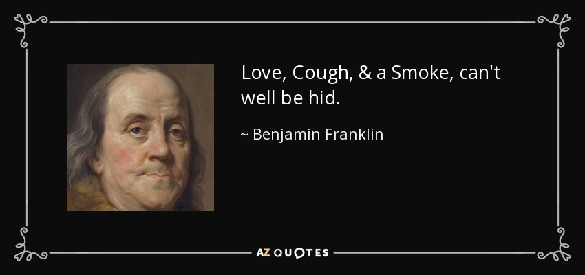
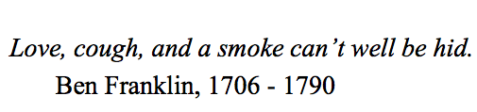

Slide 4
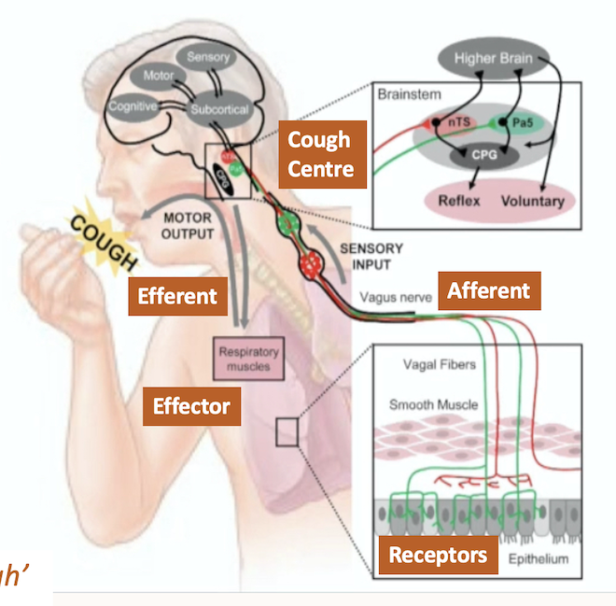
Cough Reflex
Protective reflex:
  Receptor
  Afferent
  Cough Centre
  Efferent
  Effector
When at loss to continue speaking, Cough’
It can be voluntary too
*Greek proverb

Slide 5


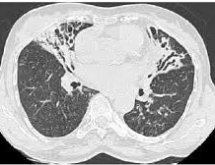
Why Cough is Important to Patient ?
Concerns in Chronic Cough | % Frequency
Embarrassment | 49%
Concerned something is wrong | 72%
Frequent retching | 56%
Spouse can't tolerate | 30%
Arch Intern Med 1998;158(10);1657

Slide 6
Classification of Cough : ‘Duration’
Acute(< 3 weeks)
Subacute (3-8 weeks)
Chronic (>8 weeks)
69% with cough are treated for the symptoms without a diagnosis
Cough.2011;7(1):7

Slide 7
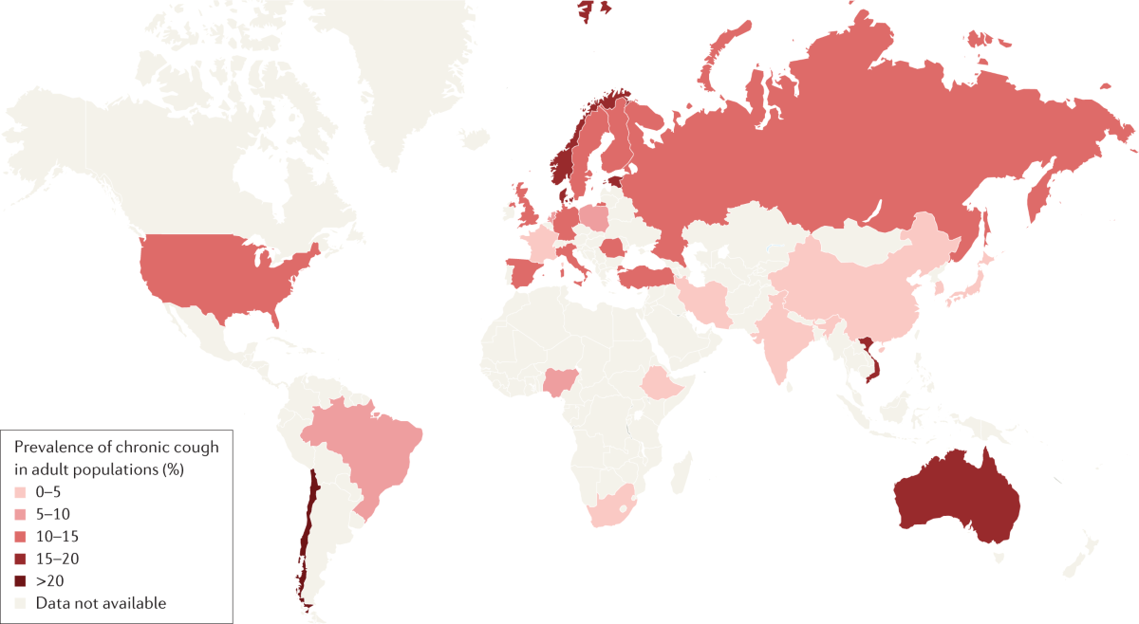
Chronic Cough :
Why Need Physician ?
Cough of > 8 weeks in adults and > 4 weeks in children
Affects 10% of population
Less in Asians and nonsmokers
Common in females, around 60 years of age
57% treated with ineffective therapies
70% patients remain unsatisfied by treatment given
Average patient sees 3 physicians, still no diagnosis
https://doi.org/10.1038/s41572-022-00370-w

Slide 8
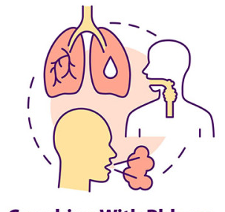

Dry vs Productive Chronic Cough
Dry cough incidence in the adult age group is between 3-12%.¹
Productive but not dry chronic cough is associated with a higher risk of mortality.²
Bilgin G. General approach to dry cough. Journal of Pulmonology and Intensive Care. 2023 Aug 29;1(3):65-9.
Satia I, Mayhew AJ, Sohel N, et al). Respiratory Medicine. 2023 Nov 1;219:107431.

Slide 9
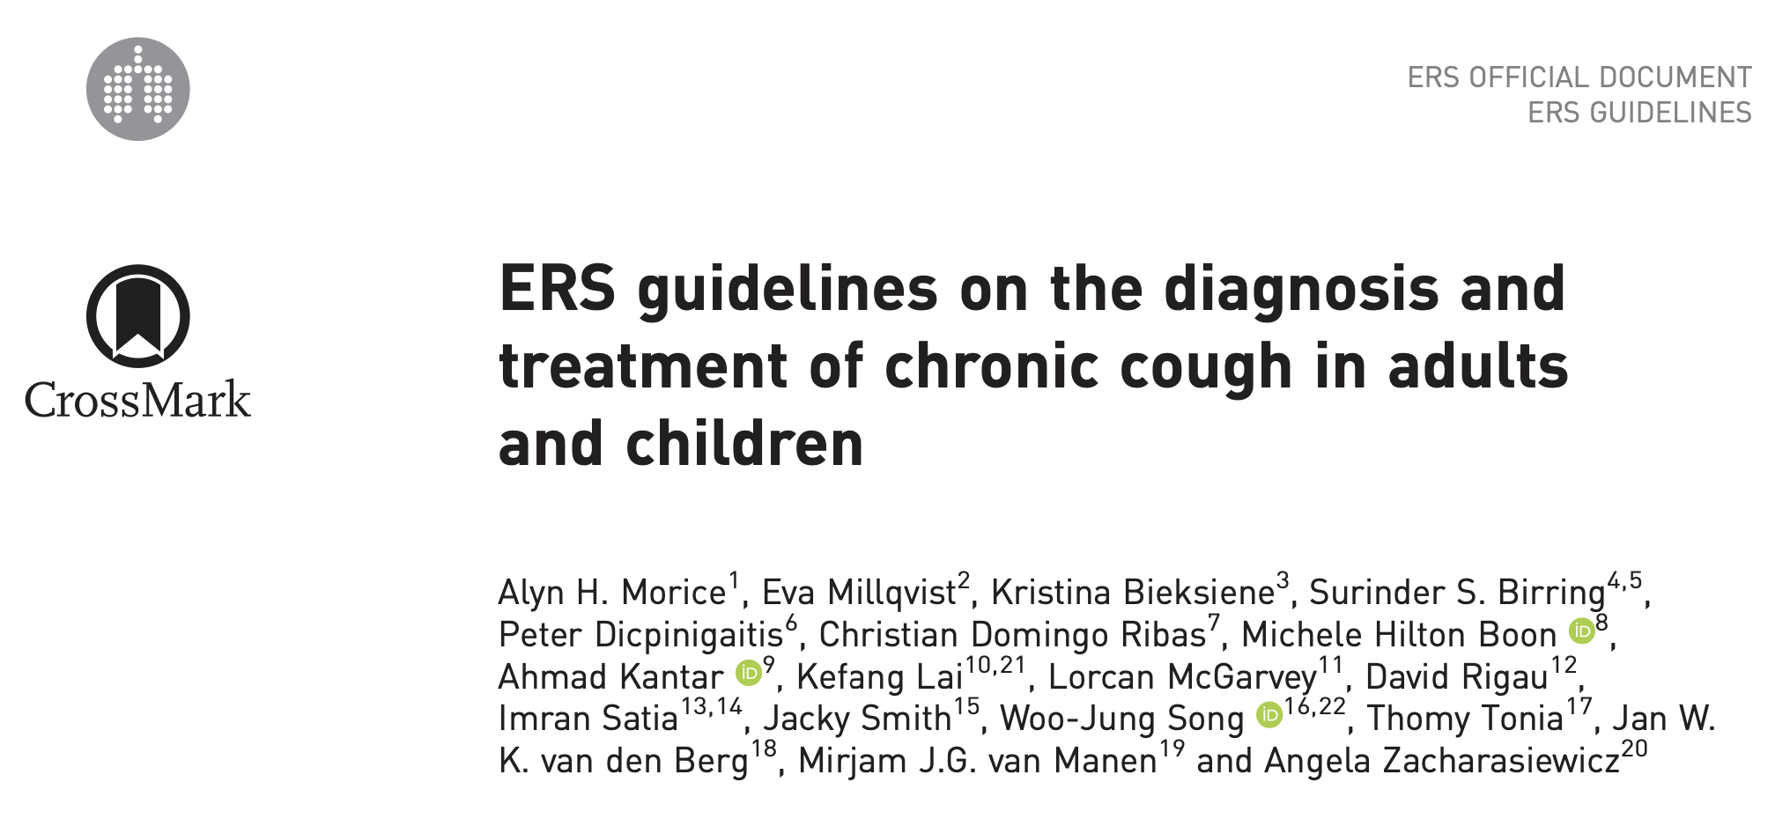
Chronic Cough : Phenotypes
Chance of treatment of cough is better when the cause of the cough is determined, and specific treatment is given
Eosinophils Related Cough – OAD
Smokers Cough – Nicotine / Tobacco Related
Reflux Cough – Esophageal disorders
PNDS : Upper Airway Disorders
Iatrogenic : Drugs
Idiopathic : Refractory
Chronic Hypersensitivity Syndrome
  ( Allotussa or Hypertussia)
Vagal sensory fibres represent potential sites for generation of chronic cough
Eur Respir J 2020; 55: 1901136
Notes:
Allotussa - cough triggered by innocuous stimuli such as talking, eating and perfumes,
Hypertussia, a heightened cough sensitivity to known tussive stimuli such as smoke, fumes and bleach
uncontrollable urge to cough. Sensations in the larynx (laryngeal paraesthesia) or chest such as tickle, itch or irritation can trigger coughing and can be more bothersome than the cough itself137. The presence of triggers and sensory symptoms may be the only feature to suggest the diagnosis of cough hypersensitivity.

Slide 10
Evaluate Chronic Cough : 5 Steps
Clinical
History
Examination
Imaging
Lungs
Profiling
Empiric / Trait Therapy
MDT
Clues to etiology
Multiple specialties
Upper airways
Step 1
Step 2
Step 3
Step 4
Step 5
Chest X ray is abnormal in only < 7% of cases
Absence of heartburn does not exclude reflux as the cause of the cough

Slide 11
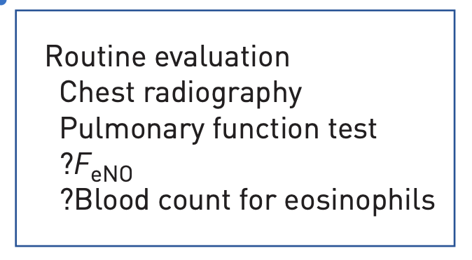
Cough Assessments
Notes:
Two studies of chronic cough patients (unselected by airway hyperresponsiveness or sputum eosinophilia) found significant benefits from a 2-week high-dose ICS treatment over placebo in reducing cough severity
We suggest a short-term antileukotriene trial (2–4weeks) in adult patients with chronic cough, particularly in those with asthmatic cough (conditional recommendation, low-quality evidence).

Slide 12
Imaging
Question 1 : Should chest CT be performed routinely on chronic cough patients with normal chest radiograph and physical examination?
Do not routinely perform a CT chest in patients with chronic cough who have normal chest radiograph and physical examination (conditional recommendation, very low-quality evidence)
CT findings seen in 6.5% - 58%
Relationship to chronic cough – ? Questionable
Potential radiation risk

Slide 13
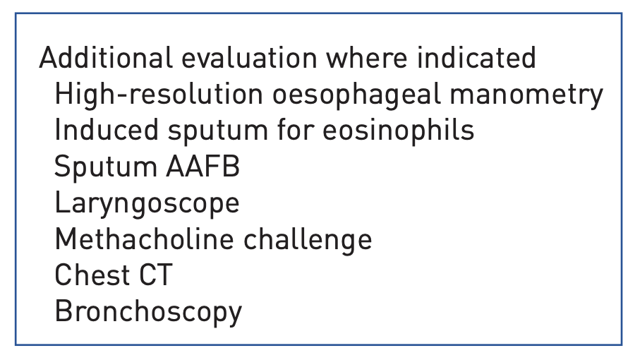
Refractory Cough :
Question : Should anti-acid drugs (PPIs and H2-antagonists) be used to treat patients with chronic cough?
Recommendation : Suggest that clinicians do not routinely prescribe anti-acid drugs in adult patients with chronic cough
(conditional recommendation, low-quality evidence)

Slide 14
Chronic Cough Management
Proton pump inhibitors are the most effective drugs used in GER coughs. Other drugs used are prokinetic agents, H2 receptor blockers
For ACE inhibitor-induced cough, discontinuation of the ACE inhibitor resolves cough in 3-4 weeks after the drug is discontinued.
Question : Should anti-asthmatic drugs (anti-inflammatory or bronchodilator drugs) be used to treat patients with chronic cough ?
Recommendation : We suggest a short-term ICS trial + LRTA’s (2–4weeks) in adult patients with chronic cough
(conditional recommendation, low-quality evidence)
Bilgin G. General approach to dry cough. Journal of Pulmonology and Intensive Care. 2023 Aug 29;1(3):65-9.
Notes:
Two studies of chronic cough patients (unselected by airway hyperresponsiveness or sputum eosinophilia) found significant benefits from a 2-week high-dose ICS treatment over placebo in reducing cough severity
Macrolides are effective in pertussis
We suggest a short-term antileukotriene trial (2–4weeks) in adult patients with chronic cough, particularly in those with asthmatic cough (conditional recommendation, low-quality evidence).

Slide 15
Management of Chronic Cough : Drugs & Non Drugs Therapy
Neuromodulators
Narcotics & Non Opiods
Cough Control Therapy
Curr Otorhinolaryngol Rep 2019;7: 116

Slide 16
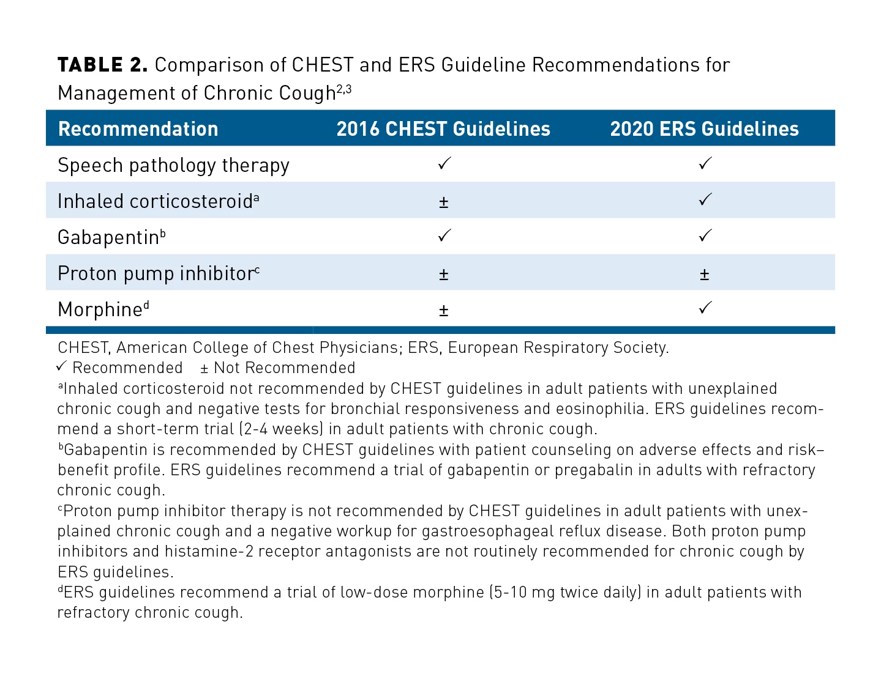
Guideline Recommendations for Management :
^{d}Codeine is useful in treating various etiologies producing chronic cough
CHEST 2018; 153(1):196-209
Notes:
https://www.ajmc.com/view/updates-in-treatment-of-adults-with-chronic-cough

Slide 17
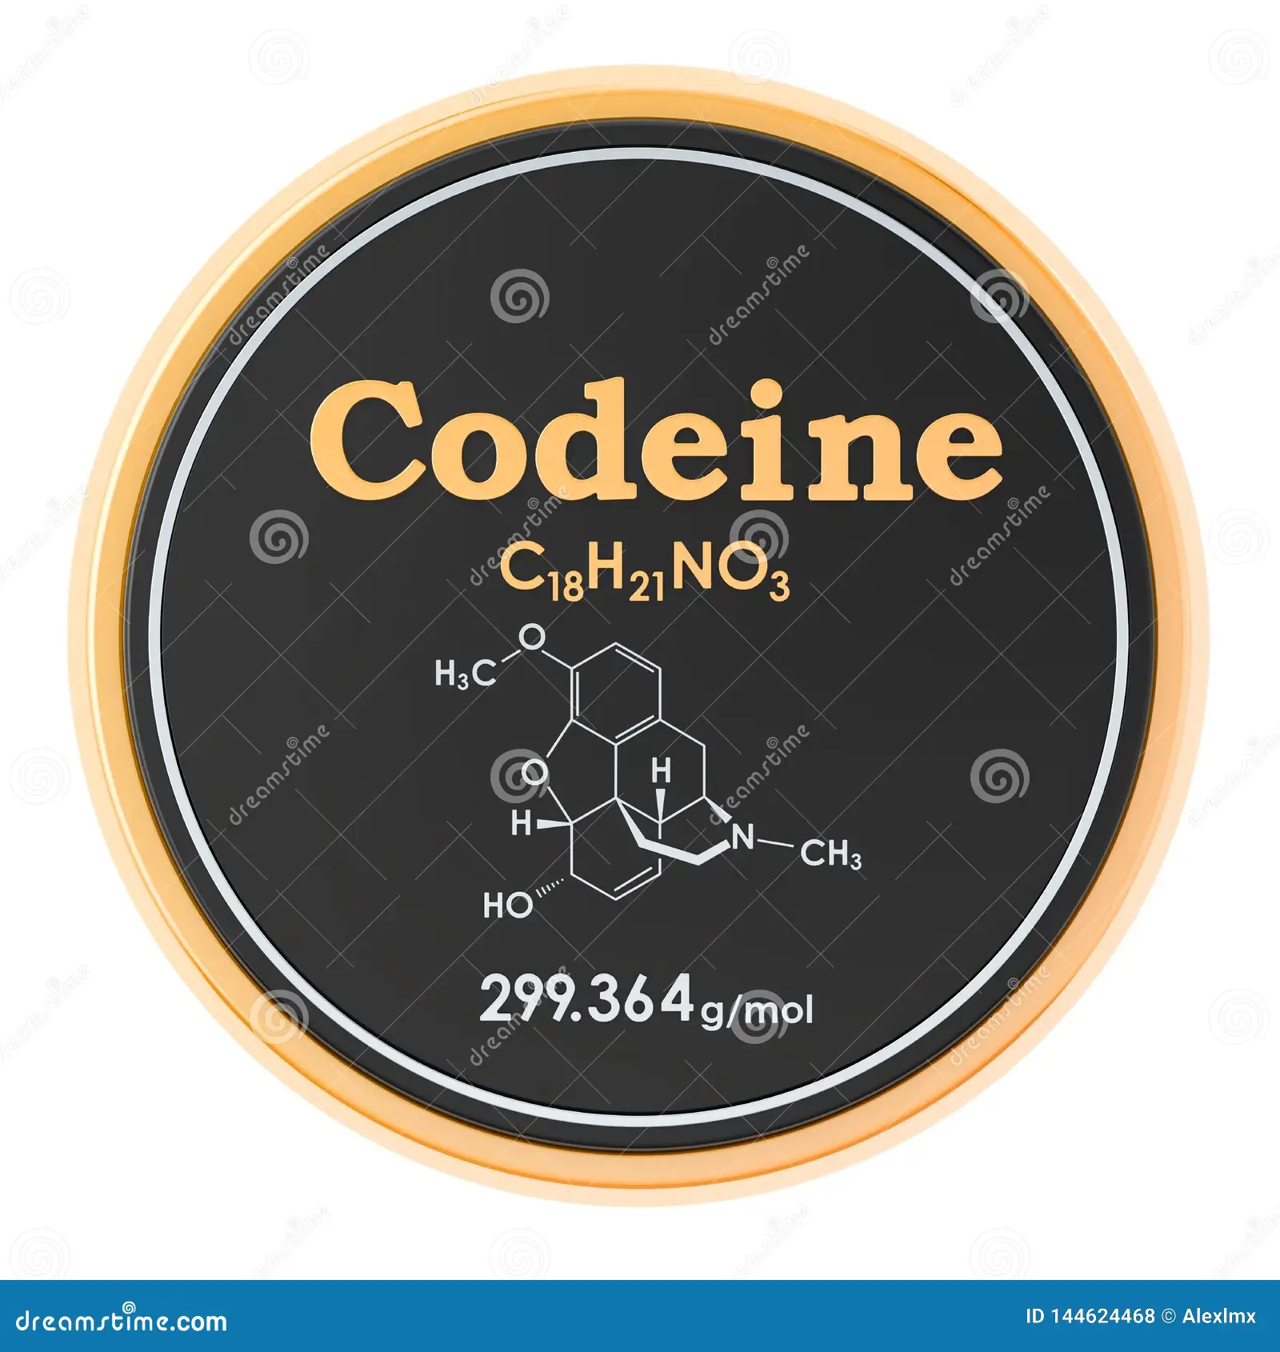
An Antitussive via μ-opioid receptor in the central nervous system & approved
Naturally occurring opium alkaloid
Prodrug metabolized by cytochrome P450
Less toxic to humans
Peak in an hour and ½ life is 33.5 hours
Metabolized in liver
Codeine :
Potential for abuse : Physical and Psychological Dependence¹

Slide 18

Potential Adverse Effects of Codeine
Constipation most common on initiation or ↑dose
Increased fluid intake : and stool softeners
Nausea/vomiting diminishes within days
Anti-emetics : oral and rectal for treatment
Sedation : fade over time
Naloxone is specific antidote to reverse overdose
The concomitant use of codeine with other known sedatives, such as alcohol or benzodiazepines, can significantly increase the risk of adverse effects.
Peechakara, B, Tharp, J., Eriator, I. et al. Codeine. In StatPearls. StatPearls Publishing.2024. https://www.ncbi.nlm.nih.gov/books/NBK526029/

Slide 19
Safety Considerations
  In less than 12 years
  Hypersensitivity Reaction to codeine
  Respiratory Depression due to comorbid respiratory disorders
  Paralytic ileus
  Intestinal Obstruction
  Box Warning : Pediatric patients with obesity or impaired respiration, and with a history of tonsillectomy or adenoidectomy.
  Box Warning : Concomitant use of opioids with benzodiazepines or other CNS depressants, including alcohol, may result in respiratory depression, profound sedation, coma, and death
  MAOi : CI
Peechakara, B, Tharp, J., Eriator, I. et al. Codeine. In StatPearls. StatPearls Publishing.2024. https://www.ncbi.nlm.nih.gov/books/NBK526029/

Slide 20
Potential Benefits vs Risks Needs Review
Benefits
Risk
Codeine can be of great benefit in patients with persistent cough despite treatment or if the treatments have failed
Patients with CRD’s , Elderly , malnourished due to disease, or with rapid metabolizer of drugs are at greater risk .²

Slide 21
Cough Syndrome Profiles for Codeine Use
Cough | Indication
Acute cough | Cough lasting for <3-week duration and associated with viral URTI
Subacute cough | Cough lasting for >3weeks but <8 weeks duration.¹
Chronic cough (unexplained) | Defined in adults as cough lasting for >8 weeks
Cough hypersensitivity syndrome | Cough induced by innocuous stimuli (ambient temperature, laughing, talking, and exposure to aerosols)
Postinfectious Cough | Coughs that persist after a common cold or other upper respiratory infection are called post-infectious or post-viral coughs.³
Idiopathic chronic cough | Cough that remained unexplained despite extensive investigation. Now replaced with the preferred term “unexplained chronic cough”
Refractory chronic cough | Cough that persists despite optimal treatment according to published best practice guidelines
McGarvey L, Gibson PG. What is chronic cough? Terminology. The Journal of Allergy and Clinical Immunology: In Practice. 2019 Jul 1;7(6):1711-4.

Slide 22
Patient Symptom Profiles for Codeine Use
Cough | Indication
Allotussia | Cough triggered at stimulus levels that is insufficient to induce cough in healthy subjects
Hypertussia | Excessive cough to stimuli that are normally cough inducing
Urge to cough | Sensation of airway irritation or “itch” that is not satiated by coughing (sometimes termed “laryngeal paresthesia”). ¹
Nocturnal Cough | Nocturnal cough from reversible airflow limitation and bronchial hyper-responsiveness is a common cough in children with asthma.²
Postinfectious Chronic Cough | Coughs that persist after a common cold or other upper respiratory infection are called post-infectious or post-viral coughs.³
Hemoptysis | Hemoptysis is the expectoration of blood due to bleed from lung parenchyma or airways.⁴

Slide 23
Conclusions :
Codeine has multimodal action of antitussive, analgesic, and sedative
Codeine suppresses cough reflex in idiopathic, postinfectious cough, cancer or IPF
Codeine dependence responsible for 2% of admissions to substance abuse
Codeine must be prescribed and dispensed with the utmost caution
Physicians need to balance ethics vis a vis necessity when QoL is impaired

Slide 24

Thank You
To Download This Presentation
https://pacsfoundation.com/

