Slide 1
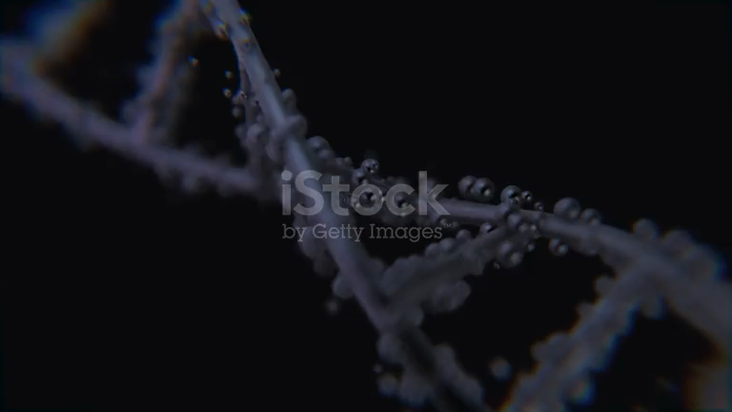
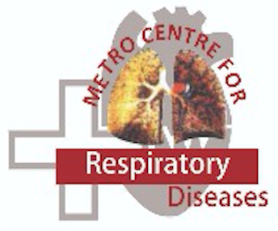
PACS - OAD Symposium : Agra - 2025
Precision Medicine in Asthma
(2025)
Deepak Talwar
MD, DTCD, DNB, DM ( Pulmonary & Critical Medicine ) FISDA, FCCP ( USA ), FNCCP
Director & Chair
Pulmonary, Sleep, Allergy & Critical Care Medicine
Metro Group of Hospitals, INDIA

Slide 2
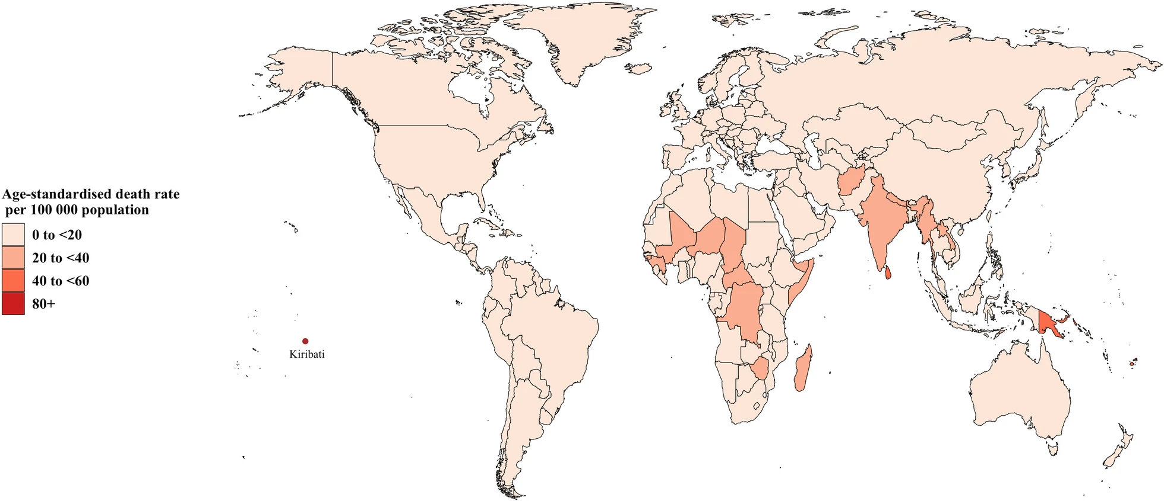
Death Continues to Haunt Asthma
Death due to asthma/100,000 population
< 20
20-40
40-60
>60
Prevalence continues to rise
Asthma continues to make sufferings
Every other death in Asthma from India
20 - 40 deaths / Lakh Indians / Year
Front. Public Health 10:1036674. doi: 10.3389/fpubh.2022.1036674

Slide 3
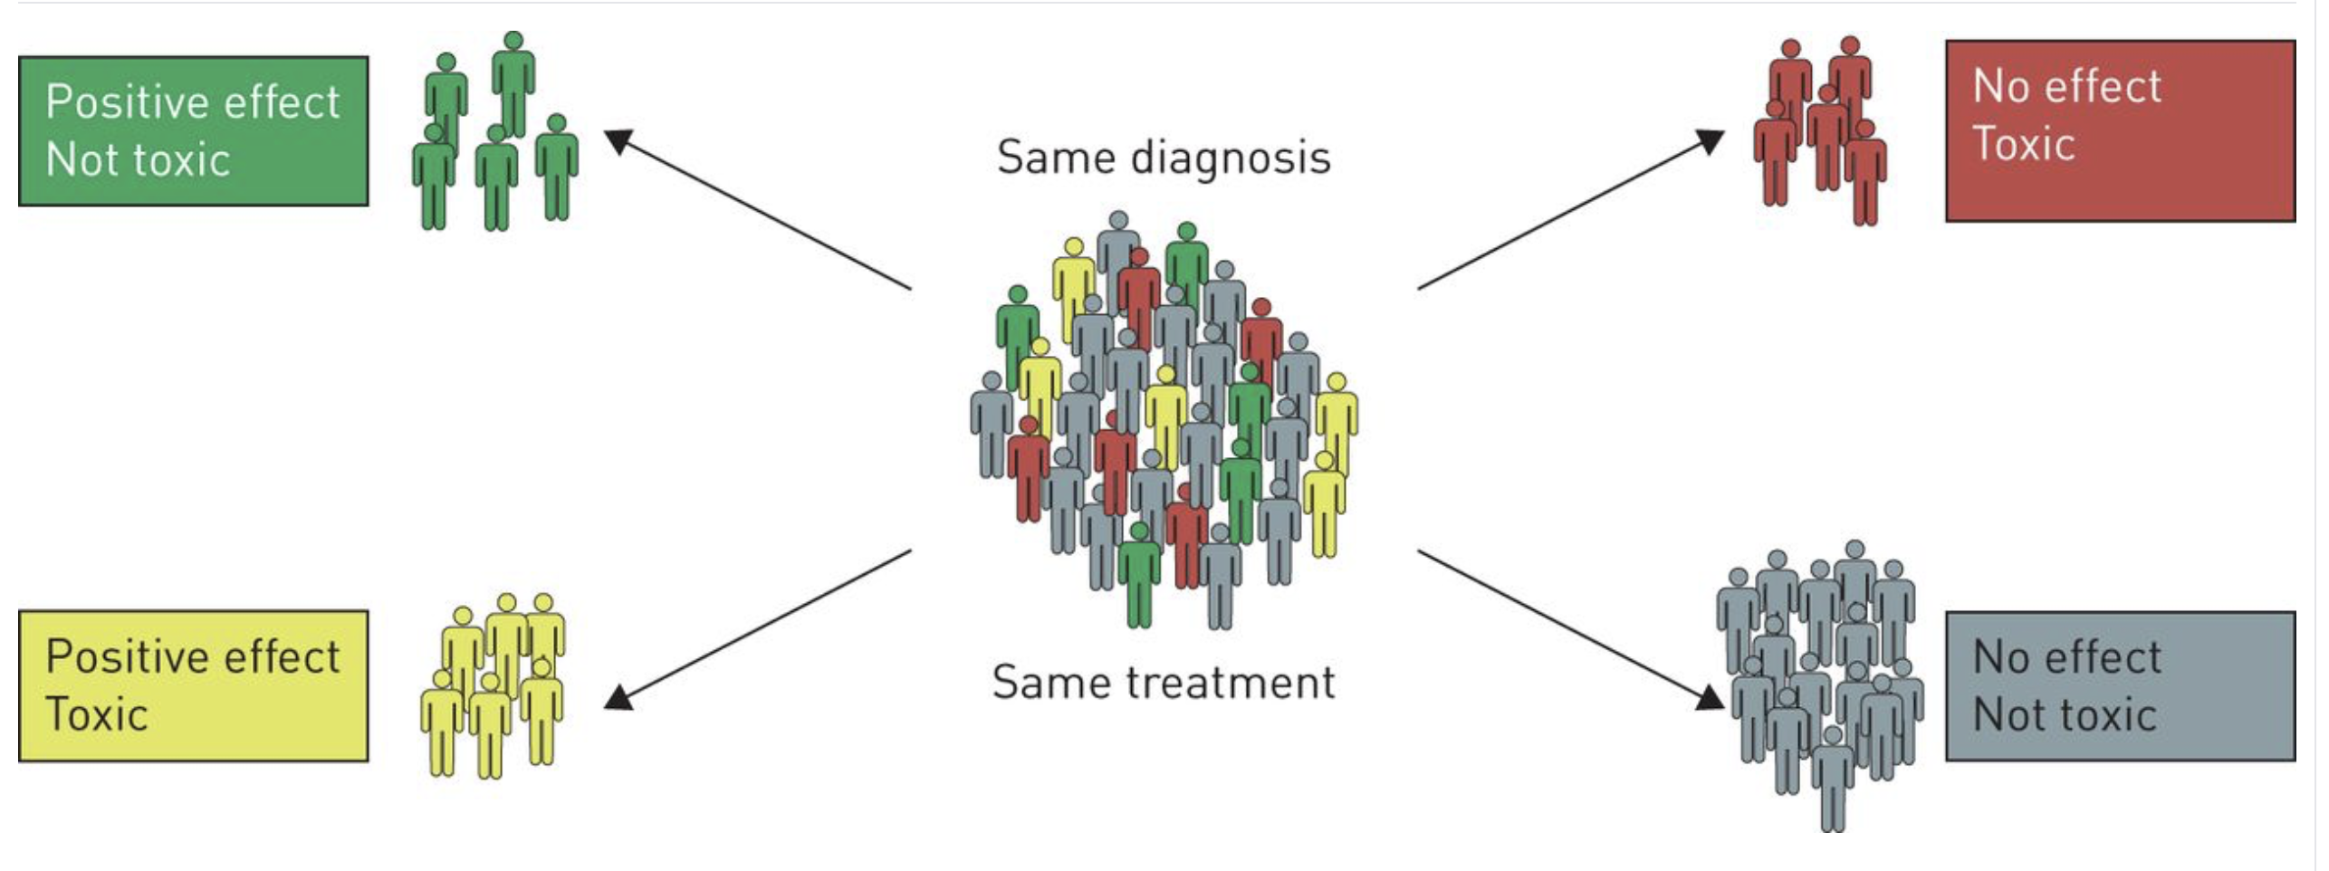
Precision Medicine
Traditional Medicine
Positive Effect
Not Toxic
No Effect
Toxic
Positive Effect
No Effect
Toxic
Not Toxic

Slide 4

Precision Medicine in Asthma : Why ?
Heterogenous disease
Different pathophysiology
Several Subtypes :
    Varied presentations
    Diverse clinical course
    Dispersed treatment response
Based on Treatable Traits
https://dx.doi.org/10.1016/j.intimp.2024.112189

Slide 5

Precision Medicine Based on Treatable Traits
‘Feature of an individual useful for predicting response to a particular treatment’
Treat
To
Target
Trait
Treatable
e.g. Airflow limitation, High EOS, Non-adherence
Untreatable
e.g. Genetics, Structural changes, Age, Fibrosis
Notes:
Asthma is ideally suited for precision medicine because they do represent continuum of different diseases but require “individualised” treatment

Slide 6
What it Needs to be a Treatable Trait ?
1. Identifiable
2. Measurable
3. Treatable
Pulmonary
Behavioral / Risk Factors
Extra -Pulmonary

Slide 7
Treatable Traits in Asthma
Eosinophilic Airway Inflammation
Airflow Limitation (AL),
Exacerbations Prone
Mucus Hypersecretion
Dyspnoea
Neutrophilic airway inflammation
Small Airway Asthma

Slide 8
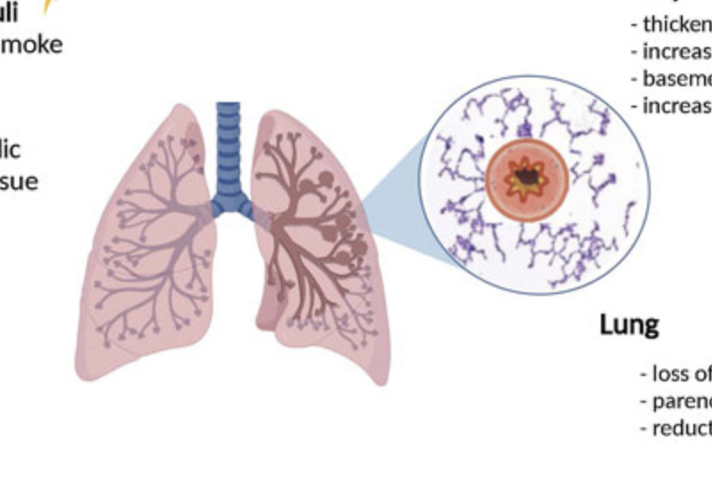
Airflow Limitation Trait : ? Treatable
FEV₁ / FVC Ratio < 0.70
Long Standing Disease
Inflammation :
Eosinophilic / Neutrophilic
Proteolysis
Frequent
Exacerbations
Airway Remodeling :
AW & BM Thickening
Less Distensible Airways
Fixed Airway Obstruction
Lung Destruction :
Parenchymal Destruction
Loss of alveolar attachments
Ageing
Potential Reversibility ?
Overtreatments ??
https://doi.org/10.3389/fphys.2022.898208

Slide 9
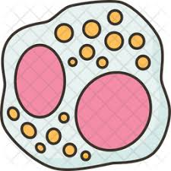


Exacerbation Prone Trait
Peripheral Eosinophilia :
> 200 /cmm
>400 /cmm for severe AE’s
Any AEC > 300 /cmm
Fixed airflow limitation
Mucus Dysfunction
Airway Remodeling
Parenchymal Destruction
Refractory to treatment
Worst Asthma Control
M3 receptors driven
Goblet cell Hyperplasia

Slide 10
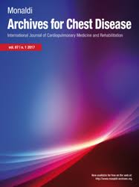
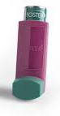
Small Airway Disease Asthma
Thick
Epithelium
Extrafine Particle Inhaler
↑ Mucus
Small Airway
Disease Asthma
SAD present in 50-60%
Can occur without large airflow obstruction
27% of Severe Asthma had only SAD*
Occurs all Asthma severities
Associated with worst asthma control
Thick
Smooth
Muscle
EC
Matrix
Airway
Innervation
*Talwar D. Small airway involvement in severe asthma: Monaldi Arch Chest Dis doi:10.4081/monaldi.2024

Slide 11
Triple Therapy in Asthma & Treatable Treats
ICS
ICS / LABA
ICS / LABA / LAMA
Exacerbation Prone
Airflow
Limitation
Neuronal
Plasticity
Eosinophilic
Inflammation
Small
Airway Dysfunction
Mucus Hyper secretion
Neutrophilic
Inflammation

Slide 12
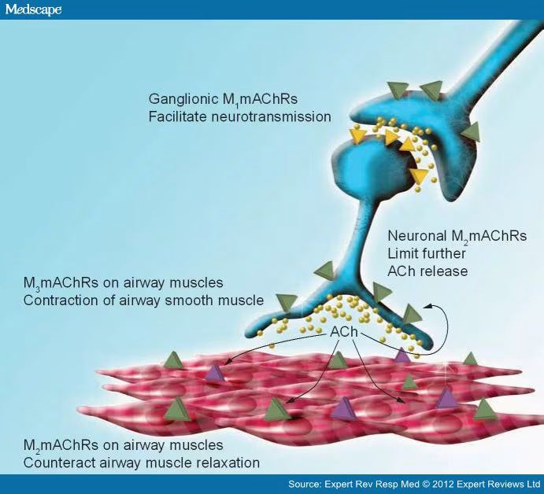
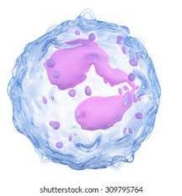
Role of LAMA in Asthma : Step 5 or 4 ?
Predictors of response :
  Fixed airflow obstruction : Extrafine particle
  Elderly
  Current or former smokers
  H/O Severe Exacerbations
  H/O Moderate exacerbation in last year
  Cholinergic plasticity
  Women
  Small airway disease
  Mucus hypersecretion
  Neutrophilic airway inflammation
Irrespective of Eosinophils

Slide 13
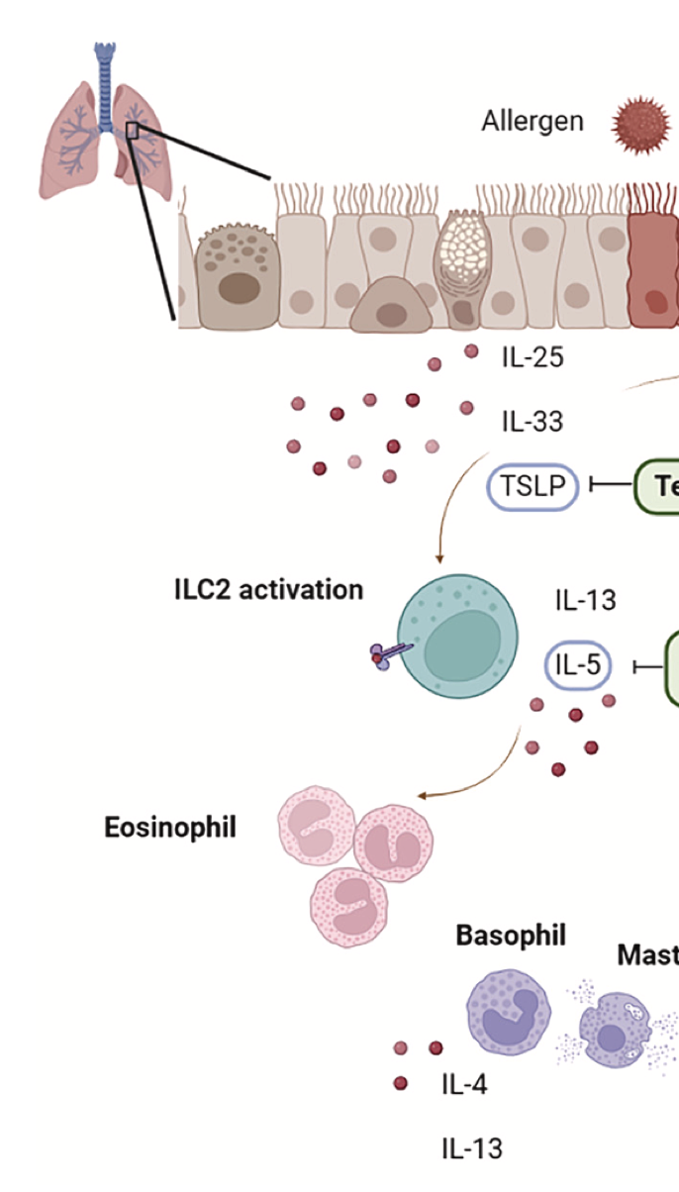
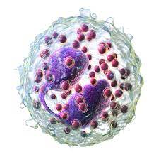
Eosinophilic Airway inflammation
Late Onset Adult Asthma
Eosinophilic Inflammation
Allergic Symptoms Minimal
Irrelevant Elevated IgE
ILC 2 Activation Mediated
IL 5 /13 without T Cell Cascade
Poor ICS Response
Persistent T2 Inflammation - Biomarkers
https://doi.org/10.1016/j.intimp.2024.112189
Notes:
levated immunoglobulin E (IgE)
and/or allergic mediator-related symptoms are not prominent. Eosinophilia
results from signaling processes triggered by an altered barrier
function of the respiratory epithelium induced by viral infections, air
pollution, or smoking, which activate innate lymphoid cells that produce
IL-5 and IL-13, bypassing the classic allergic cascade through T
cells. Furthermore, adults often respond poorly to inhaled corticosteroids
(ICSs) that do not fully suppress T2 inflammation. Accordingly,
they have persistent T2 airway inflammation,

Slide 14
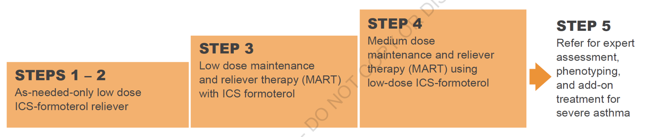
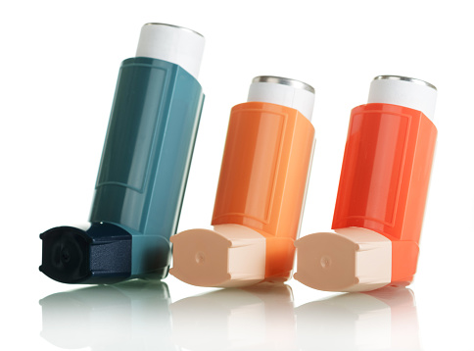
Current & Future Position of SITT in Asthma
SITT
Exacerbations Prone
Small Airways Dysfunction
Airflow Limitation
SITT
Expected Outcomes
Better Asthma Control
Improve QoL
Slow decline in FEV1
Less hospitalizations
Respiratory Medicine 200 (2022) 106915

Slide 15
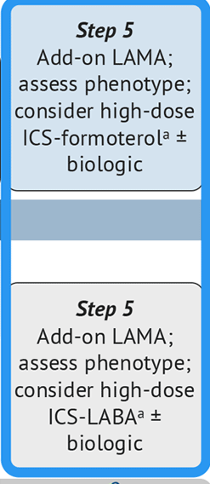
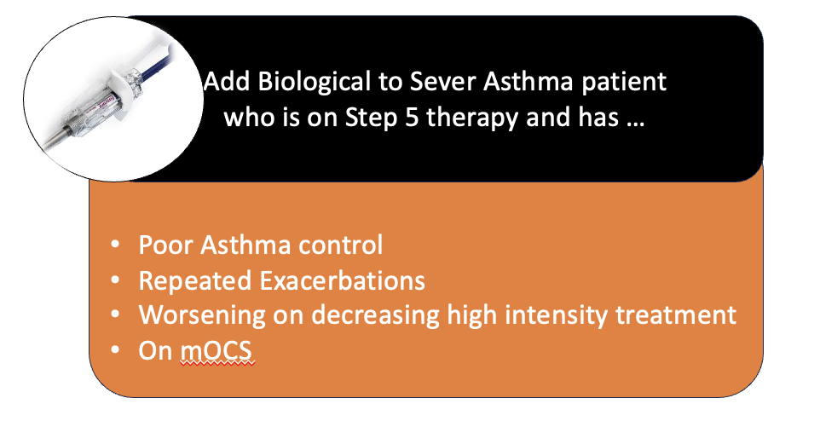
Severe Asthma Beyond Triple Therapy
Montelukast
Other Options
Azithromycin
+ Type 2 Inflammation
GINA 2024

Slide 16
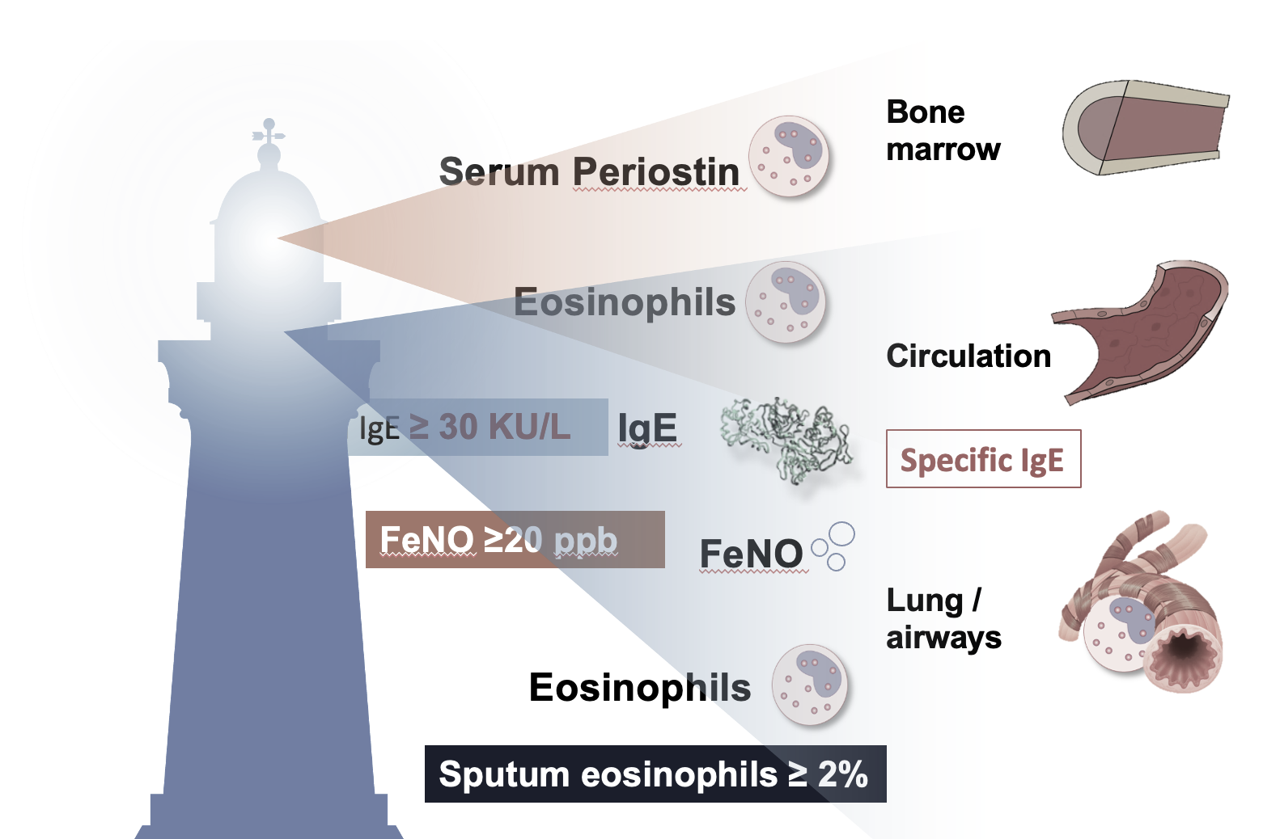
Eosinophilic Airway Inflammation Trait : Biomarkers
Blood Eosinophils : > 300 * cells/uL
FeNO*: >20 ppb
Sputum Eosinophils : > 2%
* Depends on dose of OCS & ICS
Scheerens et al. Clin Exp Allergy 2014; 44:38–46;

Slide 17
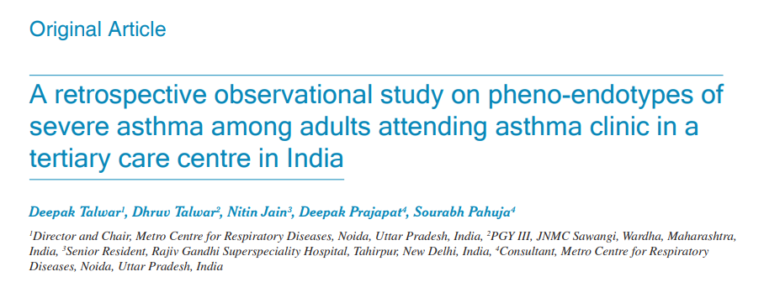
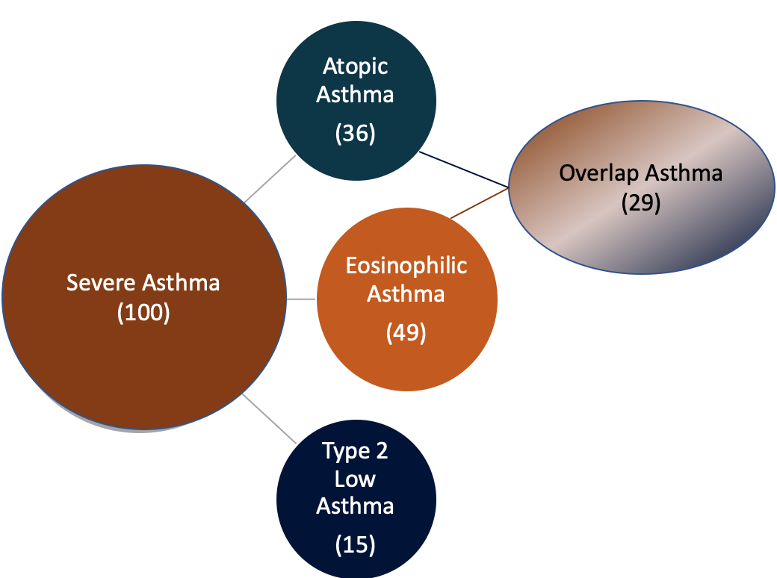
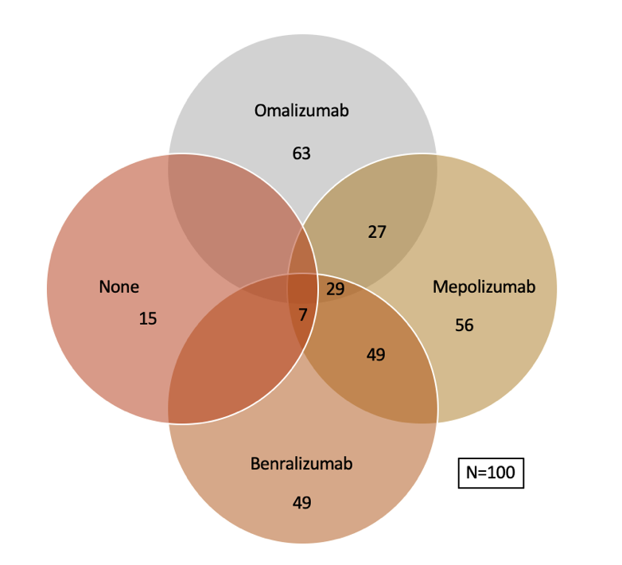
Type 2 Severe Asthma ~ 85 % : Biologicals Eligible ~ 91%
T₂ Low asthma is only 15% at AEC cut off of 300 & 9% at @ AEC -150
~ 50% of our Severe Asthmatics were eligible for both group of biologicals
Lung India 2022;39:393-400.

Slide 18
Elevated Blood Eosinophils is Most Important Biomarker
Severe
exacerbations
Overall asthma
control
INCREASED
RISK
DECREASED
CONTROL
AEC
1.4
p<0.001
Adjusted RR (95% Cl)
1.2
201-300 cells/μL (n=25,882) | 0.94 (0.91-0.98) |  |  | 0.92 (0.90-0.95)
301-400 cells/μL (n=15,030) | 1.08 (1.03-1.13) |  |  | 0.86 (0.83-0.89)
401-500 cells/μL (n=8659) | 1.16 (1.09-1.24) |  |  | 0.80 (0.77-0.84)
501-600 cells/μL (n=4928) | 1.34 (1.24-1.45) |  |  | 0.72 (0.68-0.77)
601-700 cells/μL (n=2726) | 1.71 (1.55-1.89) |  |  | 0.65 (0.60-0.71)
701-800 cells/μL (n=1631) | 1.49 (1.31-1.70) |  |  | 0.63 (0.57-0.70)
801-900 cells/μL (n=947) | 1.58 (1.33-1.87) |  |  | 0.62 (0.54-0.71)
901-1000 cells/μL (n=1019) | 2.02 (1.72-2.36) |  |  | 0.59 (0.52-0.68)
>1000 cells/μL (n=1019) | 2.32 (1.99-2.71) |  |  | 0.48 (0.42-0.55)
1.0
0.8
Increasing Blood EOS Counts
Eosinophils x10⁹ cells/L⁻¹
0.6
AEC
0.4
0.2
0
FEV₁ <50%
FEV₁ <80%
0.5
0.7
1.0
1.5
2.0
2.5
0.3
0.5
0.7
1.0
1.5
2.0
Lung functions
Adjusted RR (95% Cl)
Adjusted OR (95% Cl)
Frequent Exacerbations, Poorer Asthma Control & Lower Lung Function
EOS = eosinophil; FEV₁ = forced expiratory volume; OR = odds ratio; RR = relative risk.
1. Price D et al. Lancet Respir Med. 2015;3:849-858; 2. Bumbacea D et al. Eur Respir J. 2004;24:122-128.
18
Image is used for educational purpose only. AstraZeneca is not responsible for data and copyrights.

Slide 19
Biologicals for T2 Eosinophilic Inflammation
Anti – TSLP Tezepelumab
Anti – IL-5 Mepolizumab
Benralizumab
Anti – IL-4R/13
Dupilumab
Anti – IL-4R/13
Dupilumab
Anti – IgE
Omalizumab
Eur Respir Rev 2025; 34: 240088

Slide 20
Realistic Expectations - Matching Research
SA Outcomes | Omalizumab | Mepolizumab | Benralizumab
Reduction in Exacerbations | 25% reduction | ~ 50 % | 40 -70 %
Reduction in maintenance OCS | 50% dose reduction in those at 15 mg/day baseline | 50% dose reduction 2- 6 months↓ | 50 - 80%
FEV₁ | 2.1% | 100 ml | 100 -160 ml @ 4 weeks
QoL | SGRQ Asthma diaries | ACQ5 + 0.4 SGRQ +7 points | ACQ < 0.5 SGRQ +8.1 points
Real World Data | Reduction in AE in 42% vs 63 % & 28% vs 48% @ baseline | Reduction in AE ~ 50% Reduction in mOCS ~ 50% | All improved with 70% exacerbation free @2years
Predictors for Response CRwNP | Childhood onset,, AEC >300, FeNo > 19.5, S Periostin >50 ng/ml, ↓FEV₁ | Low mOCS, Later onset SA, ↓ BMI, AEC, ↑ Sputum Eos /AE | AEC, FEV₁<65%, mOCS, ‘f’ Exacerbations, AR

Slide 21
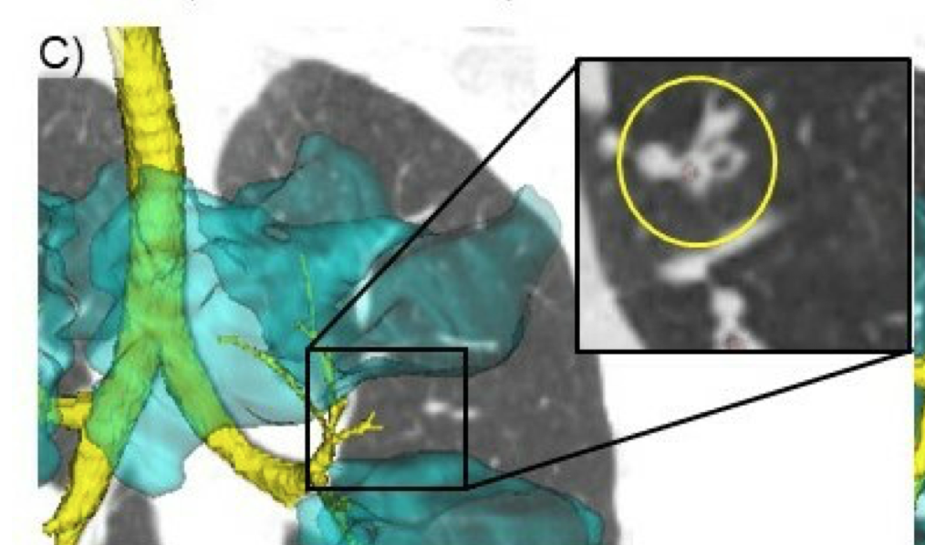
Choosing Biologicals in Severe Asthma - 2025 !
Omalizumab
Mepolizumab
Benralizumab
Childhood Onset asthma
Comorbidities :
Allergic rhinitis
Chronic idiopathic urticaria
Food Allergy
CRSwNP
Biomarkers
Serum IgE, BMI, SPT/Specific IgE, FeNO
Late Onset asthma
Comorbidities :
Chronic Sinusitis with NP
EGPA
HES
Biomarkers :
AEC, FeNO, Sputum Eosinophils
Eosinophilic Gastritis
Adult / Late Onset asthma
Comorbidities :
Nasal Polyposis
Airway Mucus
Biomarkers :
AEC, Sputum Eosinophils, FeNO
EGPA
Patient Preferences : Cost, Reimbursement, Dosing
Notes:
Higher serum IgE and BEC
and a shorter disease duration were associated with a slower response, necessitating a prolonged treatment
SoMOSA open-label studies, however, found omalizumab
to be effective independent of traditionally used biomarkers

Slide 22
Indirect Comparison Between Mepolizumab vs Benralizumab on Asthma Exacerbations & mOCS Use
 | Asthma Exacerbation Rate Reduction | % Patients with Zero Exacerbations in Asthma
Mepolizumab | Dream : - 48% Mensa : - 53% Musca : - 58% Sirius : - 32% | Cosmos : 52% Columbia : 33%
Benralizumab | SIRROCO : -51% Andhi : - 59% Zonda : - 70% Ponente ; -62% Bora : -82% Meltemi: - 96% | Bora : 74% Meltemi : 87% @ 5 years Zonda : -77% Ponente : 74%
Multiple Publications .

Slide 23
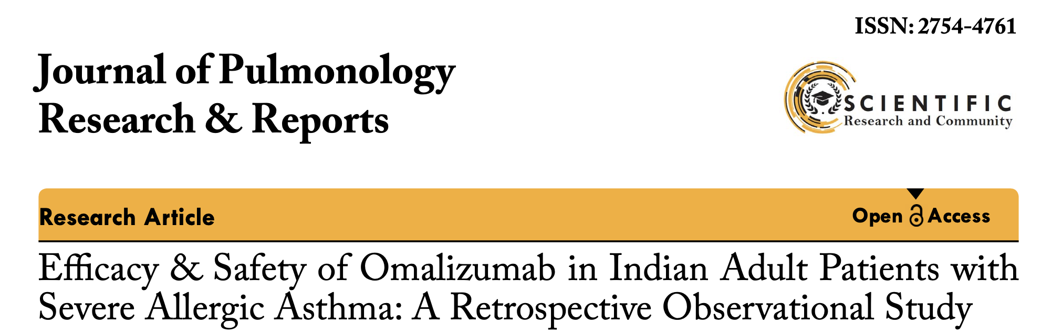
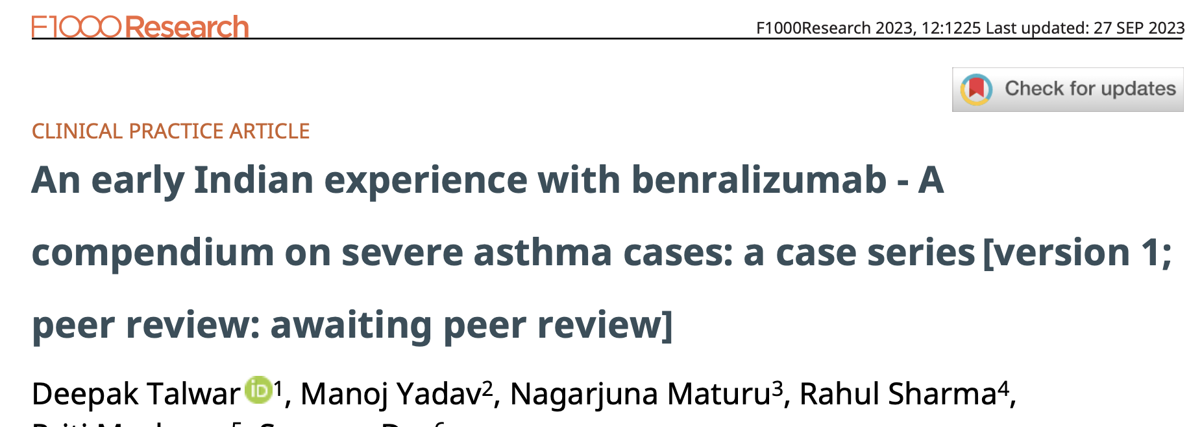
Biologicals in Severe Asthma– Indian Experience
Arjun Khanna1*, Deepak Talwar2, Linija K Nair3
Deepak Talwar * 1, Manoj Yadav2, Nagarjuna Maturu3
Conclusions:
Omalizumab led to improved asthma control, lung function, and QoL and allowed a reduction in the dosage of medications for asthma. The improvement was observed irrespective of age and biomarker levels.
Conclusions:
In all cases, management with Benralizumab resulted in optimal clinical and functional improvement, a decline in systemic steroid use, and improved QoL.
J Pulmonol Res Rep, 5(2): 4-6 2023
F1000 Research 2023, 12:1225

Slide 24
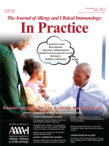
Precision Medicine Asthma
AF
Limitation
Obesity
OSA
Eosinophils
Mucus
A/CRF
Smoking
Adherence
Anxiety / depression
ILO
CRSwNP
GERD
CVD
Skin / Food Allergy
Infection
Cough
Occupation
Pollution
Poor Preceiver
Technique
Pulmonary
Extra- Pulmonary
Behavioral
Pavord et al. J Allergy Clin Immuno lPract, 2023

Slide 25
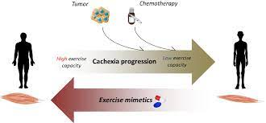

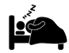
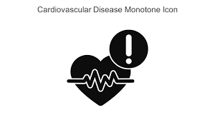


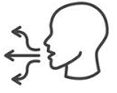

Extra- Pulmonary Treatable Traits in Asthma
Trait | Diagnostic Criteria | Choice of Treatment
Cachexia / Obesity | BMI | Diet & Physical activity
Deconditioning | CPET | Exercise , Pulmonary Rehabilitation
OSA | PSG | PAP , weight loss if Obese
CVS Comorbidity | EKG, ECHO, BNP | ACEi, Bets blockers, Diuretics
GERD | UGIE, Esophageal PH monitor | PPI , H₂ blockers
Chronic Rhino-sinusitis | Clinical, Imaging | Intra-nasal steroids
Vocal cord Dysfunction | FOL, Dynamic MRI | Speech Therapy
Psychiatric Disorders | Questionnaires, Psychiatric Exam | CBT, Pharmacotherapy

Slide 26
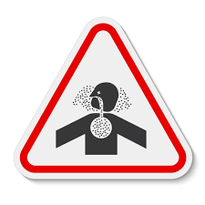



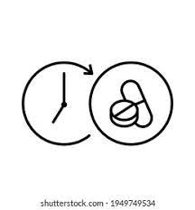

Behavioral / Risk Factors-Treatable Traits in Asthma
Trait | Diagnostic Criteria | Choice of Treatment
Smoking & Exposures | Exhaled CO, Urinary Cotinine | Cessation Support, NRT, Pharmacotherapy, Avoidance
Exposures to allergens, | RAST, SPT AQI | Avoidance, Desensitization
Poor Perceiver | Mismatch : Objective vs Subjective findings | Reassurance, Breathing Exercises
Side Effects of Drugs | Monitored withdrawal | Therapeutic Optimization
Inhaler’s Polypharmacy | Multiple devices | Device Rationalization
Technique & Adherence | Observation | Education, Simpler to use devices, easy regimens
Family Support | Observation | Family therapy

Slide 27
Conclusions:
Asthma is heterogenous disease with poor outcomes even today
Shifting strategy from ‘One Size Fits All” to Precision medicine is needed
Precision medicine is based on identifying ‘Treatable Traits’ and address them
Most important treatable traits in asthma are: Eosinophils, AL, AE, can occur at any GINA Step
SITT addresses these traits in many asthmatics
Uncontrolled eosinophilia is targeted with Biologicals
Biologicals either target IgE or Eosinophil mediated uncontrolled inflammation
Extra-pulmonary Traits are responsible for most of difficult asthma
Behavioral traits also need to be addressed before using biologicals

Slide 28






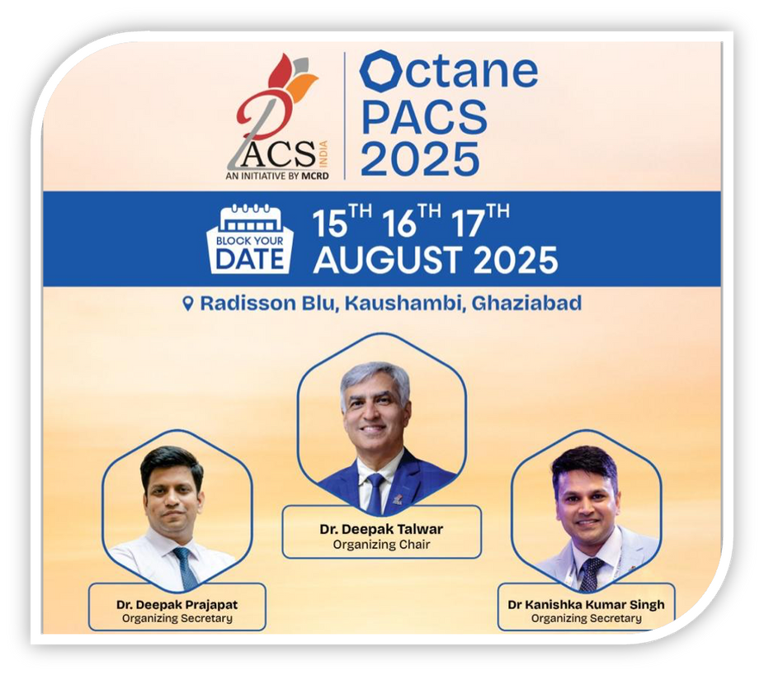
Dr Deepak Talwar
Director & Chair MCRD
Dr Deepak Prajapat
Senior Consultant
Dr Kanishka Kumar Singh
Senior Consultant
Thank You
Dr Rahul Khera
Consultant

