Slide 1
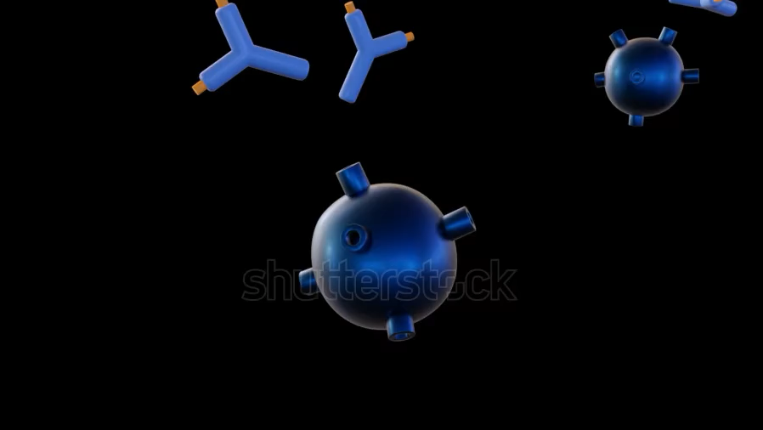

PACS & Indore Chest Society- 2025
Latest Updates in Asthma :
Biologicals
Deepak Talwar
Director & Chair, Metro Centre for Respiratory Diseases
Metro Hospitals & Institute
NOIDA, INDIA

Slide 2
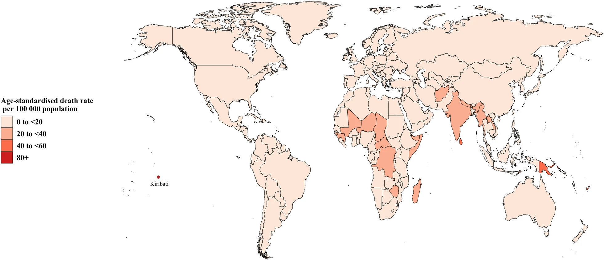
Death Continues to Haunt Asthma
Prevalence continues to rise
Asthma continues to make sufferings
Every other death in Asthma from India
20 - 40 deaths / Lakh Indians
Front. Public Health 10:1036674. doi: 10.3389/fpubh.2022.1036674

Slide 3
Biologicals : Targeted Therapies
0 %
35 %
10 %
100 %
Anti – IgE Omalizumab
Anti – IL-5 Mepolizumab
Benralizumab
Anti – IL-4/13
Dupulimab
Murine
Chimeric
Humanized
Fully Human
(-omab)
(-ximab)
(-zumab)
(-umab)
1. Anti – IgE Monoclonal Ab
Notes:
Ibrutimumab

Slide 4
4 Biologicals for Airway Diseases
Anti – TSLP Tezepelumab
Anti – IL-5 Mepolizumab
Benralizumab
Anti – IL-4R/13
Dupilumab
Anti – IL-4R/13
Dupilumab
Anti – IgE
Omalizumab
Eur Respir Rev 2025; 34: 240088

Slide 5
.
Why ???
NO to OCS !
Oral steroids were used during the previous year by 89% of patients
On average, patients reported using oral steroids 10.5 times in a year.
Prevent complications of Low Dose maintenance or Bursts of OCS
1-3 OCS Bursts :
Fractures – 8%
Gastric Ulcers :7%
Hypertension – 6%
Fractures – 21%
GI Bleeds – 33%
Hypertension – 32%
DM – 30%
Cataract -26%
Obesity -28%
GI bleed – 7%
> 4 OCS Bursts:
4-5 times OCS bursts in life are enough to cause damage
Sullivan PW, et al. J Allergy Clin Immunol 2018;141:110–116

Slide 6
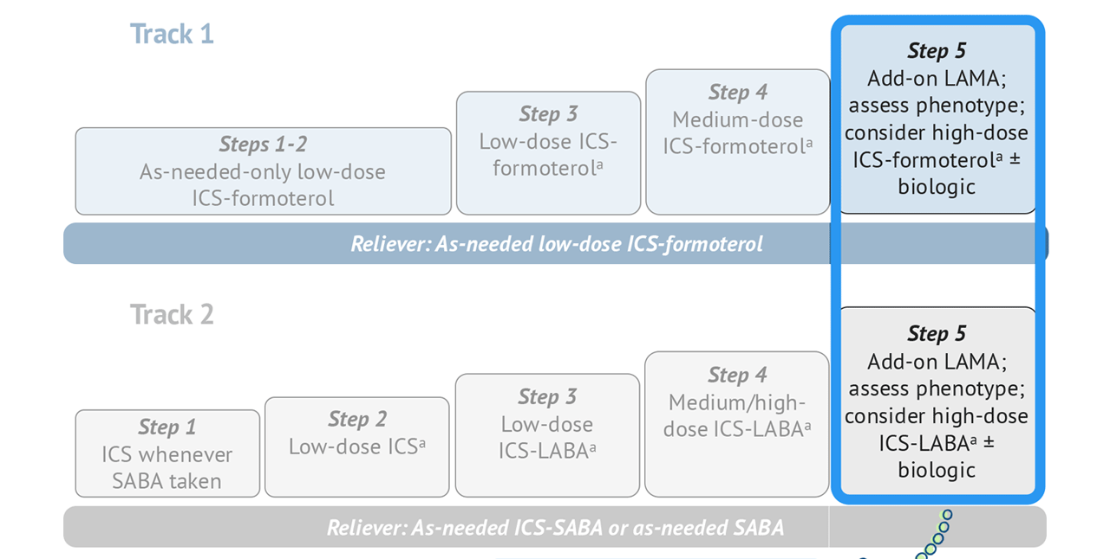
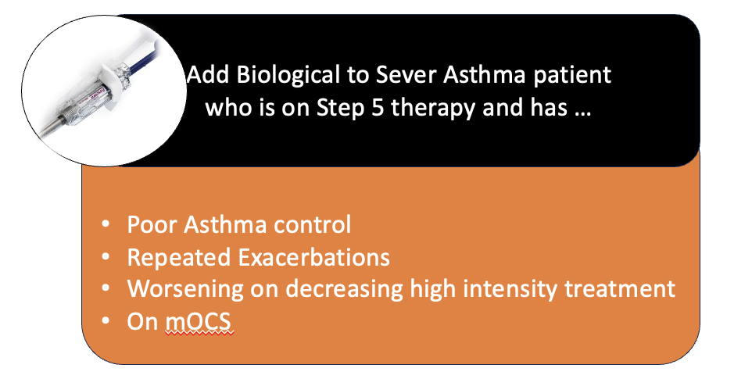
When ???
Severe Asthma
Step 5
Low Dose OCS
LAMA
High Dose ICS
LABA
Montelukast
Other Options
Azithromycin
GINA 2024

Slide 7



Remember : All Uncontrolled Asthma is NOT Severe Asthma
Difficult To Treat Asthma
Severe Asthma
GINA Step 5
90%
Comorbidities
Exposures & Triggers
50%
20%
Adherence & Technique
Retrospective label
Diagnosis
25%
Uncontrolled Asthma
World Allergy Organization Journal 2013, 6(Suppl 1):P3

Slide 8
Which Severe Asthma : Type 2 Inflammation
Type 2 Severe Asthma : Atopic / Eosinophilic Phenotype
Type 2 Inflammation
Age of onset of asthma: Childhood / Early adulthood
Allergic comorbidities : Atopic dermatitis, AR, CSwNP, ABPA, EGA
Oral steroids responsive
GINA 2023

Slide 9
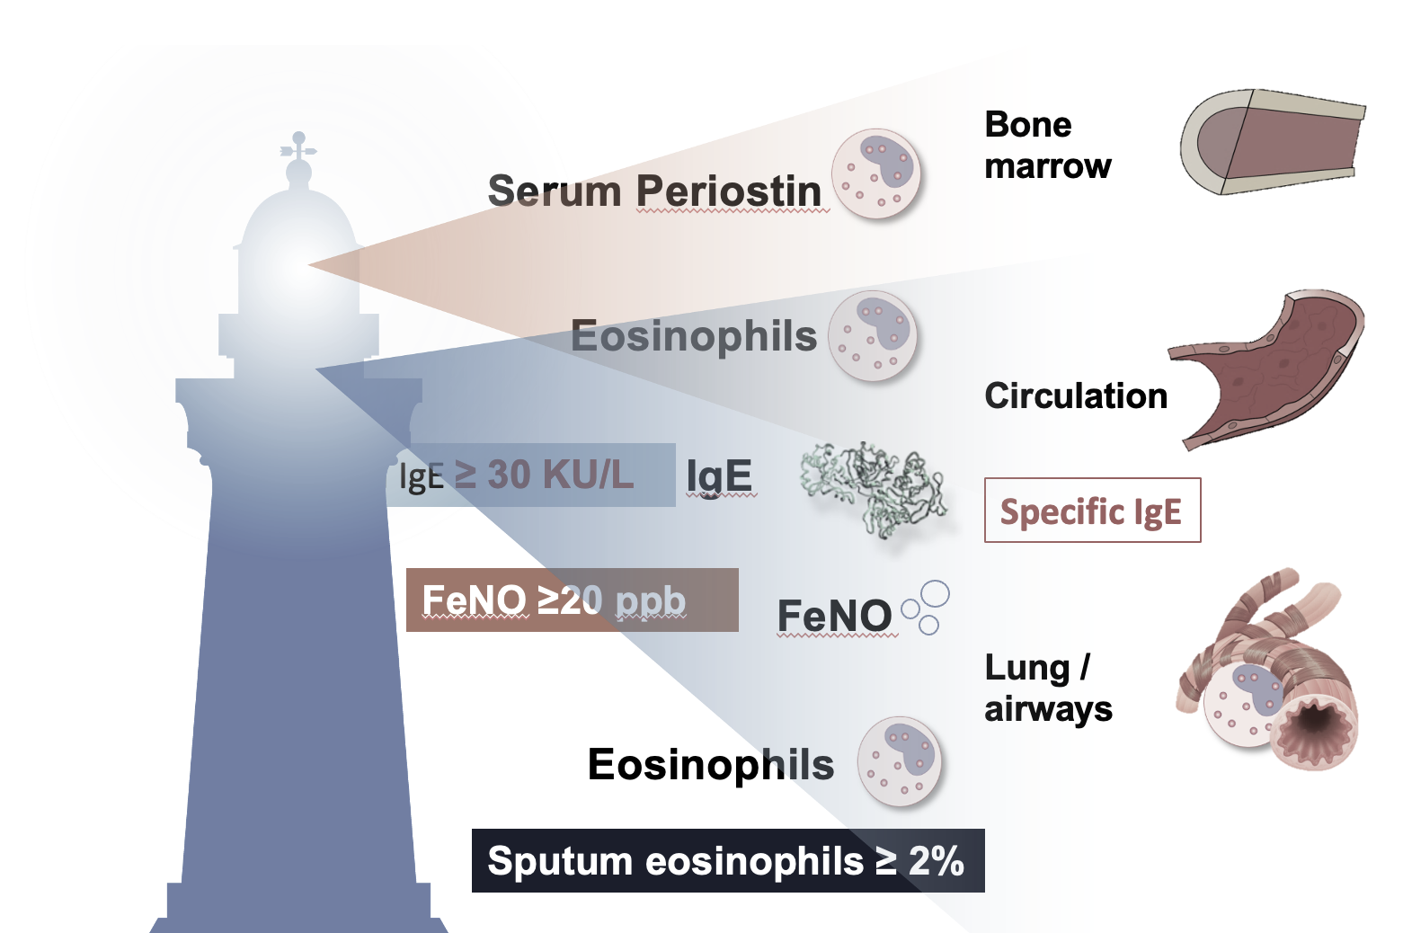
Identify T 2 Asthma- Biomarkers!
Type 2 Inflammation*
Blood Eosinophils : > 300 * cells/uL
FeNO*: >20 ppb
Sputum Eosinophils : > 2%
* Depends on dose of OCS & ICS
Scheerens et al. Clin Exp Allergy 2014; 44:38–46; Sidhu et al. Proc Natl Acad Sci USA 2010; 107:14170–14175; Suresh et al. Am J Respir Cell Mol Biol 2007; 37:97-104

Slide 10
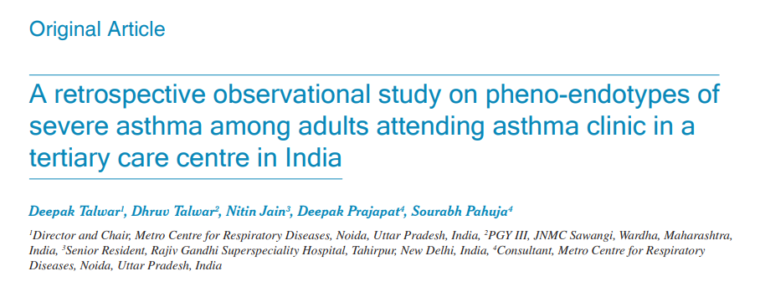
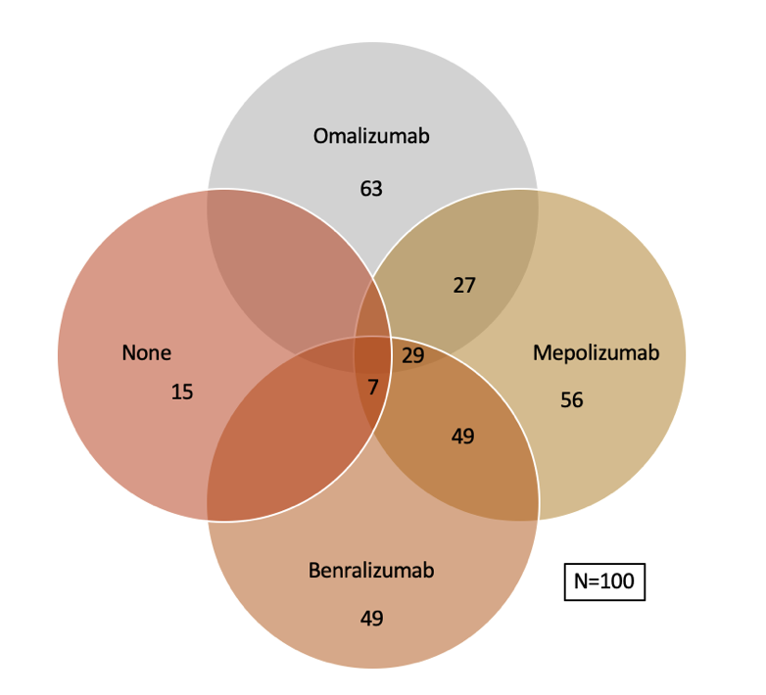
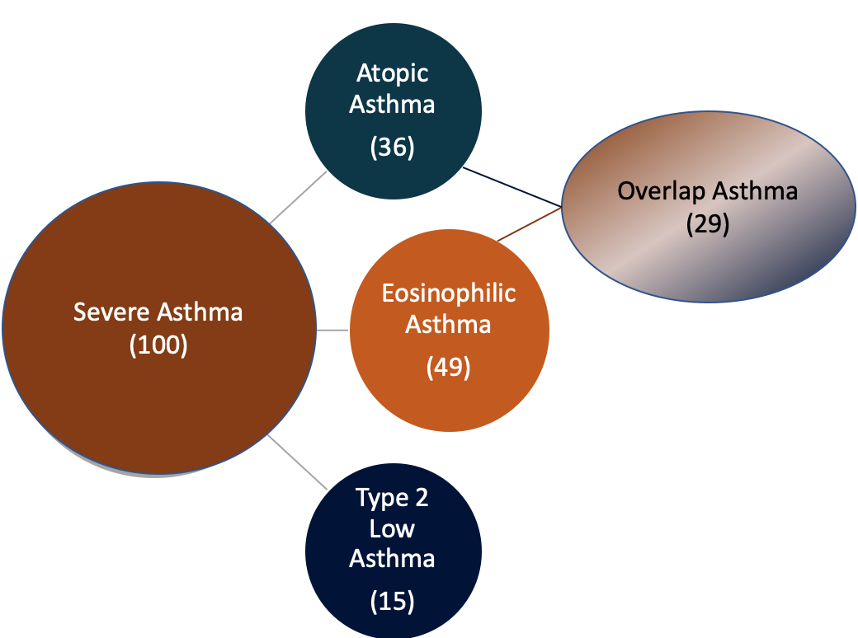
Type 2 Severe Asthma ~ 85 % & Biologicals Eligible ~ 91%
Single center, retrospective , observational study:
  100 Adult severe asthmatics from SA Clinic
  Measurements :
    Total/ Specific IgE
    AEC
    Skin prick tests
    History of allergy,
~ 50% of our Severe Asthmatics were eligible for both group of biologicals
T₂ Low asthma is only 15% at AEC cut off of 300 & 9% at @ AEC -150
Lung India 2022;39:393-400.

Slide 11
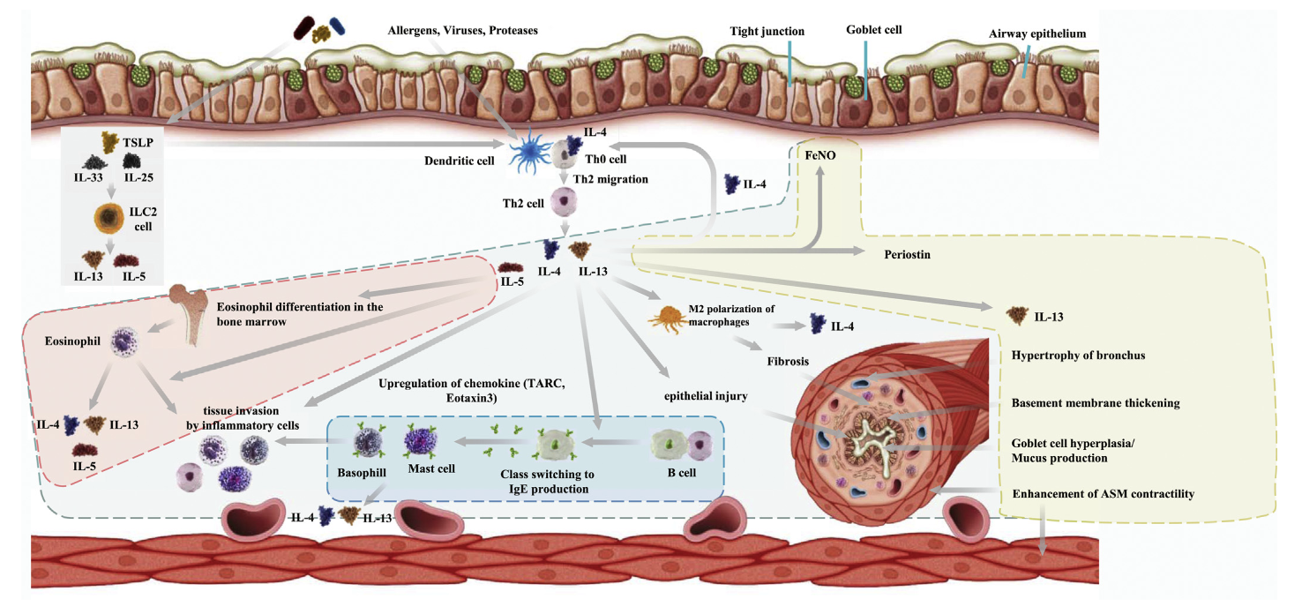
How ?? : Choose Appropriate Biologicals - Drivers
4. Anti – TSLP Tezepelumab
2. Anti – IL-5 Mepo/Benralizumab
3. Anti – IL-4R/13
Dupilumab
Anti – IgE
Omalizumab
K. Matsunaga et al. / Allergology International 69 (2020) 187e196

Slide 12
Mepolizumab vs Benralizumab : Both Anti-IL5 Mabs
https://doi.org/10.1183/16000617.0088-2024

Slide 13
Realistic Expectations - Matching Research
SA Outcomes | Omalizumab | Mepolizumab | Benralizumab
Reduction in Exacerbations | 25% reduction | ~ 50 % | 40 -70 %
Reduction in maintenance OCS | 50% dose reduction in those at 15 mg/day baseline | 50% dose reduction 2- 6 months↓ | 50 - 80%
FEV₁ | 2.1% | 100 ml | 100 -160 ml @ 4 weeks
QoL | SGRQ Asthma diaries | ACQ5 + 0.4 SGRQ +7 points | ACQ < 0.5 SGRQ +8.1 points
Real World Data | Reduction in AE in 42% vs 63 % & 28% vs 48% @ baseline | Reduction in AE ~ 50% Reduction in mOCS ~ 50% | All improved with 70% exacerbation free @2years
Predictors for Response CRwNP | Childhood onset,, AEC >300, FeNo > 19.5, S Periostin >50 ng/ml, ↓FEV₁ | Low mOCS, Later onset SA, ↓ BMI, AEC, ↑ Sputum Eos /AE | AEC, FEV₁<65%, mOCS, ‘f’ Exacerbations, AR

Slide 14
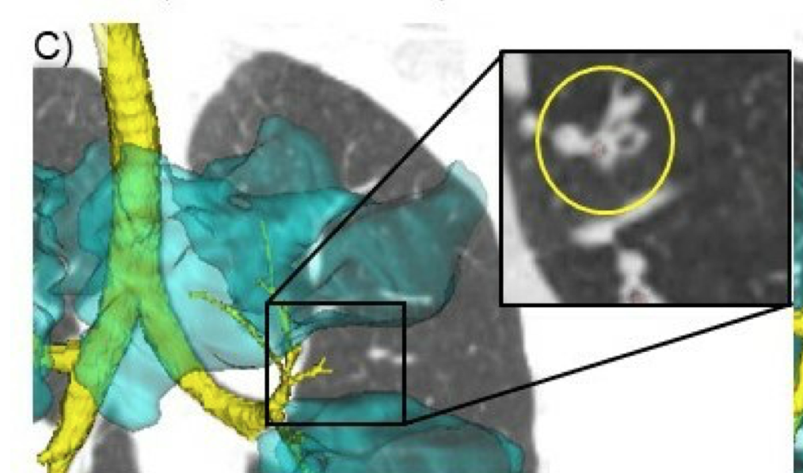
Choosing Biologicals in SA - 2025 !
Omalizumab
Mepolizumab
Benralizumab
Childhood Onset asthma
Comorbidities :
Allergic rhinitis
Chronic idiopathic urticaria
Food Allergy
CRSwNP
Biomarkers
Serum IgE, BMI, SPT/Specific IgE, FeNO
Late Onset asthma
Comorbidities :
Chronic Sinusitis with NP
EGPA
HES
Biomarkers :
AEC, FeNO, Sputum Eosinophils
Eosinophilic Gastritis
Adult / Late Onset asthma
Comorbidities :
Nasal Polyposis
Airway Mucus
Biomarkers :
AEC, Sputum Eosinophils, FeNO
Patient Preferences : Cost, Reimbursement, Dosing
Notes:
Higher serum IgE and BEC
and a shorter disease duration were associated with a slower response, necessitating a prolonged treatment
SoMOSA open-label studies, however, found omalizumab
to be effective independent of traditionally used biomarkers

Slide 15
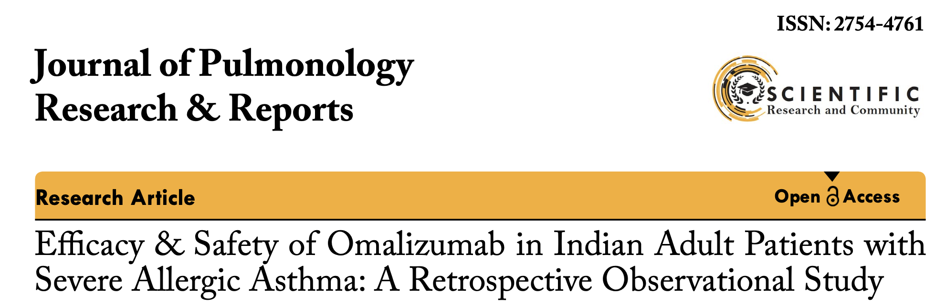
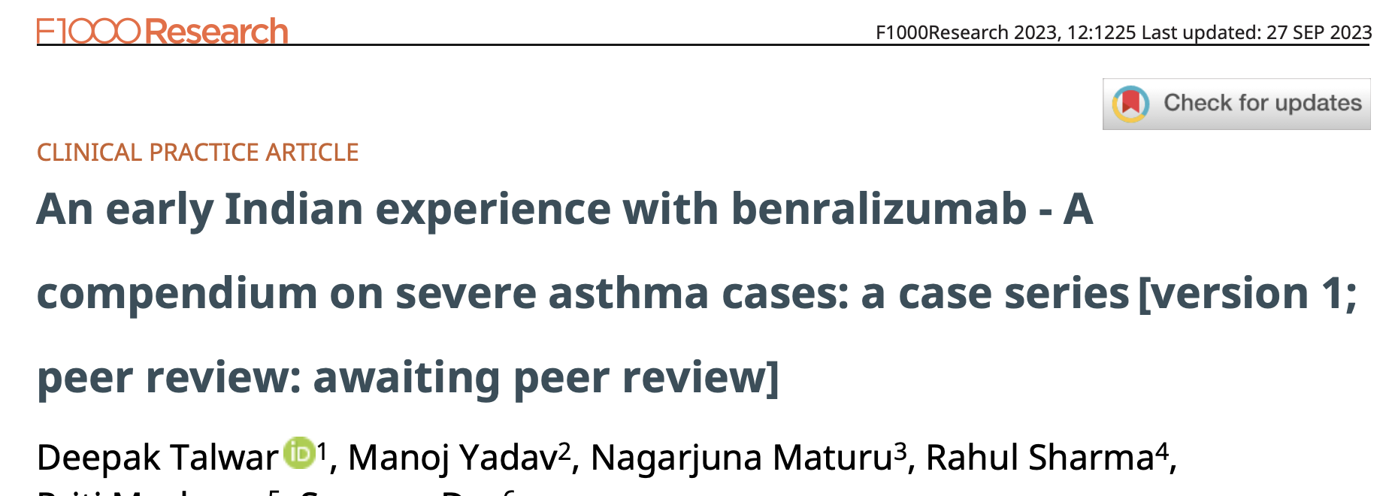
Biologicals in Severe Asthma– Indian Experience
Arjun Khanna1*, Deepak Talwar2, Linija K Nair3
Deepak Talwar * 1, Manoj Yadav2, Nagarjuna Maturu3
Conclusions:
Omalizumab led to improved asthma control, lung function, and QoL and allowed a reduction in the dosage of medications for asthma. The improvement was observed irrespective of age and biomarker levels.
Conclusions:
In all cases, management with Benralizumab resulted in optimal clinical and functional improvement, a decline in systemic steroid use, and improved QoL.
J Pulmonol Res Rep, 5(2): 4-6 2023
Published: April 28, 2023
F1000 Research 2023, 12:1225 Last updated: 27 SEP 2023

Slide 16
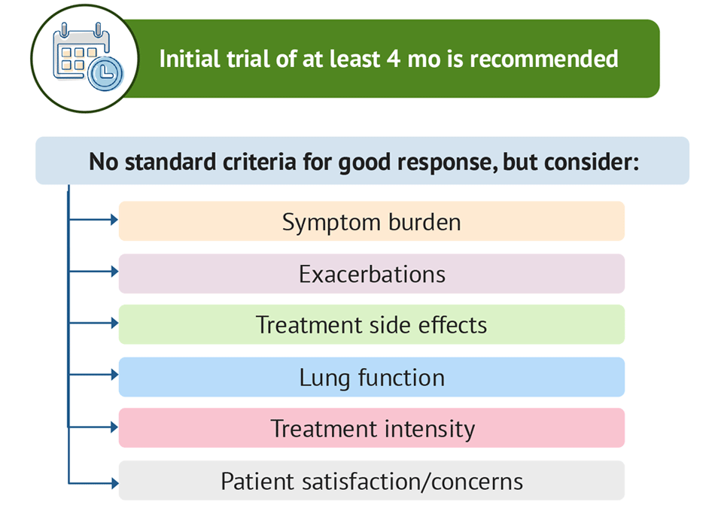

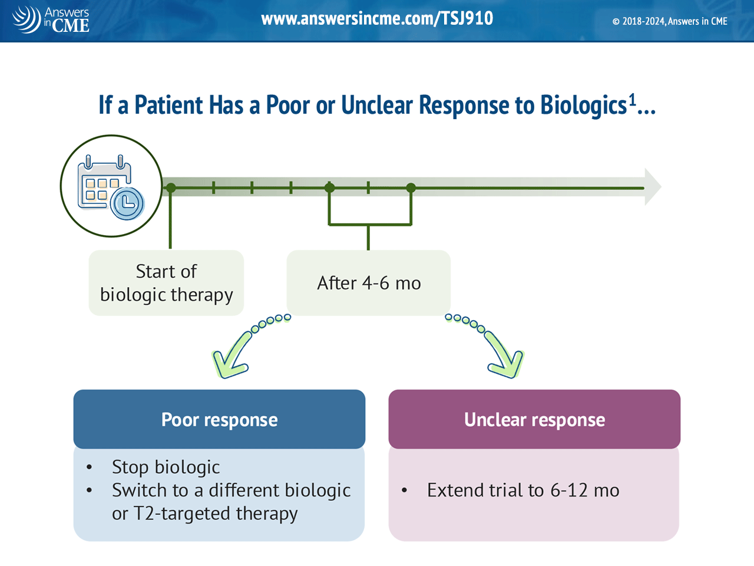
Assessing Effectiveness of Biologicals : FU@ 6 months
Good /Response
GINA 2024
Initial Trial for 4 months Minimum
Continue

Slide 17

Remission in Asthma : Cure ??
Mild asthma
Better lung function
Better asthma control
Younger age
Early-onset
Shorter duration
Milder BHR
Fewer comorbidities
Never smoking
Known in children* ~ 22% diagnosed with allergic asthma after a mean follow-up of 30 years, achieving it*
Thorax. 2004;59:925–9, http://dx.doi.org/10.1136/thx.2003.016246.

Slide 18

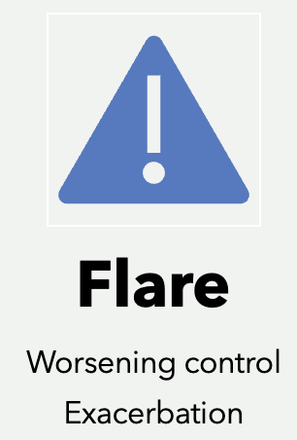
Remission in Severe Asthma : New Concept
Complete or near complete disappearance of signs & symptoms of a disease e.g. cancer
May last for months, years or rest of life
Remission on / off treatment
Remission doesn’t mean necessarily off medication too
IBD
RA
Hostile Situations
DM

Slide 19
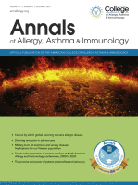
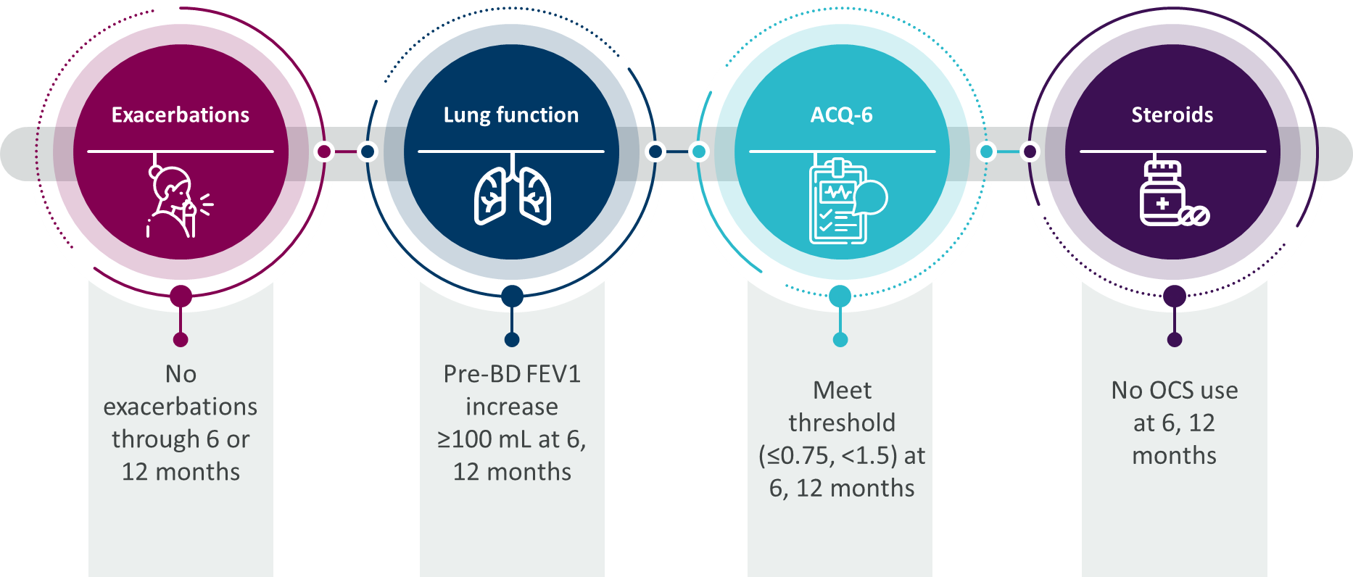
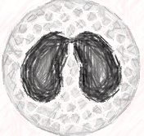
Clinical Remission :
.
Complete Remission on Treatment / Off Treatment
Complete Remission :
No Exacerbations
No OCS Use
No Symptoms
Stable / optimized Lung Functions
Low Intensity controller T/t
Airway Inflammation
Inflammation
FeNO, AEC, Sputum eosinophils
BHR
Menzies-Gow A, et al. J Allergy Clinical Immunol Pract 2020; 145: 757-765

Slide 20
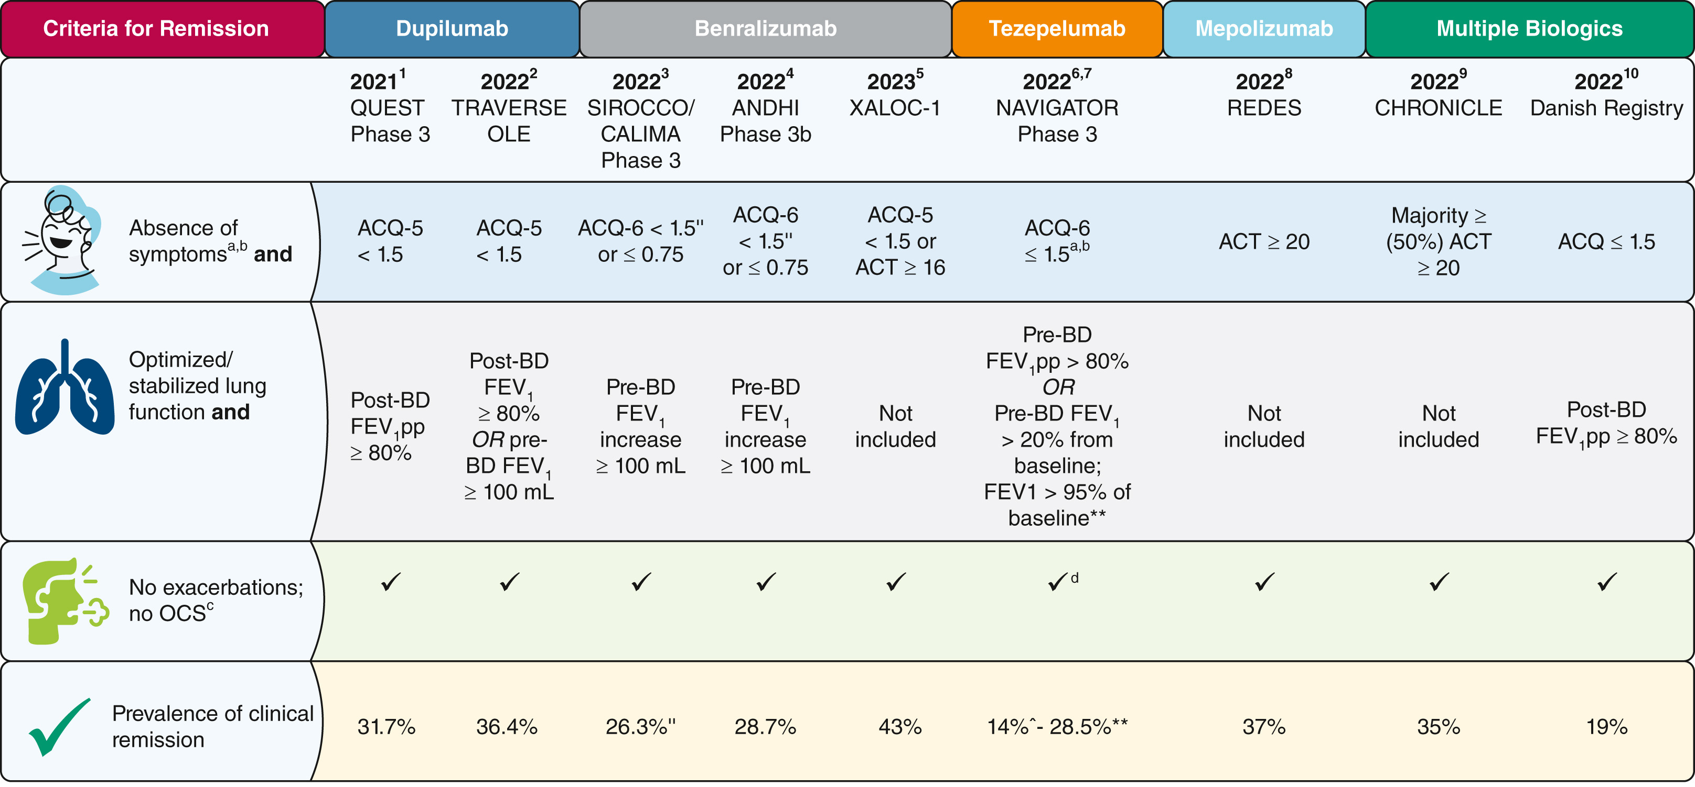
Clinical Remission in Asthma : FACT !
DOI: 10.1016/j.chest.2023.04.028

Slide 21

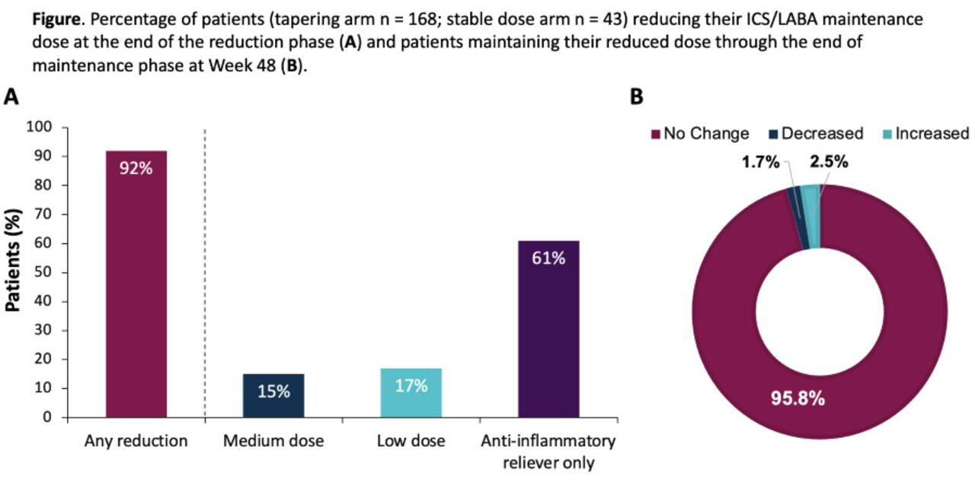
Can SA Patients Transform to Mild Asthma ?
@ 48 weeks
92% at 48 weeks had no AE

Slide 22


When Biologicals Response Is Inadequate ?
Early Failure : Baseline Fault
Late Failures : Resistance
Fewer exacerbations
Low BEC
mOCS use
Airway Eosinophilia
Neutralizing Ab to MAB’s
Comorbidities
20% refractory to biologicals @ 1 year

Slide 23
Failure : Can We Switch Biologicals ?
58 previously exposed to Omalizumab / Mepolizumab or Omalizumab + Mepolizumab patients with inadequate response switched to Benralizumab
Suboptimal Control
Patients switched to Benralizumab improved if they were more atopic
Benralizumab improved overall asthma control in switched patients
Front. Med. 9:950883. doi: 10.3389/fmed.2022.
ANANKE Study

Slide 24
Results of Switching Biologicals
Relative rate reduction in AER
Mean change daily mOCS dose @ baseline
XALOC 1 Program
Eur Respir J 2024; 64: 2301521
MCID improvement-asthma Symptom score

Slide 25
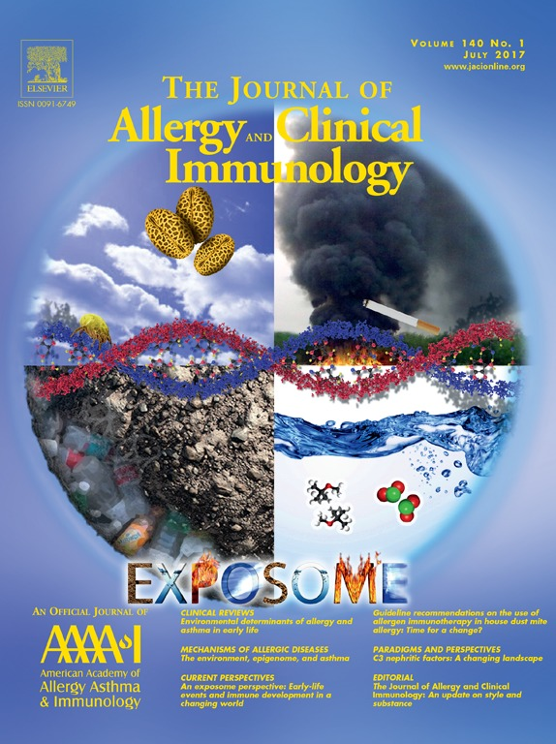
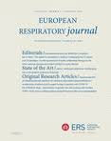
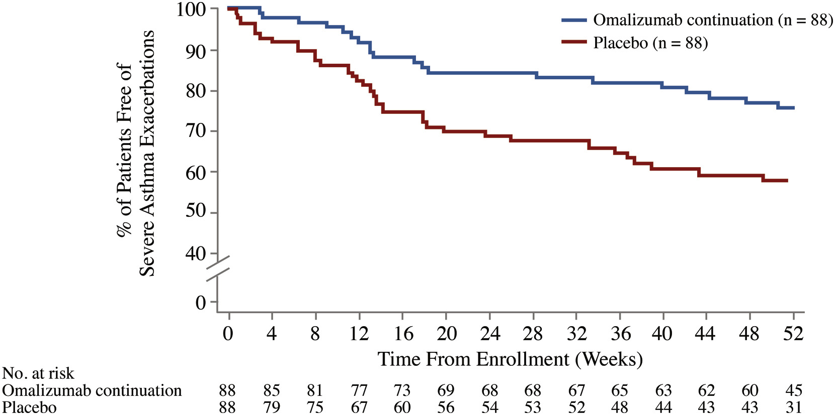
Stopping Biologicals ?
Can Biologicals be Stopped ?
Omalizumab : XPORT Study
Mepolizumab : COMET Study
19.3% less exacerbations in Continuation group vs discontinuation group
13% less exacerbations in continuation mepolizumab
J Allergy Clin Immunol. 2017 Jul;140(1):162-169.
Eur Respir J 2022; 59: 2100396

Slide 26
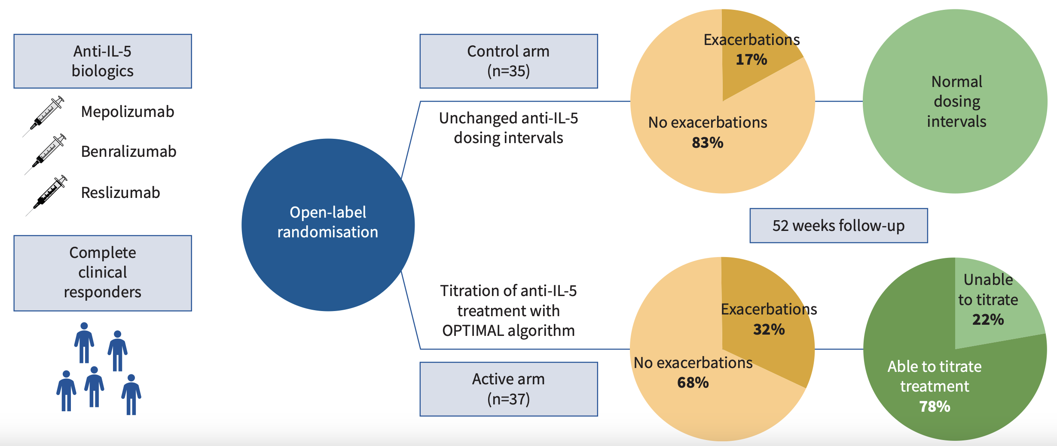
How to Stop Biologicals ? OPTIMAL Study
Screenshot 2025-03-04 at 7.04.26 PM
Titration Study
P =0.13
Soendergaard MB, Eur Respir J ; 2024 : 24004o4
Notes:
The OPTIMAL algorithm was designed as a tool to determine the optimal dosage of anti-IL-5 for individual patients
by adjusting the intervals between the administration of treatments (figure 1). The dose remained the same at each administration;
however, intervals were prolonged (down-titration) when there
were no signs of loss of disease control and shortened again (up-titration) if there were signs of loss of
disease control. Intervals were prolonged by 50% from normal at first and, if well tolerated, then by a
further 50% from the first interval increase, i.e. 125% from normal intervals. If intervals prolonged by
125% were well tolerated, the patient entered a trial period with cessation of treatment. This meant that
patients on mepolizumab or reslizumab first had dosing intervals increased to 6 weeks and then to 9 weeks
before possible cessation, and patients on benralizumab first had dosing intervals increased to 12 weeks
and then to 18 weeks before possible cessation. We defined signs of loss of disease control as either 1) a
reduction in FEV1 ⩾15% from baseline, 2) blood eosinophils ⩾0.3×109 cells·L−1 or 3) an exacerbation.
If one or more of the three occurred, the intervals were shortened to the
previous step and no further down-titration was attempted.
majority of patients tolerate intervals prolonged by 50%, a large part tolerates
intervals prolonged by 125% and that relatively few patients tolerate cessation,
just as relatively few patients do not tolerate tapering at all.

Slide 27
Biologicals In Asthma : Conclusions
Uncontrolled Asthmatics on GINA Step 5
Type 2 Severe Asthma ( Biomarkers )
Match comorbidities & Expectations
Space / Abrupt
Zero OCS Use
When :
Which :
How :
When to stop :
Why

Slide 28






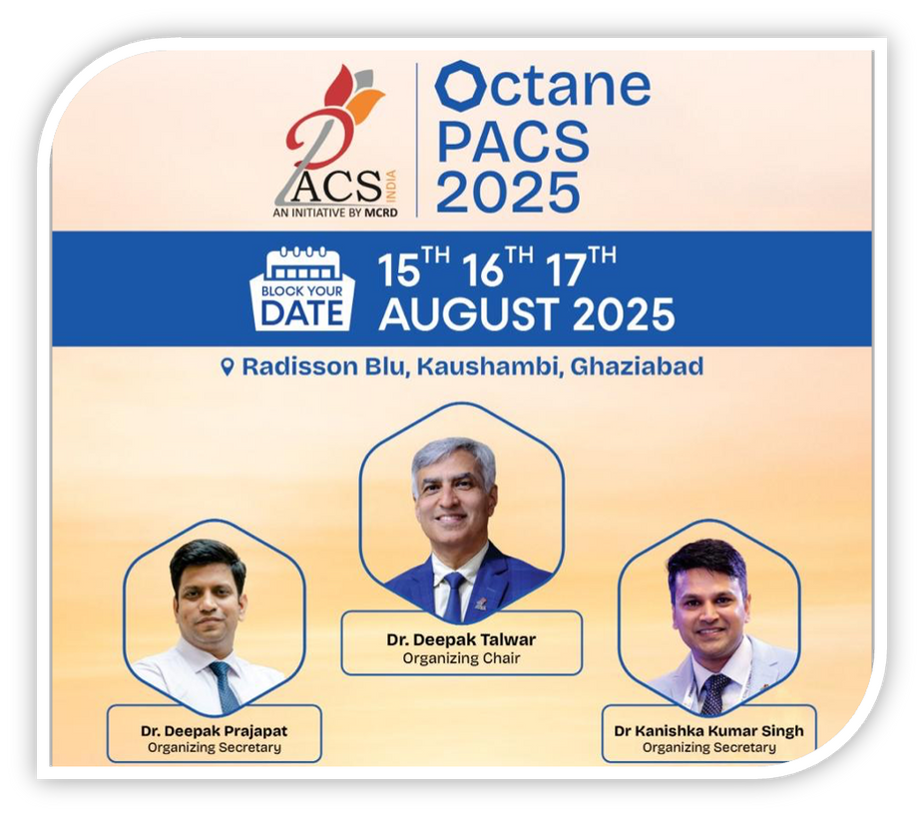
Dr Deepak Talwar
Director & Chair MCRD
Dr Deepak Prajapat
Senior Consultant
Dr Kanishka Kumar Singh
Senior Consultant
Thank You
Dr Rahul Khera
Consultant

Slide 29
Art of Choosing Biologicals

