Slide 1


Biologicals in COPD Work
Debate - Pro
Deepak Talwar
MD, DTCD, DNB, DM ( Pulmonary & Critical Medicine ) FISDA, FCCP ( USA ), FNCCP
Director & Chair
Pulmonary, Sleep, Allergy & Critical Care Medicine
Metro Group of Hospitals, INDIA

Slide 2


Slide 3
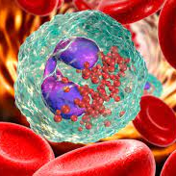
Biologicals Work in Asthma, But In COPD ..
Biologicals are targeted missiles :
  Transformed management of severe asthma, approved @23 years
  In COPD Anti- IL-4/13r blocker, Dupulimab approved
  Biologicals are the future as OAD management is shifting to ‘Precision Medicine’ from Traditional Medicine
Identify Treatable Trait
Offer Treat to Target
‘ Medicine’

Slide 4
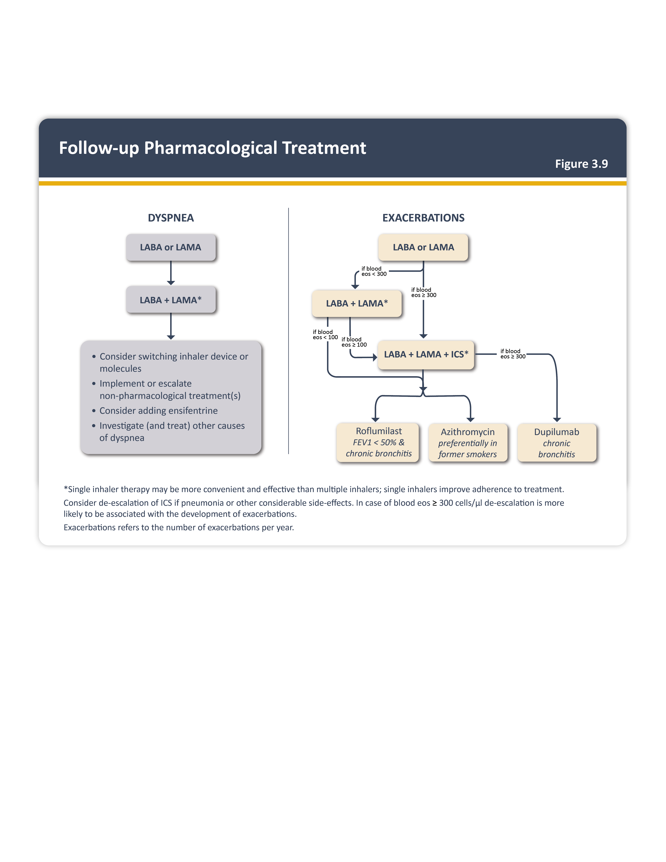
Biologicals in COPD : Why & When ?
~ 67% exacerbate on SITT
~ 50% exacerbated despite add on Roflumilast/ Macrolides
Type 2 inflammation in COPD:
  ↑ Future risk of exacerbations in ‘f’ exacerbators
  Some with COPD & Asthma (ACO)
~ 40% exacerbations in COPD are eosinophilic
GOLD 2025
Treatable trait : Eosinophilic COPD
European Journal of Internal Medicine 2024.05.011

Slide 5
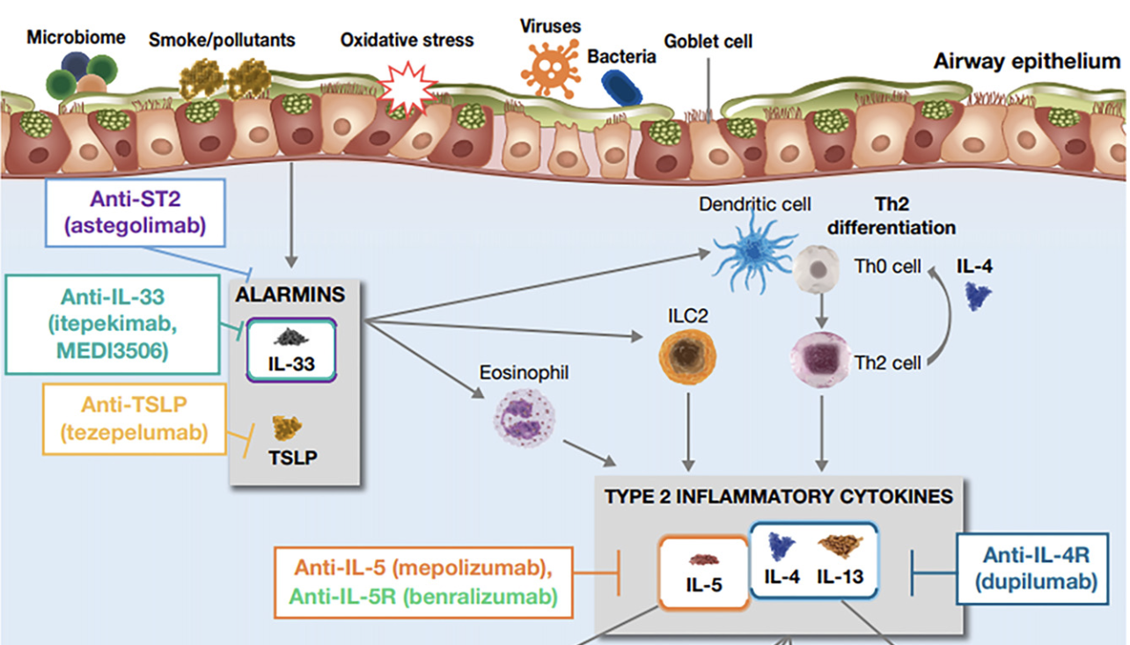
Inflammation in COPD is Type 2 too..
20- 40% COPD have Type 2 Inflammation
Am J Respir Crit Care Med : 208 ; 4, 395–405,2023

Slide 6

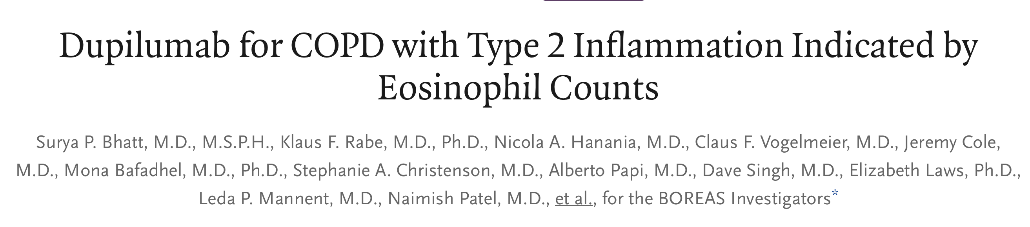
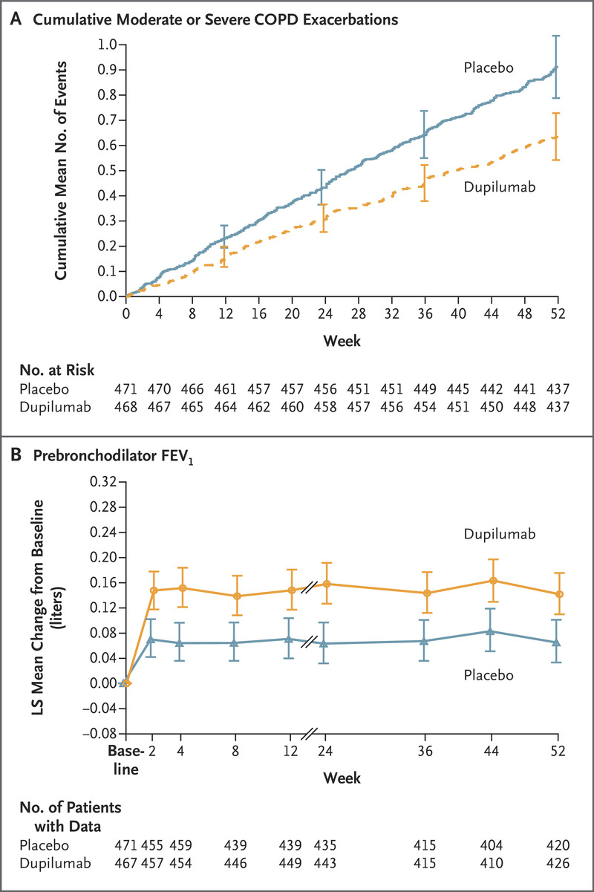
Phase 3, double-blind, randomized trial
COPD who had a blood eosinophil count of at least 300 per uml and an elevated exacerbation risk despite use of standard triple therapy
Dupilumab (300 mg) or placebo subcutaneously once every 2 weeks
COPD with T2 inflammation ( AEC > 300 ) had fewer exacerbations, better lung function and QoL, and less severe respiratory symptoms
30% reduction in exacerbations
160 ml FEV₁
Notes:
A total of 939 patients underwent randomization: 468 to the dupilumab group and 471 to the placebo group
The annualized rate of moderate or severe exacerbations was 0.78 (95% confidence interval [CI], 0.64 to 0.93) with dupilumab and 1.10 (95% CI, 0.93 to 1.30) with placebo (rate ratio, 0.70; 95% CI, 0.58 to 0.86; P<0.001). The prebronchodilator FEV₁ increased from baseline to week 12 by a least-squares (LS) mean of 160 ml (95% CI, 126 to 195) with dupilumab and 77 ml (95% CI, 42 to 112) with placebo (LS mean difference, 83 ml; 95% CI, 42 to 125; P<0.001), a difference that was sustained through week 52. At week 52, the SGRQ score had improved by an LS mean of −9.7 (95% CI, −11.3 to −8.1) with dupilumab and −6.4 (95% CI, −8.0 to −4.8) with placebo (LS mean difference, −3.4; 95% CI, −5.5 to −1.3; P=0.002).

Slide 7
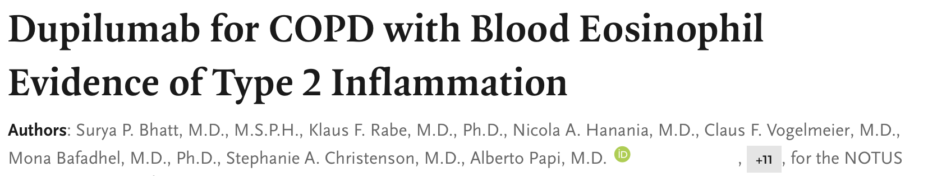
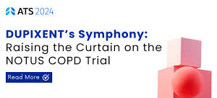
NOTUS, Dupilumab reduced exacerbations by a magnitude never seen before with an investigational biologic in a phase 3 COPD clinical study
No Effect of
Age
Sex
Smoking
FEV1
Emphysema
Exacerbations
34% reduction in exacerbations
139 ml FEV₁
↑ Symptoms
↑ SGRQ
Notes:
A total of 939 patients underwent randomization: 468 to the dupilumab group and 471 to the placebo group
The annualized rate of moderate or severe exacerbations was 0.78 (95% confidence interval [CI], 0.64 to 0.93) with dupilumab and 1.10 (95% CI, 0.93 to 1.30) with placebo (rate ratio, 0.70; 95% CI, 0.58 to 0.86; P<0.001). The prebronchodilator FEV₁ increased from baseline to week 12 by a least-squares (LS) mean of 160 ml (95% CI, 126 to 195) with dupilumab and 77 ml (95% CI, 42 to 112) with placebo (LS mean difference, 83 ml; 95% CI, 42 to 125; P<0.001), a difference that was sustained through week 52. At week 52, the SGRQ score had improved by an LS mean of −9.7 (95% CI, −11.3 to −8.1) with dupilumab and −6.4 (95% CI, −8.0 to −4.8) with placebo (LS mean difference, −3.4; 95% CI, −5.5 to −1.3; P=0.002).

Slide 8


Biologicals in COPD:
Published July 19, 2023 N Engl J Med 2023;389:274-275 D
Published May 20, 2024 DOI: 10.1056/NEJMoa2401304
COPD with type 2 inflammation ( AEC > 300 ) on dupilumab had fewer exacerbations, better lung function and QoL, and less severe respiratory symptoms than those who received placebo
No Signal for Safety

Slide 9
Biologicals in COPD: Finally Approved
Published July 19, 2023 N Engl J Med 2023;389:274-275 D
Published May 20, 2024 DOI: 10.1056/NEJMoa2401304
COPD with type 2 inflammation ( AEC > 300 ) on dupilumab had fewer exacerbations, better lung function and QoL, and less severe respiratory symptoms than those who received placebo
No Signal for Safety

Slide 10
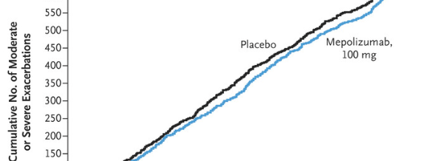

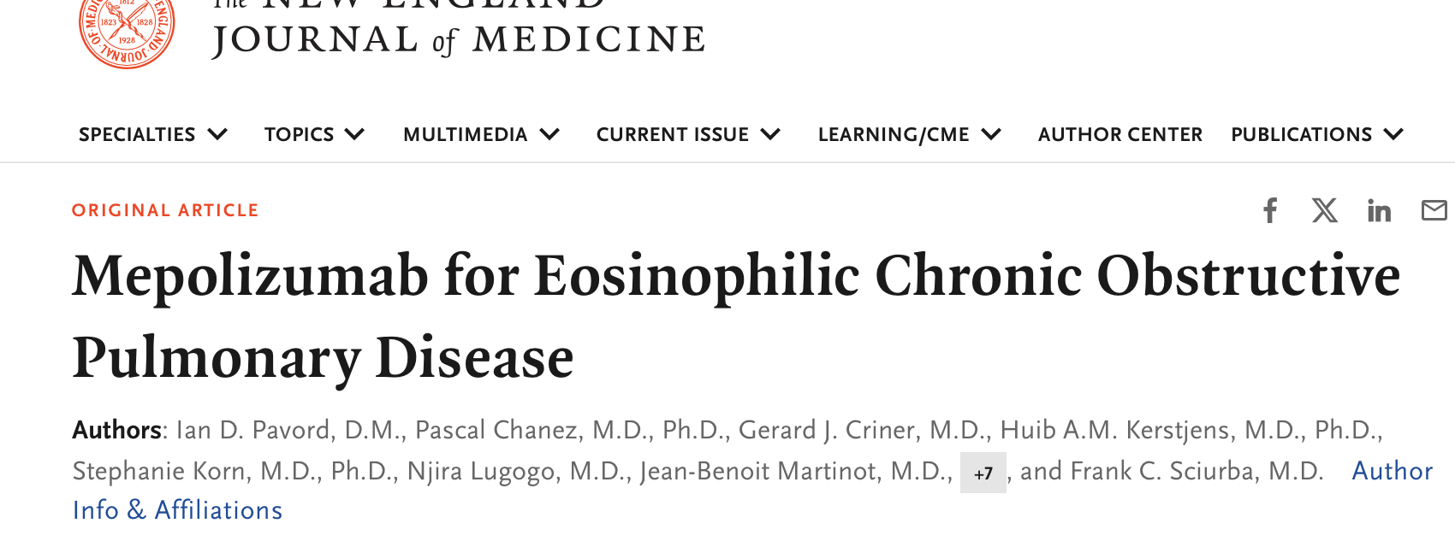
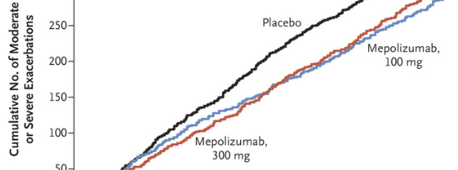
Biologicals in COPD :
Anti IL-5 -Mepolizumab
METREX
METREX & METREO
14-20% reduction
3 More Ongoing Trials
SUMMER
MATINEE
&
COPD-HELP
METREO
Notes:
There was a significant increase in odds for individual patient FEV1 response greater than 20% from baseline with high dose oral steroid treatment compared to placebo, OR 2.71; 95% CI 1.84 to 4.01 (9 studies) . It would be necessary to treat 7 patients (95% CI 5 to 12) with oral corticosteroids to achieve one extra case of increasing FEV1 by more than 20%, with a placebo group risk of 0.13. All differences in health-related quality of life were less than the minimum clinically important difference. There were small statistically significant advantages for functional capacity and respiratory symptom of wheeze with oral steroid treatment but no significant difference in risk of withdrawal from study due to an exacerbation or rate of serious exacerbations over 2 years with low dose oral steroid treatment. There was an increased risk of adverse effects, including increased blood glucose, adrenal suppression and reduced serum osteocalcin.

Slide 11
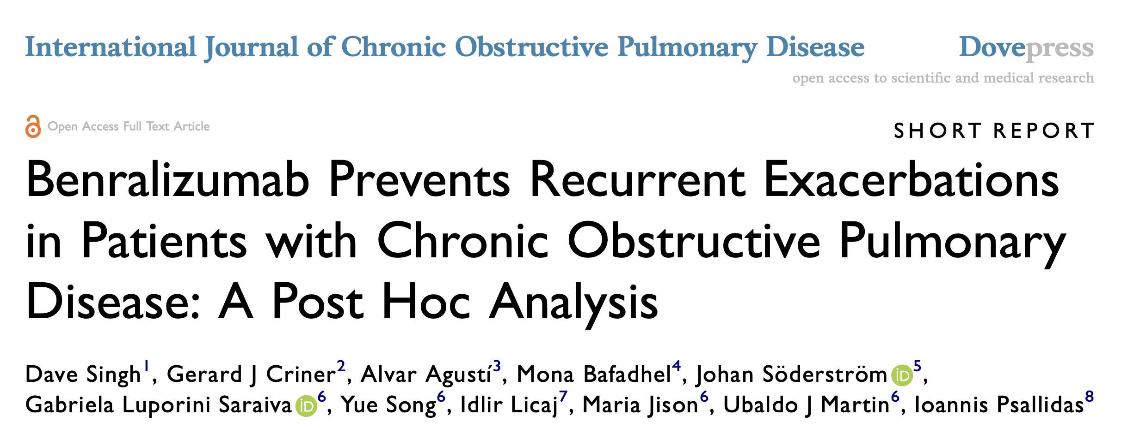
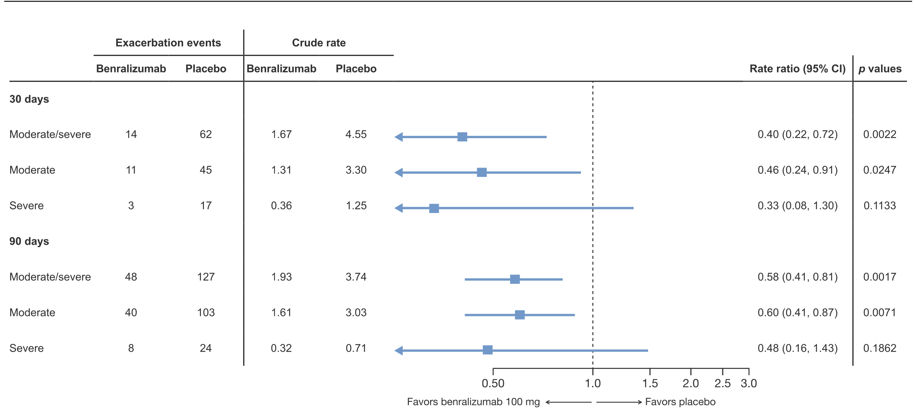
Benralizumab: Anti IL - 5r Blocking Monoclonal antibody
Exploratory post hoc analysis of the GALATHEA and TERRANOVA trials
Subgroup of COPD with:
  > 3 exacerbations on Triple therapy
  Baseline AEC > 300
Benralizumab ( 100 mg/month) reduces risk of exacerbations @ 30- and 90-days post exacerbation ( vulnerable period )
RESOLUTE - recruiting
International Journal of Chronic Obstructive Pulmonary Disease 2023:18

Slide 12
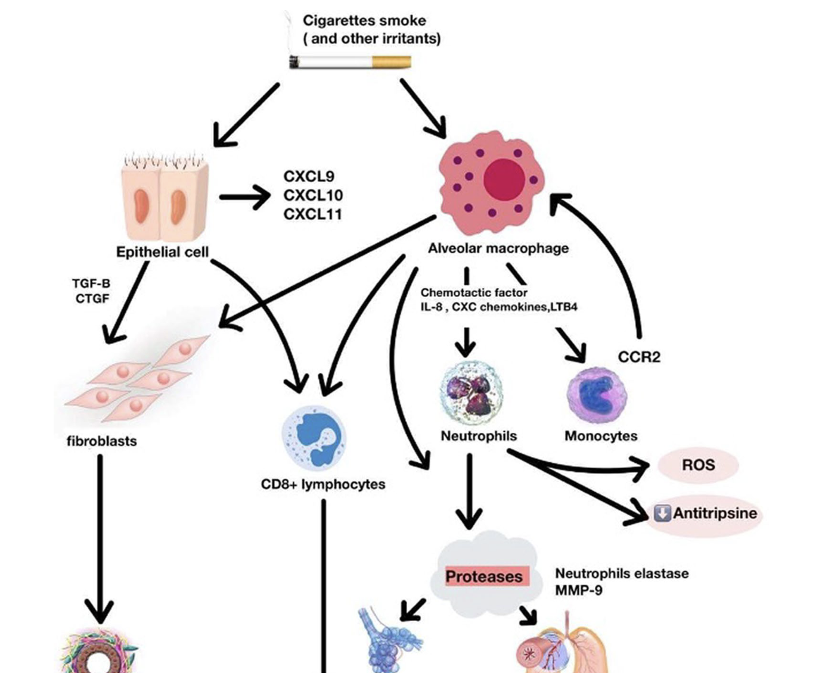
What More to Target In COPD ?
COPD
‘COPD is characterized by
different biological pathways known as endotypes’
Fibrosis
Destruction
Mucus
Bronchiolitis
Emphysema
Bronchitis
Notes:
3 types of lineage
Master of orchestra
Show stoppers 2
crowd
Front liners 2 cells

Slide 13
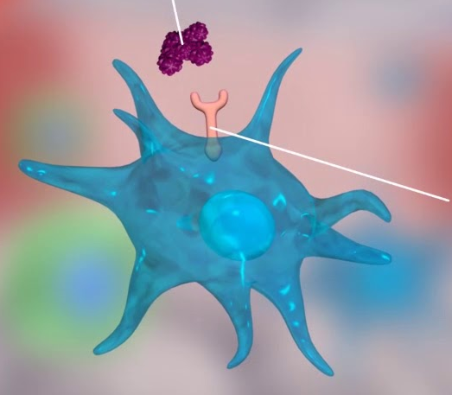
Targeting Type 1 Inflammation in COPD
TNF⍺ blocker
TNF Alpha :
  Proinflammatory cytokine
  ~ 70% of emphysema
  Cascade of inflammatory mediators
    Pro-inflammatory cytokines (IL-1),
    Chemokines ( CXCL -8 )
    Proteases (MMP 9 & 12)
  TNF alpha inhibitors :
    Infliximab:
    Etanercept :
TNF Alpha
TNF⍺ Receptor
No beneficial Effect
? ↑ infections
More Pneumonia’s & Cancers : Signal for Non-Safety

Slide 14
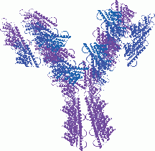
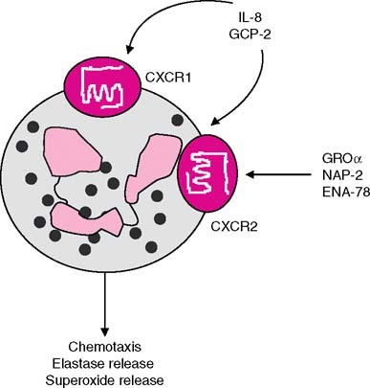
Targeting Type 1 Inflammation in COPD
IL-8 & CXCR :
  Neutrophilic Cytokine
  Stimulates CXC Receptors 1 & 2
  Increased Levels in BALF in COPD
  ABX IL-8 :
  CXCR2 receptor antagonist : Navarixin
IL-8 Blocker
Mild ↓ Dyspnea
Rest no Effect
CXCR Blocker
↓ Dyspnea, FEV₁ ↑
Current smokers
Adverse Event : ~ Neutropenia

Slide 15
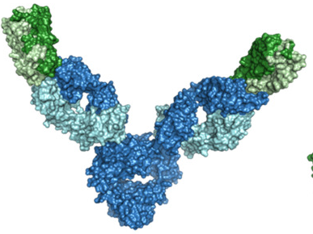
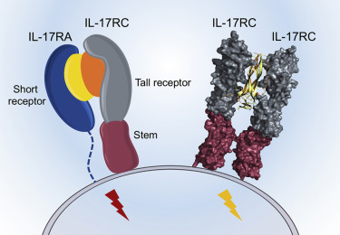
Targeting Type 3 Inflammation in COPD
IL- 17 :
  6 Chemokines & 5 Receptors
  Crucial for host defense
  Stimulates Inflammation & damage
Anti IL-17
  Studies mostly in asthma
  Secukinumab: Neutralize IL-17A
  More infections & Exacerbations
IL-17 & Blocker
Mild FEV₁ ↑ only
Adverse Event : ~ Immunosuppression

Slide 16
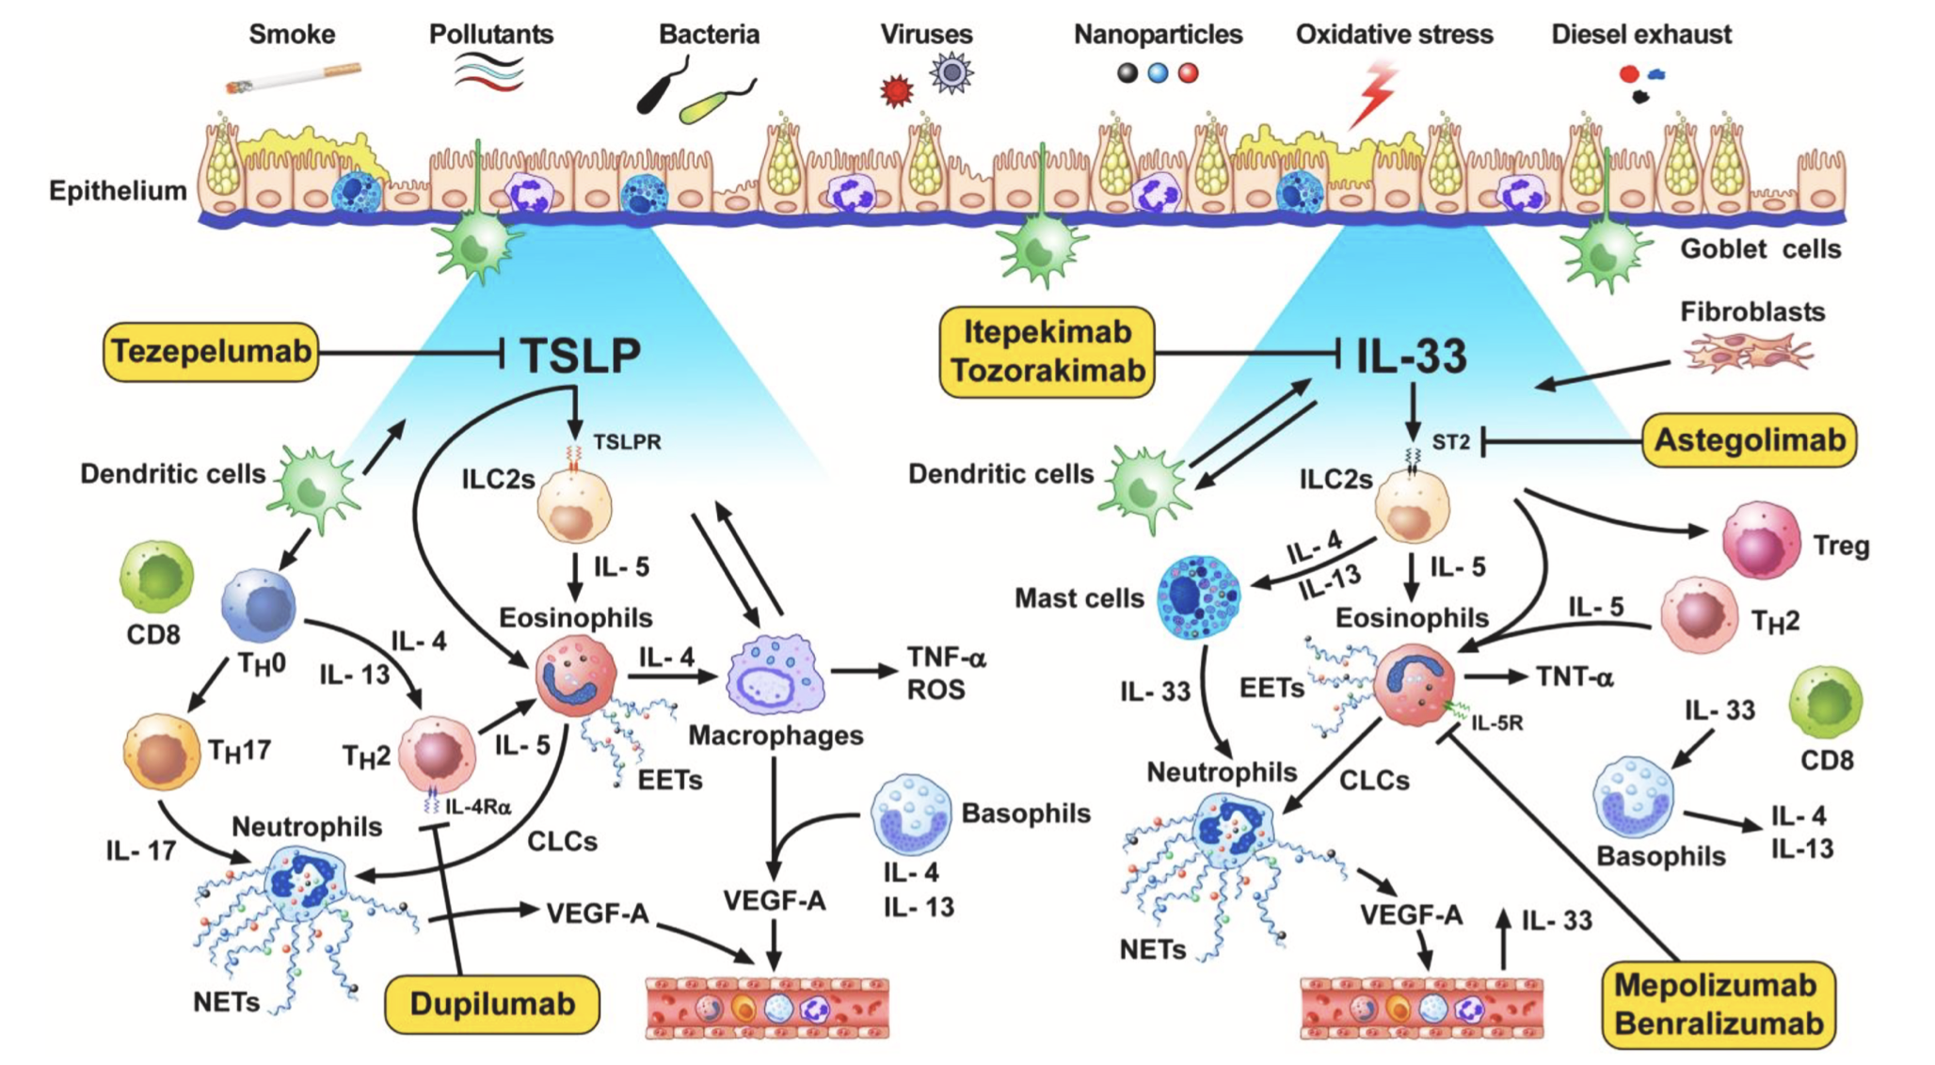
Pandora Box !

Slide 17
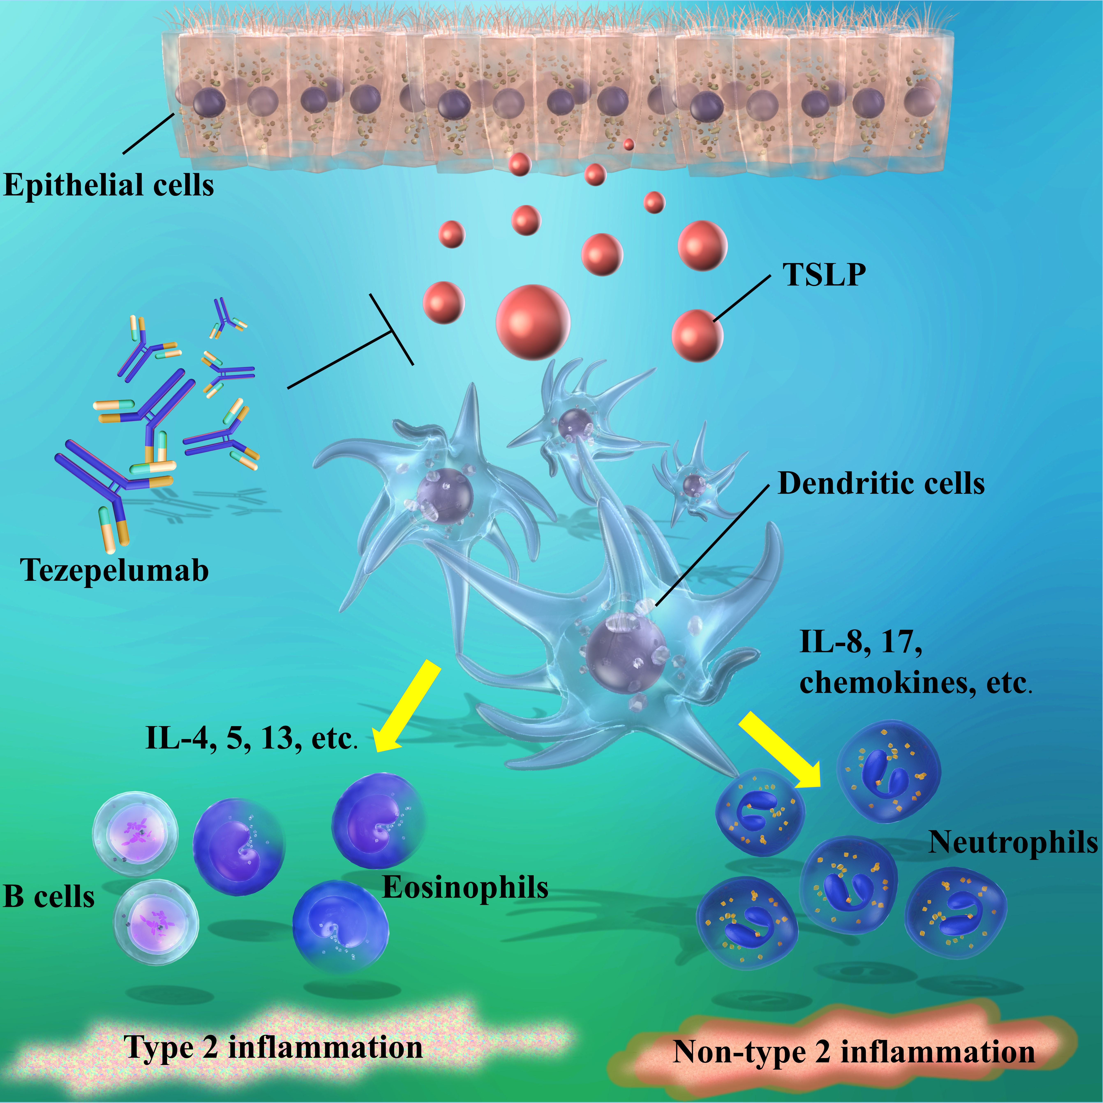
Biologicals in COPD : Anti-TSLP
Epithelial cytokine (IL-7 like cytokine)
Increased in viral induced AE-COPD
Tezepelumab : Undergoing Phase 2a COURSE, clinical trial in > 2 AE COPD’s
  17% ↓ exacerbations AEC > 150 cmm
  37% ↓ exacerbations AEC > 300 cmm
  Better lung functions & QoL
  No safety signal
Future
    But not statistically significant

Slide 18
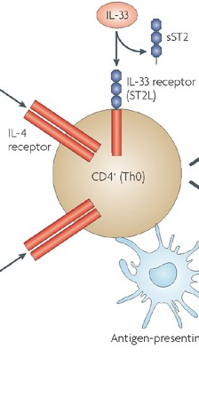
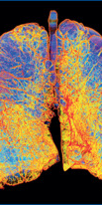
Biologicals in COPD : Alarmins -Anti-IL -33/ST2r
Endogenous danger signalling IL-33(sST2L)
Crucial cytokine in viral AE-COPD
Itepekimab : IL-33 MAB
  Phase 2 : Reduced AE, ↑ FEV₁ ( 90 ml) in former smokers
  No effect in current smokers
  No significant AE’s
  AERIFY 1 & 2 ongoing in former smokers
Astegolimab : Anti ST2R MAB
  Phase 2 : Improved QoL but no other effect
No Signal for Safety
Lancet Respir Med. 2021;9(11):1288–1298

Slide 19
Conclusions:
COPD is Heterogenous : Type 1 (60%), Type 2 (20-40 %) & Type 3 (? ) inflammation
Common is irreversible damage and progression despite maximized therapies
SITT in COPD is nearly last frontier but patients suffer with Symptoms, Exacerbations, ↓ Lung functions & QoL
Biologicals are treat to target therapies being studies extensively to fill the GAP
COPD with Type 2 inflammation - Anti –IL-4/13 ( Dupulimab ) have proved benefit
COPD with Type 1 inflammation lies with Anti TSLP and Anti IL-33 biologicals

Slide 20

End of the Road !
GOLD 2025

Slide 21
Biologicals in COPD Work
Debate - Pro
Rebuttal
Deepak Talwar
MD, DTCD, DNB, DM ( Pulmonary & Critical Medicine ) FISDA, FCCP ( USA ), FNCCP
Director & Chair
Pulmonary, Sleep, Allergy & Critical Care Medicine
Metro Group of Hospitals, INDIA

Slide 22
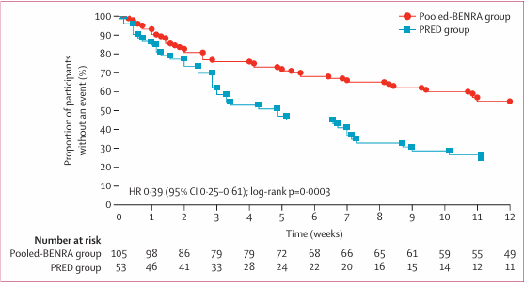
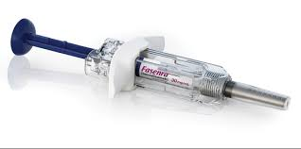

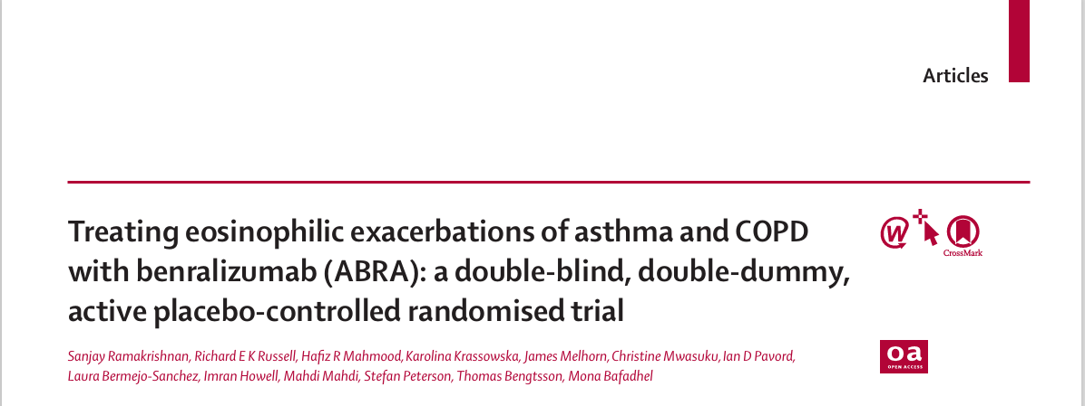
Treatment Failures as Outcome :
More In Prednisolone Group
OBJECTIVE:
To compare the Benralizumab, alone or in combination with prednisolone, as a treatment for Eosinophilic Endotypes of Asthma and COPD Exacerbations
3 Groups :
BENRALIZUMAB + PREDNOSOLONE
BENRALIZUMAB Only
PREDNISOLONE
287 patients were screened for study inclusion. 158 patients who met inclusion criteria of acute eosinophilic exacerbation of asthma or COPD ,were randomly assigned to one of the 3 groups
There was a significant reduction in treatment failure risk in pooled-BENRA compared with PRED at 30 days and no difference between BENRA and BENRA plus PRED
JAMA.2025;333(2):143-152.doi:10.1001/jama.2024.22700

Slide 23
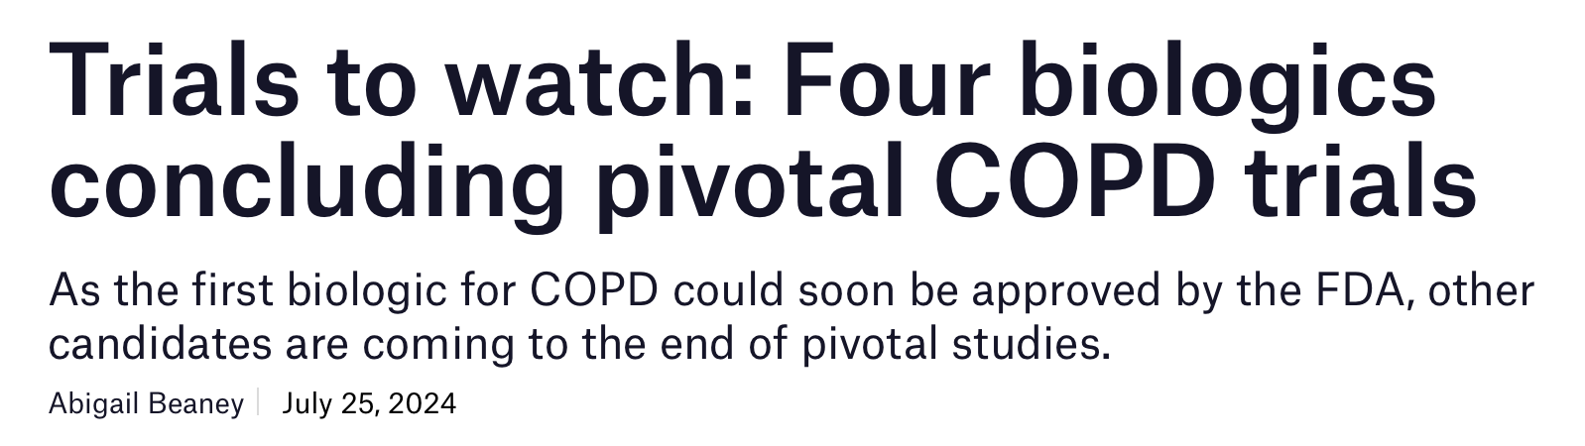
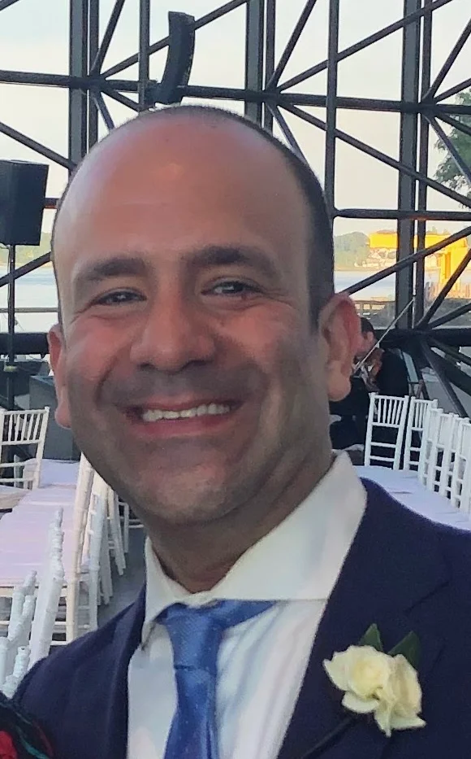
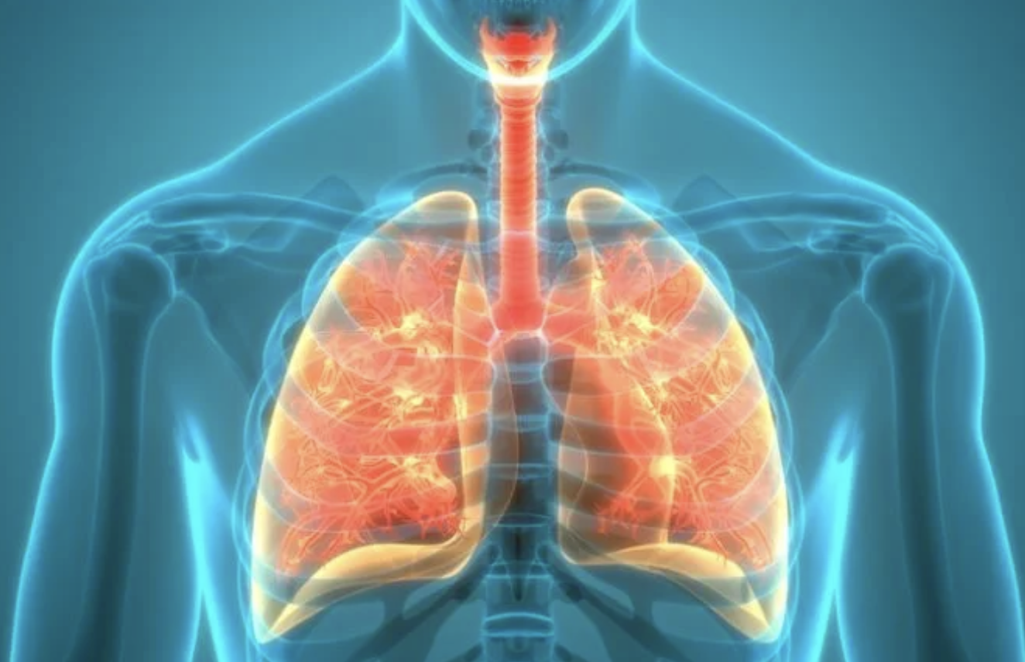

Future is Here …
The AERIFY-1 and AERIFY-2 Phase III trials Itepekimab in former and current smokers
Phase III ARNASA) is investigating astegolimab with once every four weeks and once every fortnight, versus placebo.

