Slide 1
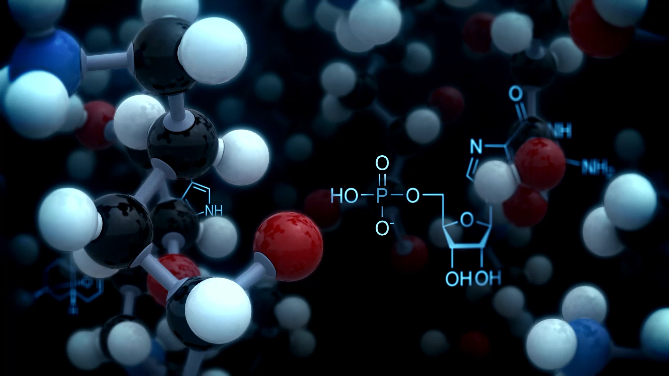

Biologicals in Asthma :
PULMONIS - 2025
Why, When Which & How ?
Deepak Talwar
Director & Chair, Metro Centre for Respiratory Diseases
Metro Hospitals & Institute
NOIDA, INDIA

Slide 2
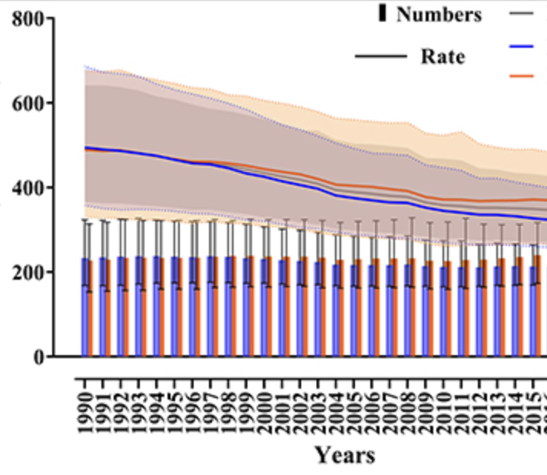
Death Continues to Haunt asthma
Prevalence continues to rise
Asthma continues to make patient suffer
Every other death in Asthma happens in India
Front. Public Health 10:1036674. doi: 10.3389/fpubh.2022.1036674

Slide 3
Biologicals : Targeted Therapies
0 %
35 %
10 %
100 %
Anti – IL-5 Mepolizumab
Benralizumab
Anti – IgE Omalizumab
Anti – IL-4/13
Dupulimab
Murine
Chimeric
Humanized
Fully Human
(-omab)
(-ximab)
(-zumab)
(-umab)
1. Anti – IgE Monoclonal Ab
Notes:
Ibrutimumab

Slide 4
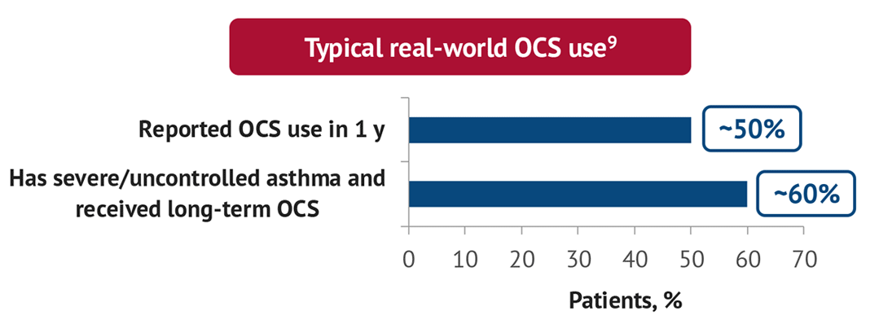
.
Why ???
NO to OCS !
Prevent complications of Low Dose maintenance or Bursts of OCS
1-3 OCS Bursts :
Fractures – 8%
Gastric Ulcers :7%
Hypertension – 6%
Fractures – 21%
GI Bleeds – 33%
Hypertension – 32%
DM – 30%
Cataract -26%
Obesity -28%
GI bleed – 7%
> 4 OCS Bursts:
4-5 times OCS bursts in life are enough to cause damage
Sullivan PW, et al. J Allergy Clin Immunol 2018;141:110–116

Slide 5
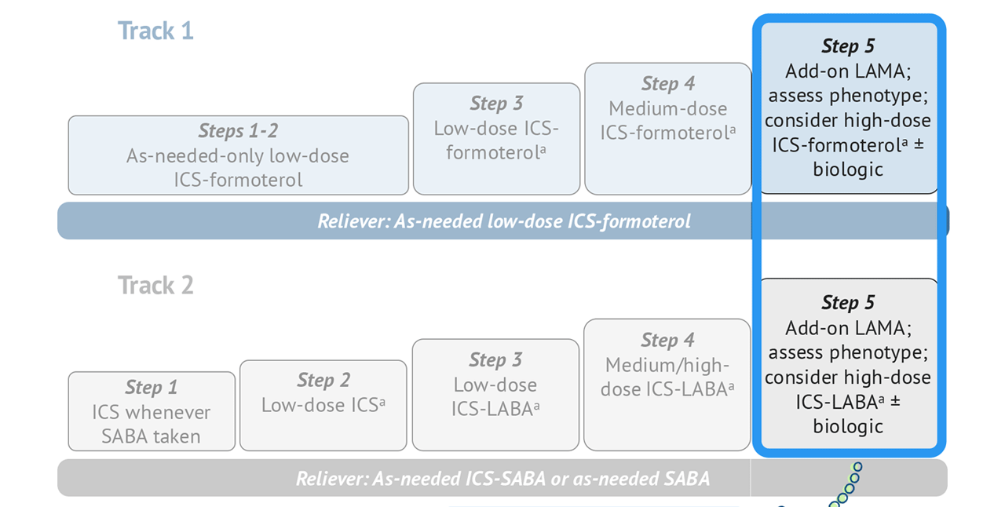
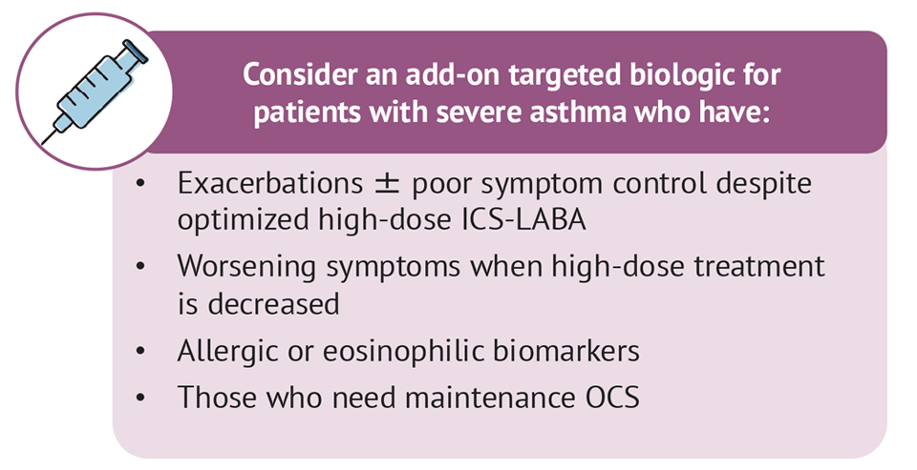
When ???
Severe Asthma
Step 5
Low Dose OCS
LAMA
High Dose ICS
LABA
Montelukast
Other Options
Azithromycin
GINA 2024

Slide 6



Remember : All Uncontrolled Asthma is NOT Severe Asthma
Difficult To Treat Asthma
Severe Asthma
GINA Step 5
90%
Comorbidities
50%
Exposures & Triggers
20%
Adherence & Technique
Retrospective label
25%
Diagnosis
Uncontrolled Asthma
World Allergy Organization Journal 2013, 6(Suppl 1):P3

Slide 7
Which ???
Type 2 Inflammation
Type 2 Severe Asthma : Atopic / Eosinophilic Phenotype
Type 2 Inflammation
Age of onset of asthma: Childhood / Early adulthood
Allergic comorbidities : Atopic dermatitis, AR, CSwNP, ABPA, EGA
Oral steroids responsive
GINA 2023

Slide 8
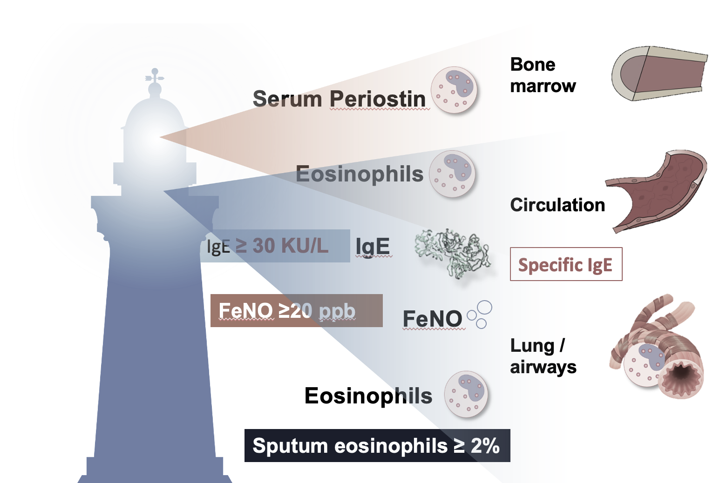
Remember: Identify T 2 Asthma- Biomarkers!
Type 2 Inflammation*
Blood Eosinophils : > 300 * cells/uL
FeNO*: >20 ppb
Sputum Eosinophils : > 2%
* Depends on dose of OCS & ICS
Scheerens et al. Clin Exp Allergy 2014; 44:38–46; Sidhu et al. Proc Natl Acad Sci USA 2010; 107:14170–14175; Suresh et al. Am J Respir Cell Mol Biol 2007; 37:97-104

Slide 9
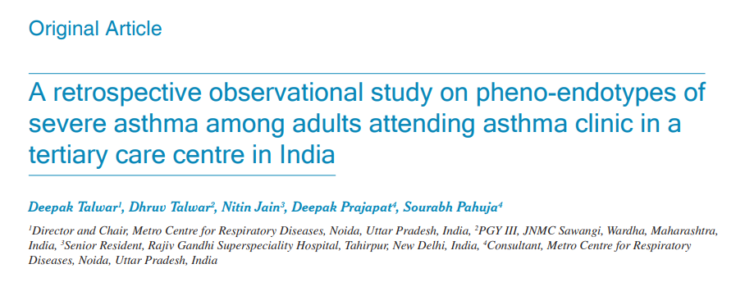
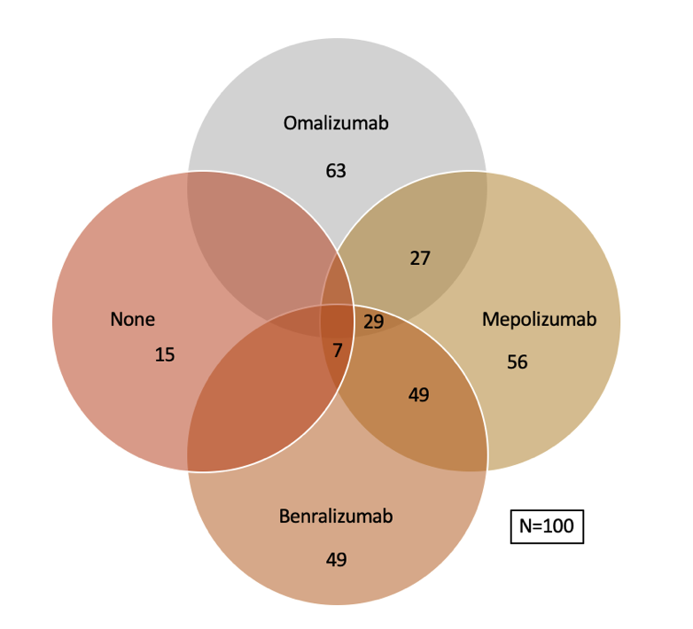
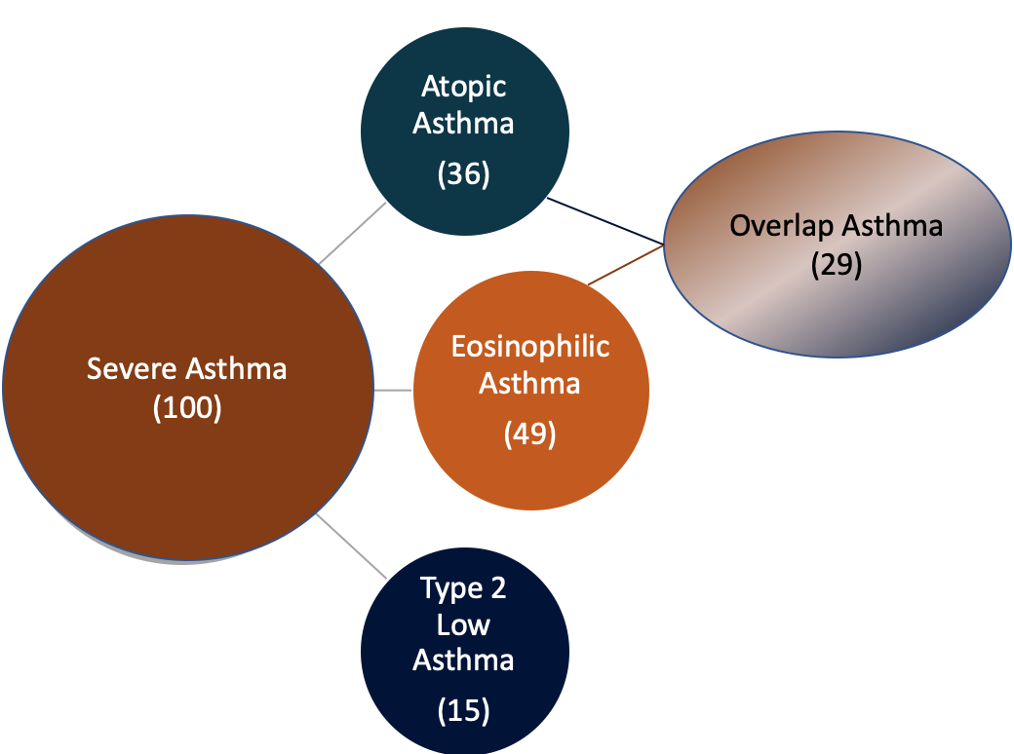
Type 2 Severe Asthma ~ 85 % & Biologicals Eligible ~ 91%
Single center, retrospective , observational study:
  100 Adult severe asthmatics from SA Clinic
  Measurements :
    Total/ Specific IgE
    AEC
    Skin prick tests
    History of allergy,
~ 50% of our Severe Asthmatics were eligible for both group of biologicals
~ 30% of Severe Asthma patients were in the Overlap Group
T₂ Low asthma is only 15% at AEC cut off of 300 & 9% at @ AEC -150
Lung India 2022;39:393-400.

Slide 10
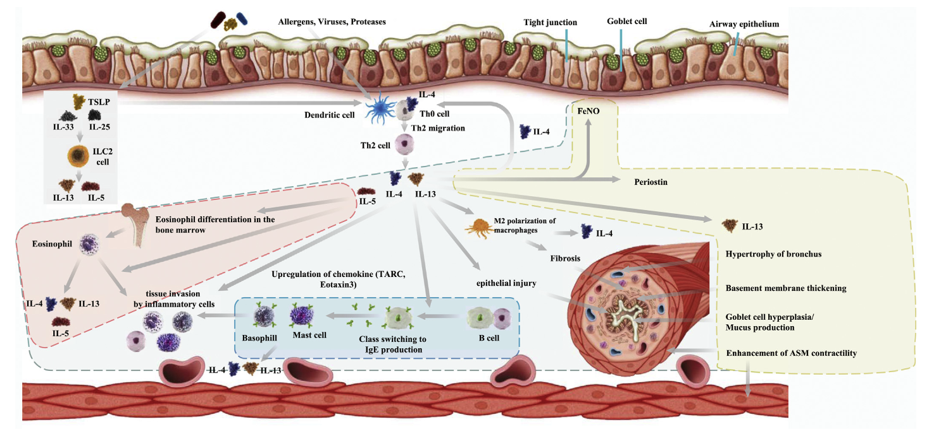
How ?? : Choose Appropriate Biologicals - Drivers
4. Anti – TSLP Tezepelumab
2. Anti – IL-5 Mepo/Benralizumab
3. Anti – IL-4R/13
Dupilumab
Anti – IgE
Omalizumab
K. Matsunaga et al. / Allergology International 69 (2020) 187e196

Slide 11
Remember : Match Expectations with Research
SA Outcomes | Omalizumab | Mepolizumab | Benralizumab
Reduction in Exacerbations | 25% reduction | ~ 50 % | 40 -70 %
Reduction in maintenance dose of OCS | 50% dose reduction in those at 15 mg/day baseline | 50% dose reduction 2- 6 months | 50 - 80%
FEV₁ | 2.1% | 100 ml | 100 -160 ml @ 4 weeks
QoL | SGRQ Asthma diaries | ACQ5 + 0.4 SGRQ +7 points | ACQ < 0.5 SGRQ +8.1 points
Real World Data | Reduction in AE in 42% vs 63 % & 28% vs 48% @ baseline | Reduction in AE ~ 50% Reduction in mOCS ~ 50% | All improved with 70% exacerbation free @2years
Comorbidities | CRwNP, Food Allergy Chronic Idiopathic Urticaria | EGPA ( 300 mg/ month ) CRSwNP | EGPA Mucus Impaction

Slide 12
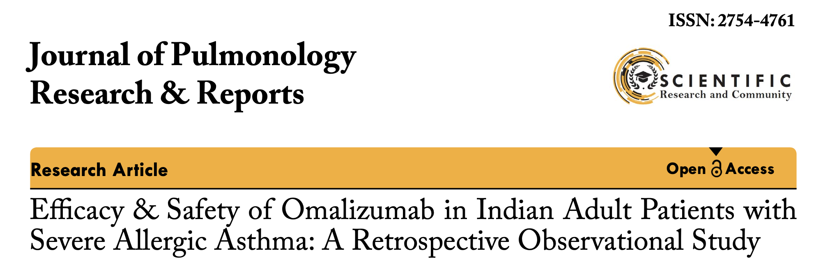
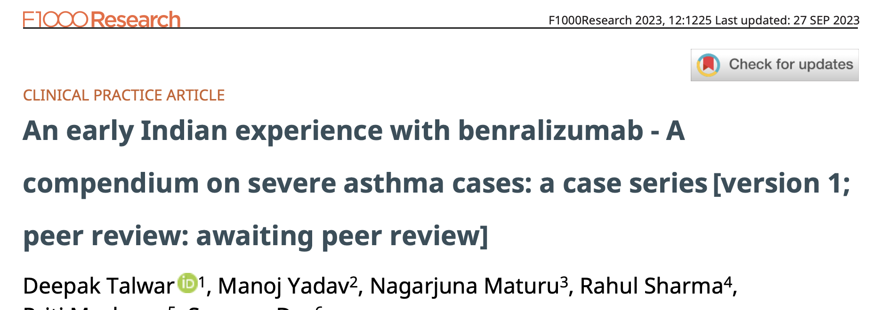
Biologicals in Severe Asthma– Indian Experience
Arjun Khanna1*, Deepak Talwar2, Linija K Nair3
Deepak Talwar * 1, Manoj Yadav2, Nagarjuna Maturu3
Conclusions:
Omalizumab led to improved asthma control, lung function, and QoL and allowed a reduction in the dosage of medications for asthma. The improvement was observed irrespective of age and biomarker levels.
Conclusions:
In all cases, management with Benralizumab resulted in optimal clinical and functional improvement, a decline in systemic steroid use, and improved QoL.
J Pulmonol Res Rep, 5(2): 4-6 2023
Published: April 28, 2023
F1000 Research 2023, 12:1225 Last updated: 27 SEP 2023

Slide 13
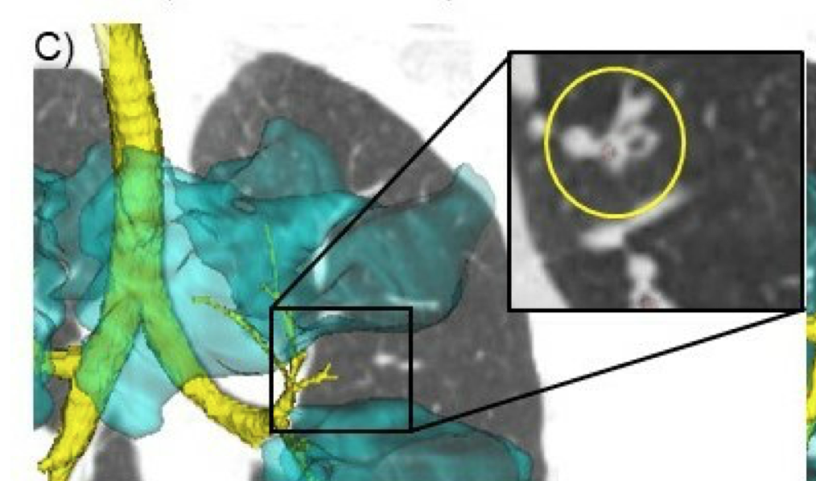
How ?? Choosing Biologicals in SA - 2025 !
Omalizumab
Mepolizumab
Benralizumab
Childhood Onset asthma
Comorbidities :
Allergic rhinitis
Chronic idiopathic urticaria
Food Allergy
CRSwNP
Late Onset asthma
Comorbidities :
Chronic Sinusitis with NP
EGPA
HES
Adult / Late Onset asthma
Comorbidities :
Nasal Polyposis
Airway Mucus
EGPA / CEP
NO safety signal has come up with antibodies directed against IL-5 after up to 5 years administration for mepolizumab and > 4 years for Benralizumab

Slide 14
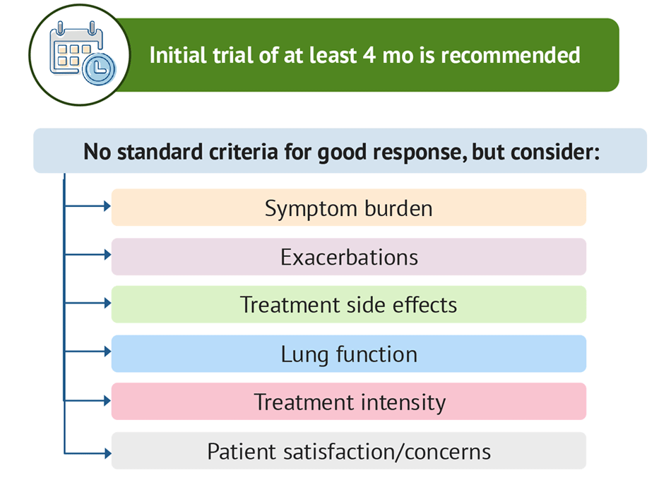

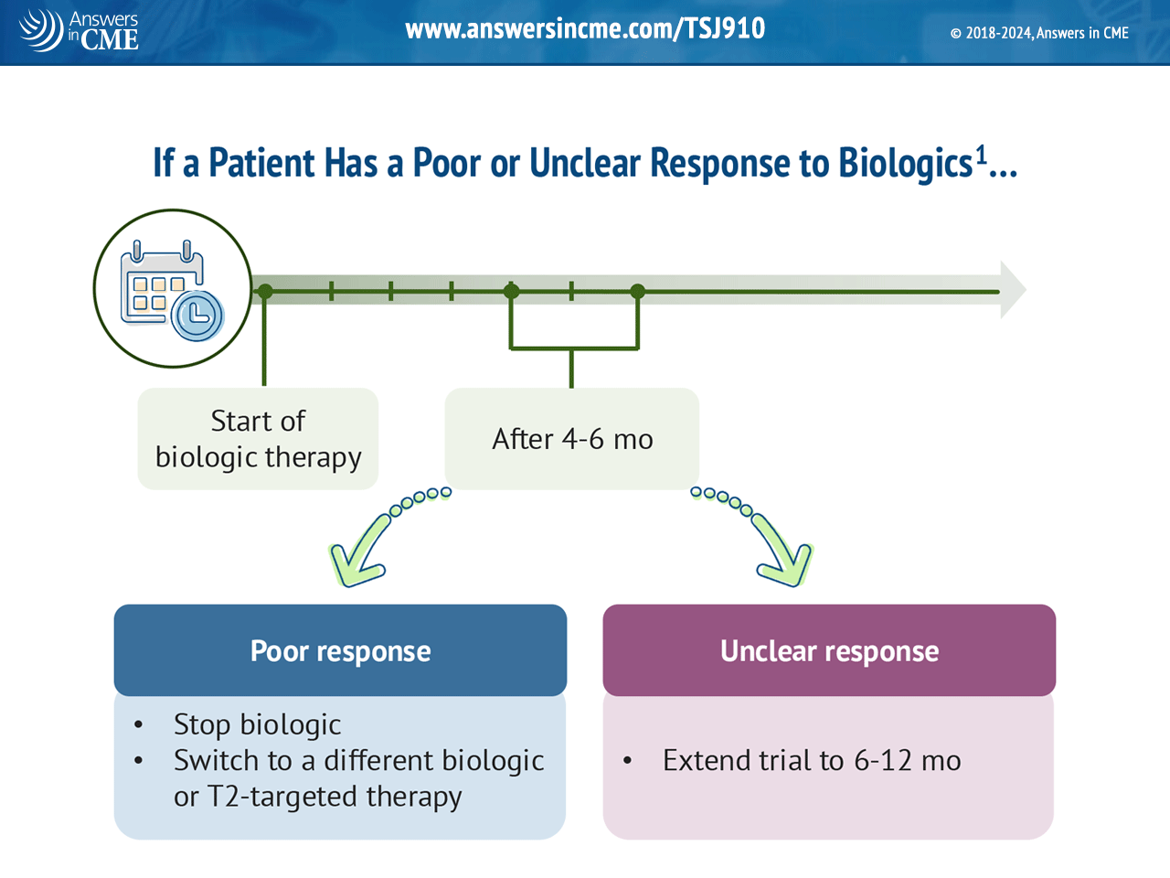
Assessing Effectiveness of Biologicals : FU@ 6 months
Good /Response
Initial Trial for 4 months Minimum
Continue

Slide 15
Biologicals In Asthma : Conclusions
Uncontrolled Asthmatics on GINA Step 5
Type 2 Severe Asthma ( Biomarkers )
Match comorbidities & Expectations
NOK
Zero OCS Use
When :
Which :
How :
When to stop :
Why

Slide 16






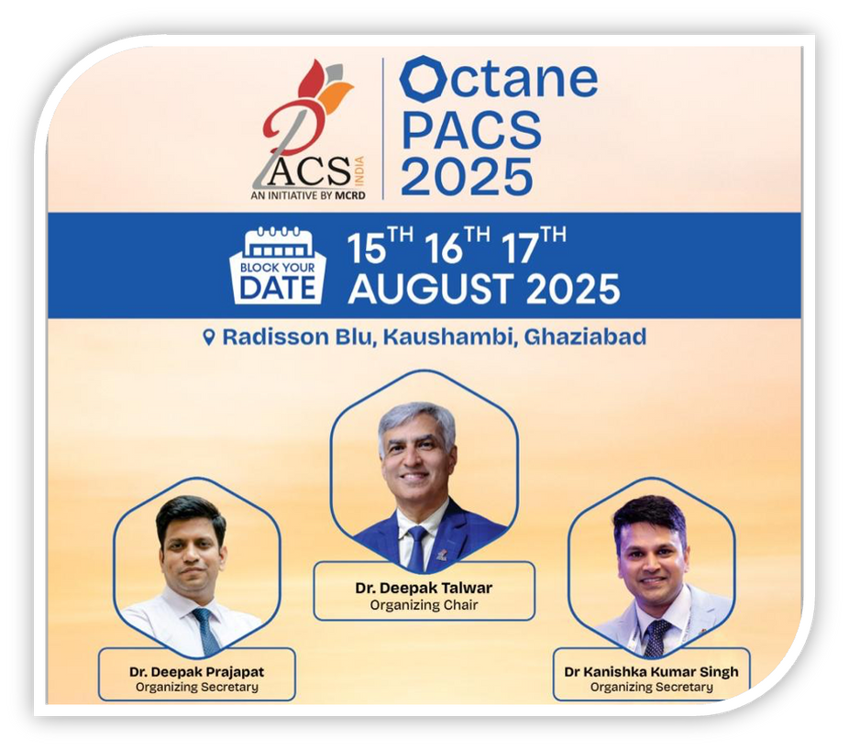
Dr Deepak Talwar
Director & Chair MCRD
Dr Deepak Prajapat
Senior Consultant
Dr Kanishka Kumar Singh
Senior Consultant
Thank You
Dr Rahul Khera
Consultant

