Slide 1
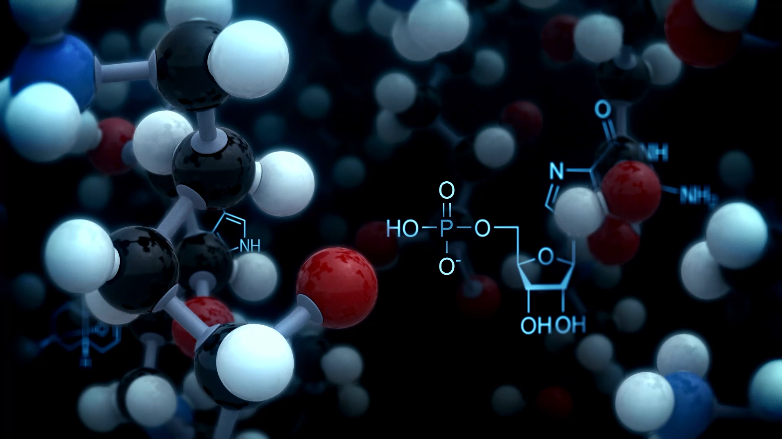

Biologicals in Allergy : Primer
Allergy Conclave 2025 Mumbai
Deepak Talwar
Director & Chair, Metro Centre for Respiratory Diseases
Metro Hospitals & Institute
NOIDA, INDIA

Slide 2
Biologicals : Targeted Therapies
0 %
35 %
10 %
100 %
Anti – IL-5 Mepolizumab
Benralizumab
Anti – IgE Omalizumab
Anti – IL-4/13
Dupulimab
Murine
Chimeric
Humanized
Fully Human
(-omab)
(-ximab)
(-zumab)
(-umab)
1. Anti – IgE Monoclonal Ab
Notes:
Ibrutimumab

Slide 3





Spectrum of Allergic Diseases & Role of Biologicals
Bronchial Asthma
Chronic Rhinosinusitis with Nasal Polyposis
Chronic Spontaneous Urticaria
Atopic Dermatitis
Food Allergy
J Allergy Clin Immunol Pract 2021;9:1118-20.

Slide 4
Chronic Rhinosinusitis with Nasal Polyposis
~ Young Adults
~ Often with Asthma & NP
~ TSLP is main driver
~ 67% associated Asthma
~ 60% Severe Asthma
~ 8-26% comorbid AERD
~ AERD in 7% Asthmatics
~ 90% CRSwNP and AERD severe NP
Allergy, Volume: 77, Issue: 12, Pages: 3593-3605, First published: 06 September 2022, DOI: (10.1111/all.15507)
Notes:
63% of patients with CRSwNP were colonized
with Staphylococcus aureus, which has been shown to secrete
enterotoxins that can induce antigen-specific IgE production and
thus augment type 2 inflammatory responses

Slide 5
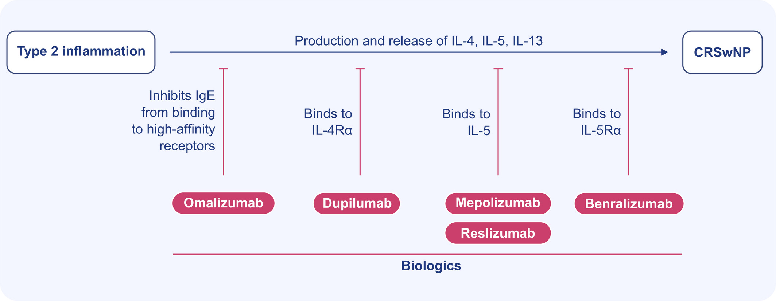
Rationale for Biologicals : Type 2 Inflammation
Allergy, Volume: 77, Issue: 12, Pages: 3593-3605, First published: 06 September 2022, DOI: (10.1111/all.15507)

Slide 6
From Bench to Bedside : Biologicals in CRSwNP
Biologicals | Clinical Trials | Results | Interpretation | Subgroup Inference
Omalizumab | POLYP 1 & POLYP 2 (Phase-III) Extension trial Sug group Analysis | Endoscopic, Clinical & and Patient-oriented Outcomes | Extension study showed full benefit after > 6 months of T/t | Benefits irrespective of Eosinophilia, Aspirin sensitivity or Asthma status (N-ERD improved)
Dupulimab | LIBERTY NP, SINUS 24 and SINUS 52 | Improved nasal polyp, nasal congestion, smell | Improvement seen in 4-8 weeks, continued @52 weeks | Improvement irrespective of level of eosinophilia
Mepolizumab | SYNAPSE Phase 3 & 1 Prospective study | Improved nasal obstruction, ↓ need for sinus surgery | Need for OCS and AES decreased | Improvement irrespective of comorbid SA or N-ERD
Benralizumab | OSTRO, ANDHI and Post Hoc analysis | Improved nasal polyp and symptoms improved | Improved eosinophilic asthma and NP, | NP scores improve
Allergy. 2022;77:3593–3605.

Slide 7
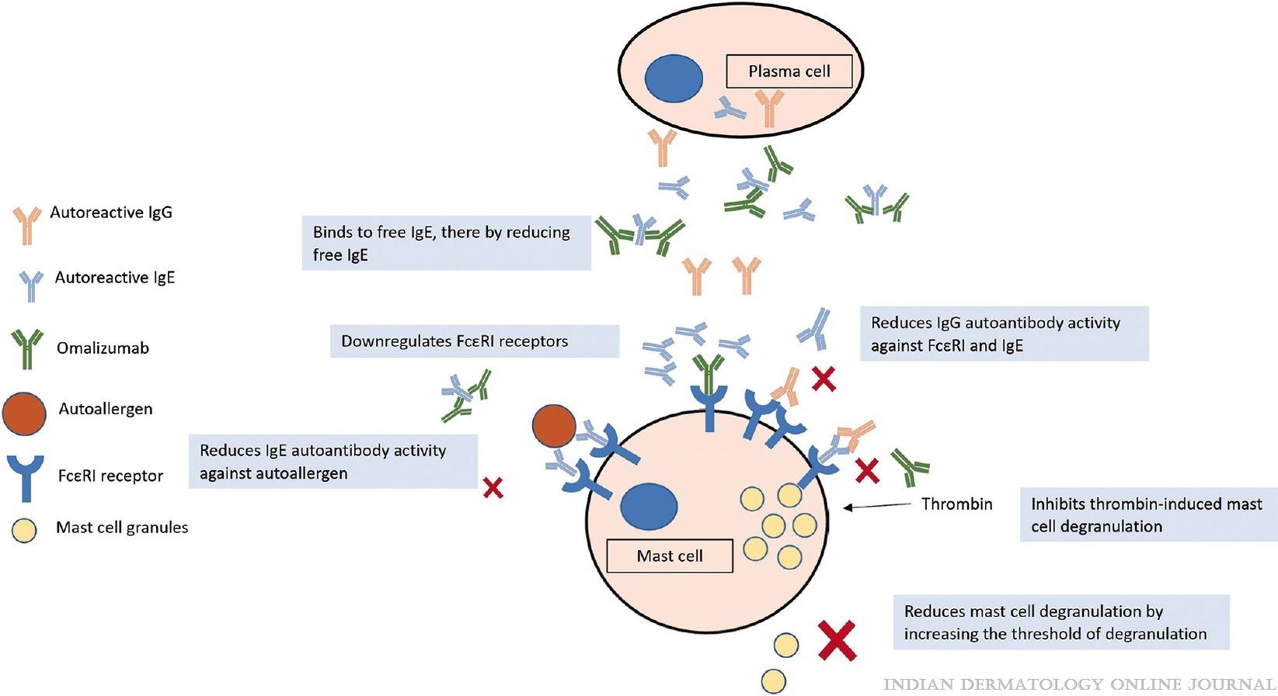
Chronic Spontaneous Urticaria : Omalizumab
3 RCT’s
Each had 300+ patients of Anti-histamine Resistant CIU
75-300 mg Omalizumab/ month vs Placebo
Omalizumab is safe and effective in AH R – CIU
Start 300mg/month & up to 600 mg twice a month
complete and Partial response rates of 72.2% and 17.8%, respectively
Mustari, Indian Dermatology Online Journal 14(1):p 9-20, Jan–Feb 2023.
Notes:
Normal / high Serum IGE
High D Dimer
Very high FceRI on basophils
Negative Autologous Serum ST
Negative Basophil Activation Test

Slide 8
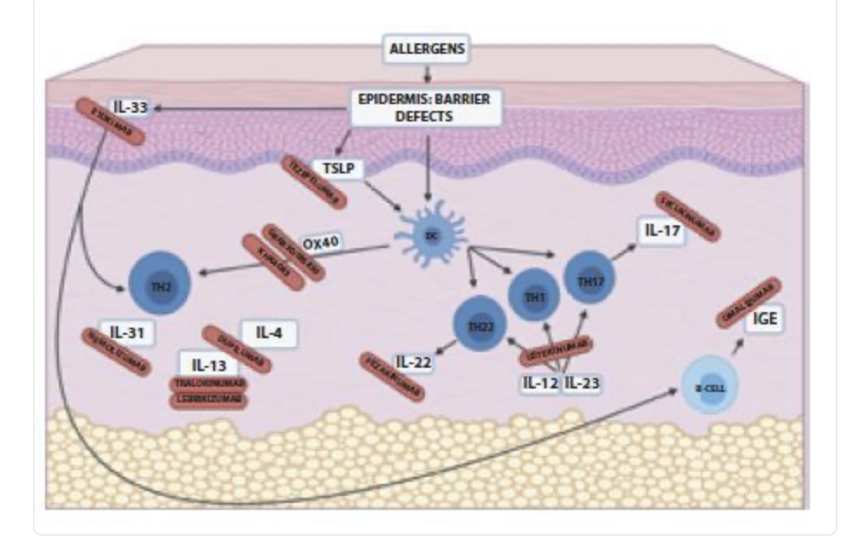
Atopic Dermatitis : Biologicals - Dupulimab
Most common inflammatory skin disorder
Affects people of all ages and ethnicities
Typical age-dependent clinical features
Substantial individual suffering
Huge economic impact
Schneider S. Dermatol Pract Concept. 2021 1;11(4)

Slide 9
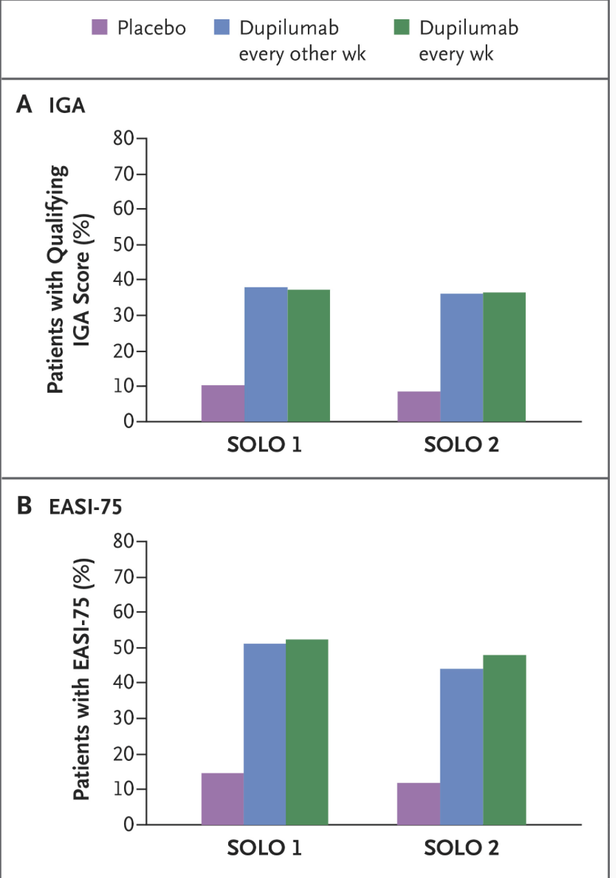
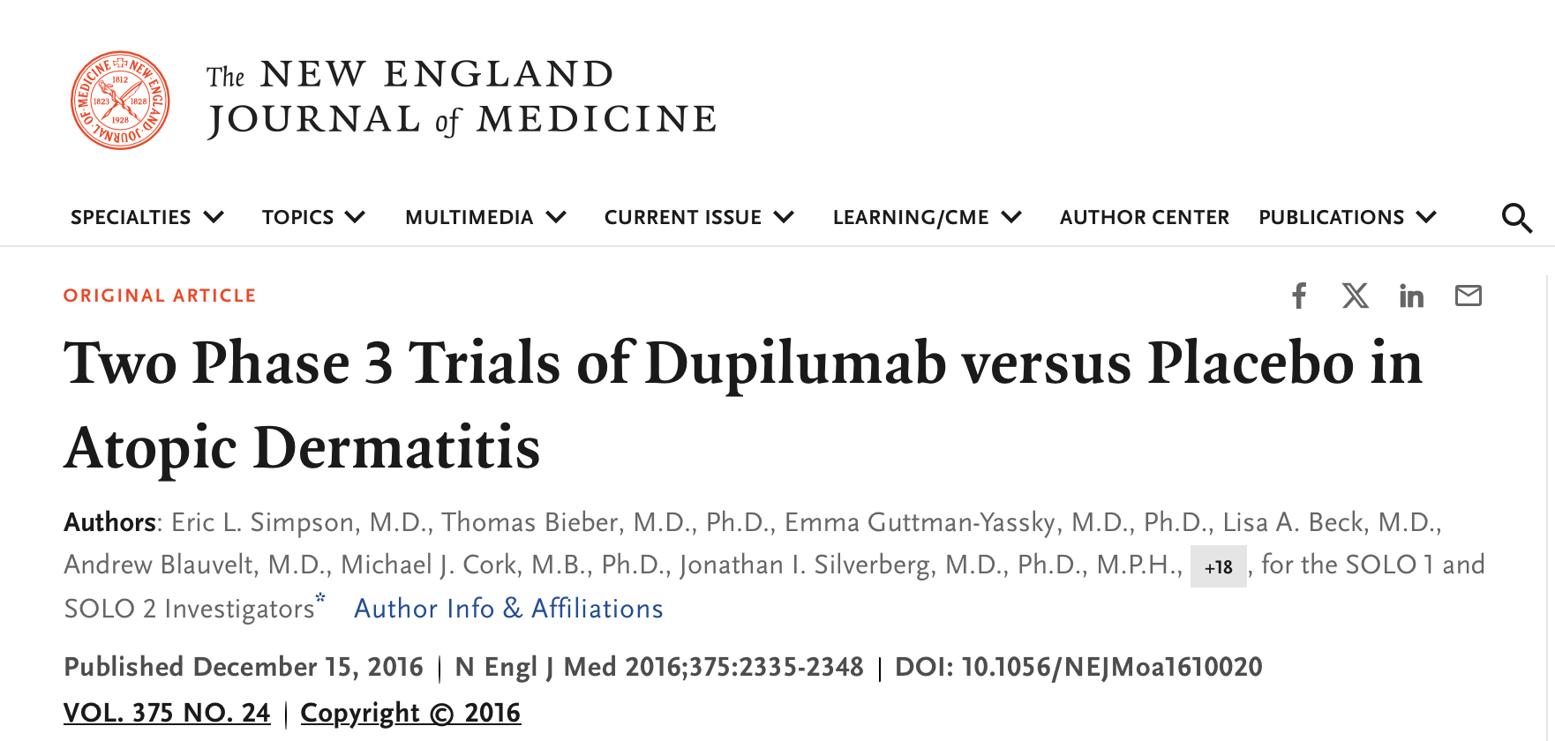
Dupilumab in Atopic Dermatitis
In two phase 3 trials of identical design involving patients with atopic dermatitis, dupilumab improved the signs and symptoms of atopic dermatitis, including pruritus, symptoms of anxiety and depression, and quality of life, as compared with placebo

Slide 10
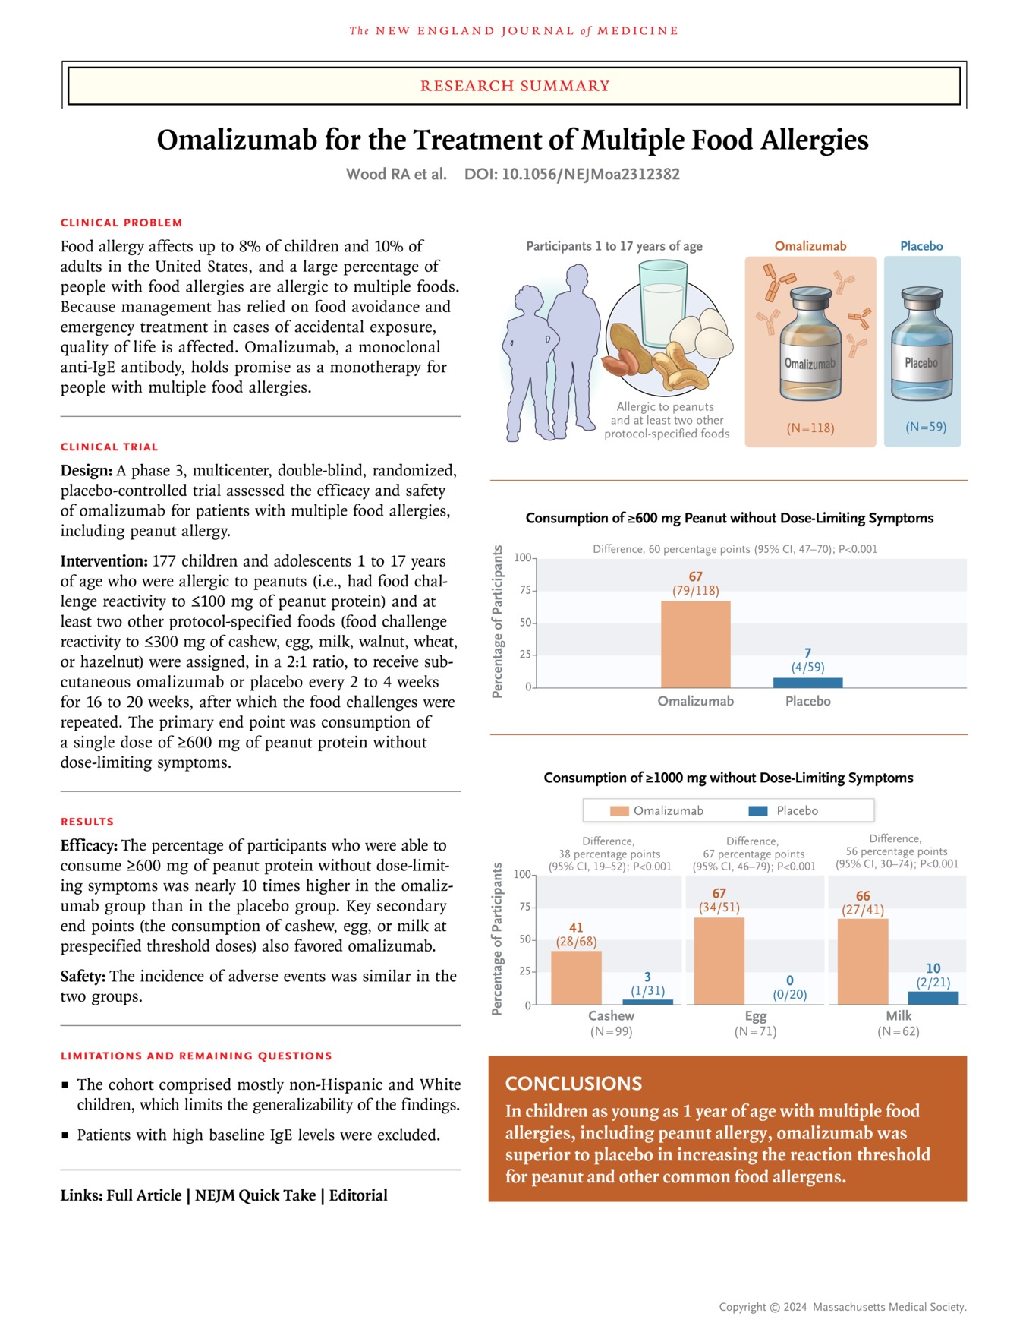
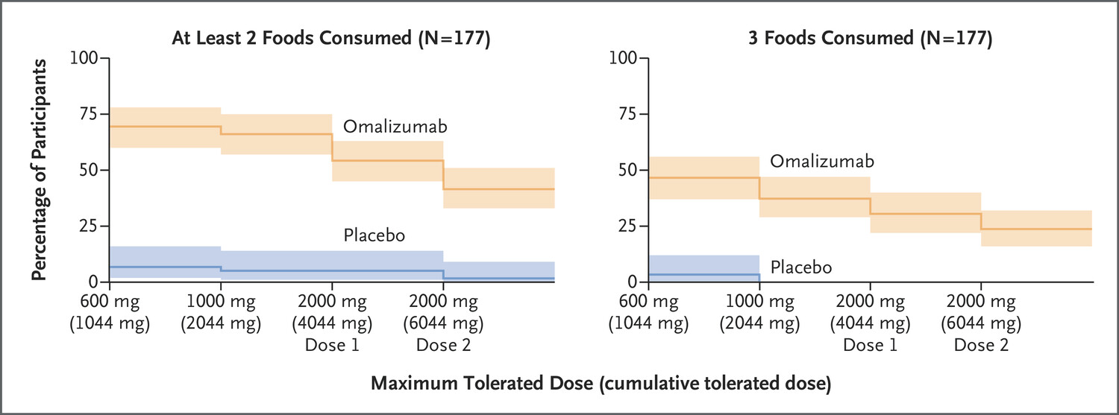
Food Allergy & Biologicals
462 patients randomized trial
Age 1 year – 55 years
Multiple Food Allergies
Omalizumab vs Oral immunotherapy
N Engl J Med 2024;390:889-899

Slide 11
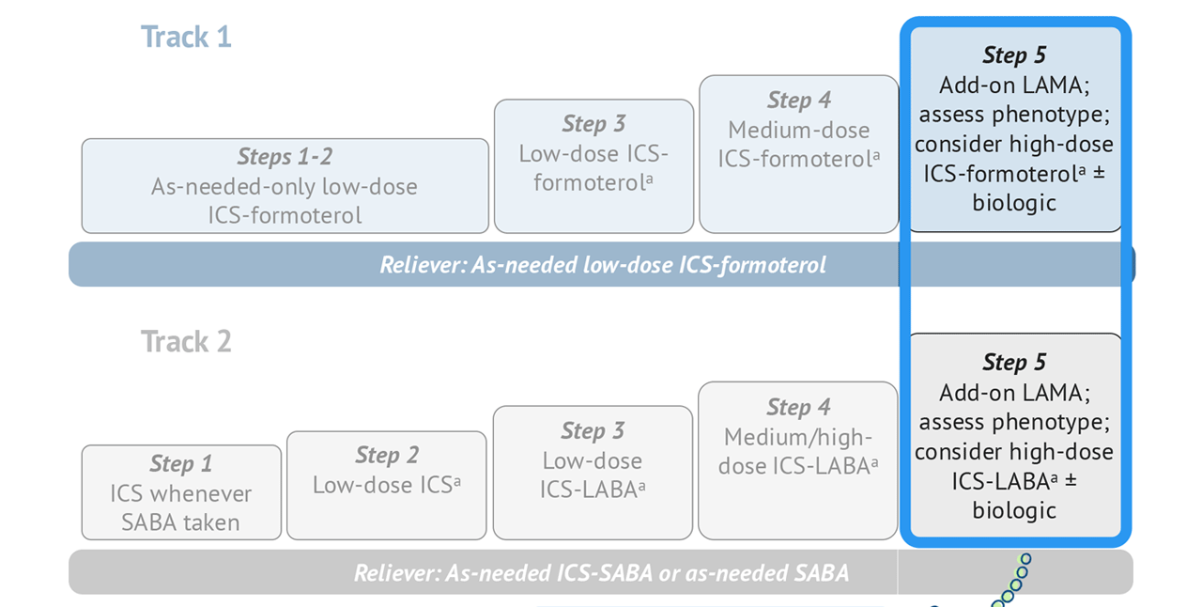
Severe Asthma and Biologicals
Step 5
Low Dose OCS
LAMA
High Dose ICS
LABA
Montelukast
Other Options
Azithromycin

Slide 12



All Uncontrolled Asthma is NOT Severe Asthma # Biologicals
Severe Asthma
GINA Step 5
Difficult To Treat Asthma
90%
Comorbidities
Retrospective label
50%
Exposures & Triggers
20%
Adherence & Technique
25%
Diagnosis
Uncontrolled Asthma
World Allergy Organization Journal 2013, 6(Suppl 1):P3

Slide 13
Which Patients with Severe Asthma ?
Type 2 Severe Asthma : Atopic / Eosinophilic Phenotype
Type 2 Inflammation
Age of onset of asthma: Childhood / Early adulthood
Allergic comorbidities : Atopic dermatitis, AR, CSwNP, ABPA, EGA
Oral steroids responsive
GINA 2023

Slide 14
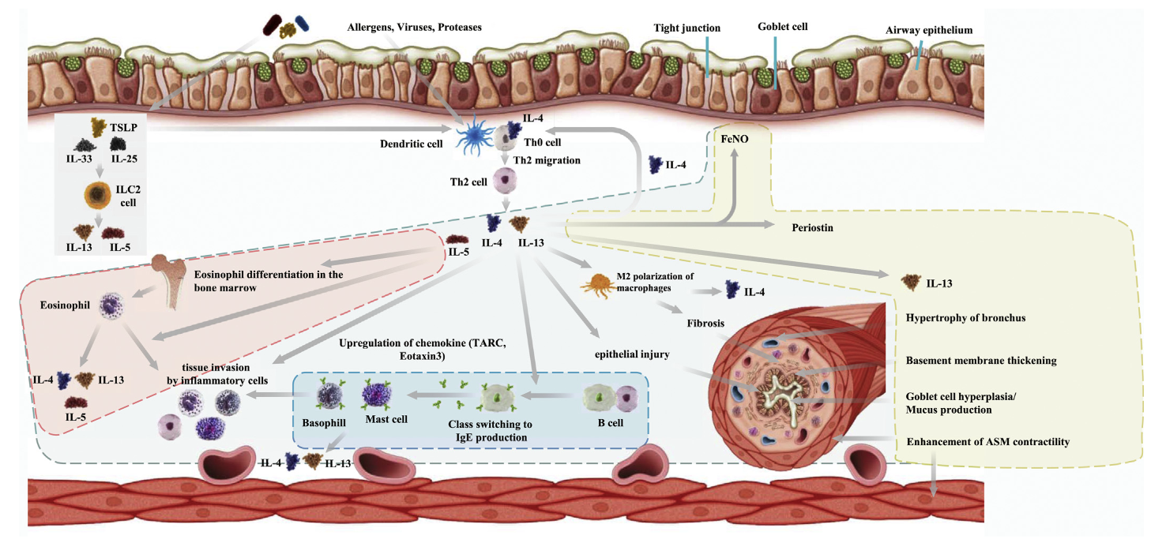
Choosing Appropriate Biologicals in Asthma- Drivers
4. Anti – TSLP Tezepelumab
2. Anti – IL-5 Mepo/Benralizumab
3. Anti – IL-4R/13
Dupilumab
Anti – IgE
Omalizumab
K. Matsunaga et al. / Allergology International 69 (2020) 187e196

Slide 15
Choosing Biologicals in SA : Match Expectations with Research
SA Outcomes | Omalizumab | Mepolizumab | Benralizumab
Reduction in Exacerbations | 25% reduction | ~ 50 % | 40 -70 %
Reduction in maintenance dose of OCS | 50% dose reduction in those at 15 mg/day baseline | 50% dose reduction 2- 6 months | 50 - 80%
FEV₁ | 2.1% | 100 ml | 100 -160 ml @ 4 weeks
QoL | SGRQ Asthma diaries | ACQ5 + 0.4 SGRQ +7 points | ACQ < 0.5 SGRQ +8.1 points
Real World Data | Reduction in AE in 42% vs 63 % & 28% vs 48% @ baseline | Reduction in AE ~ 50% Reduction in mOCS ~ 50% | All improved with 70% exacerbation free @2years
Comorbidities | CRwNP Chronic Idiopathic Urticaria | EGPA ( 300 mg/ month ) CRSwNP | WIP

Slide 16
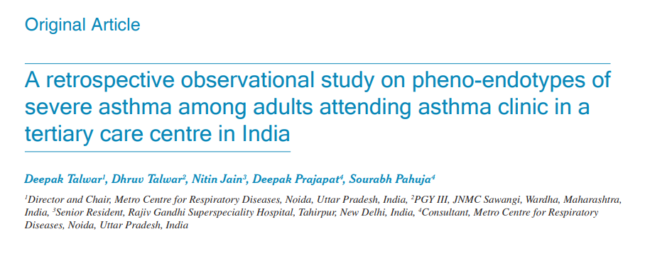
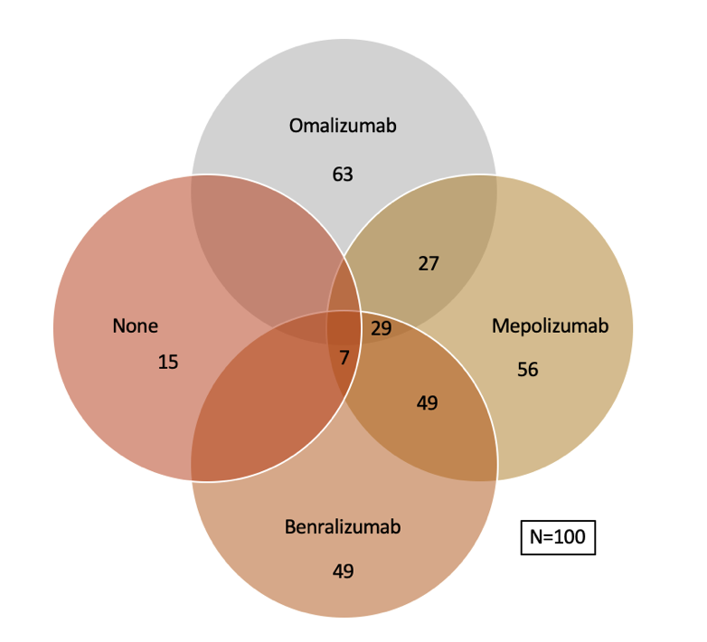
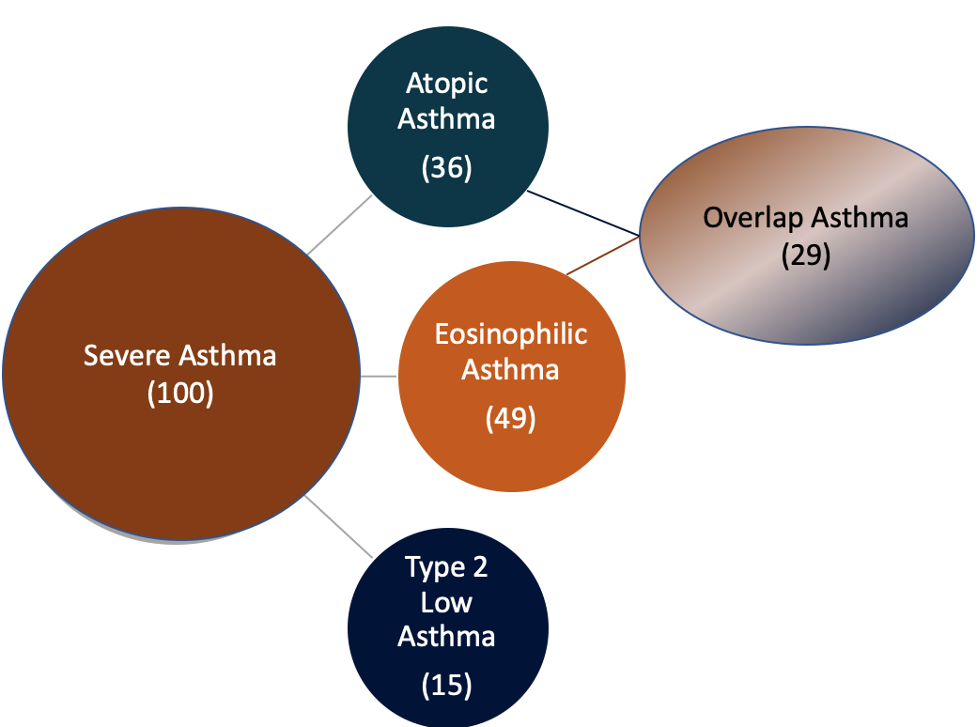
Type 2 Severe Asthma ~ 85 % & Biologicals Eligible ~ 91%
Single center, retrospective , observational study:
  100 Adult severe asthmatics from SA Clinic
  Measurements :
    Total/ Specific IgE
    AEC
    Skin prick tests
    History of allergy,
~ 50% of our Severe Asthmatics were eligible for both group of biologicals
~ 30% of Severe Asthma patients were in the Overlap Group
T₂ Low asthma is only 15% at AEC cut off of 300 & 9% at @ AEC -150
Lung India 2022;39:393-400.

Slide 17
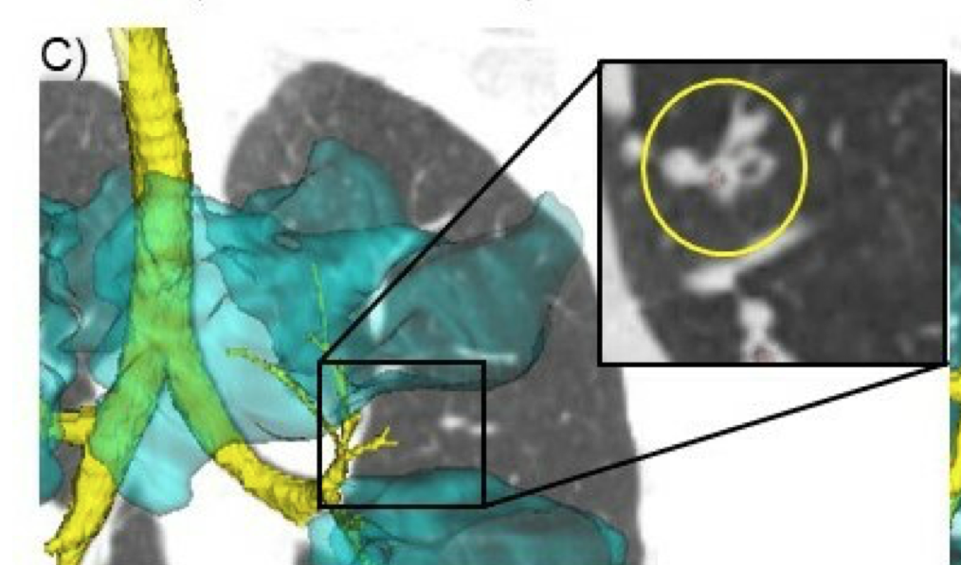
How to Choose Biologicals in Severe Asthma in India - 2024 !
Omalizumab
Mepolizumab
Benralizumab
Childhood Onset asthma
Comorbidities :
Allergic rhinitis
Chronic idiopathic urticaria
Food Allergy
CRSwNP
Late Onset asthma
Comorbidities :
Chronic Sinusitis with NP
EGPA
HES
Adult / Late Onset asthma
Comorbidities :
Nasal Polyposis
Airway Mucus
HES / CEP
NO safety signal has come up with antibodies directed against IL-5 after up to 5 years administration for mepolizumab and > 2 years for Benralizumab

Slide 18
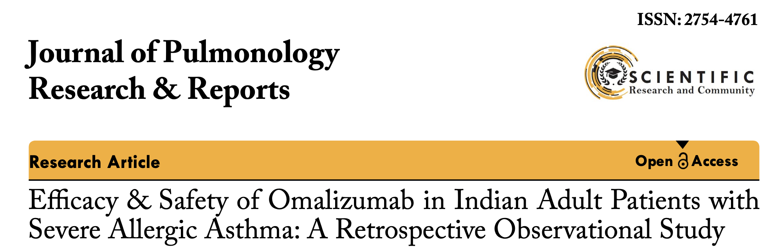
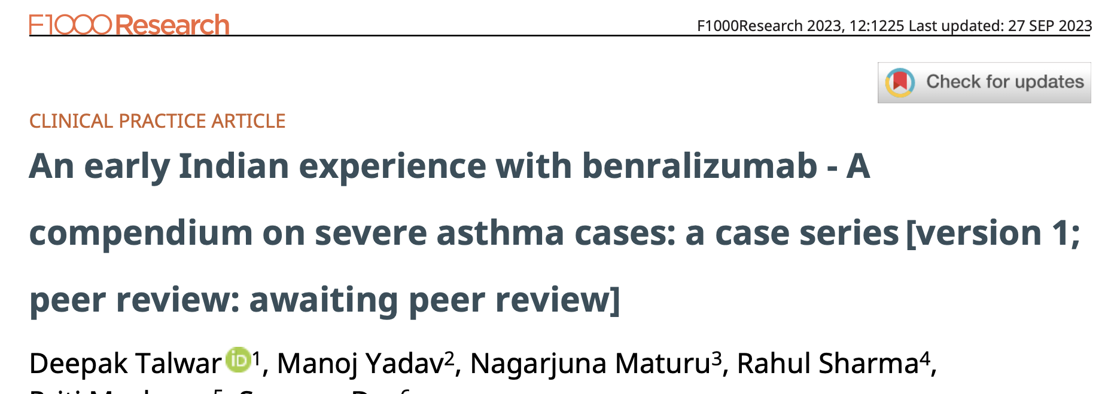
Biologicals in Severe Asthma– Indian Experience
Arjun Khanna1*, Deepak Talwar2, Linija K Nair3
Deepak Talwar * 1, Manoj Yadav2, Nagarjuna Maturu3
Conclusions:
Omalizumab led to improved asthma control, lung function, and QoL and allowed a reduction in the dosage of medications for asthma. The improvement was observed irrespective of age and biomarker levels.
Conclusions:
In all cases, management with Benralizumab resulted in optimal clinical and functional improvement, a decline in systemic steroid use, and improved QoL.
J Pulmonol Res Rep, 5(2): 4-6 2023
Published: April 28, 2023
F1000 Research 2023, 12:1225 Last updated: 27 SEP 2023

Slide 19
Algorithm for Using Biologicals in Allergy’s
Patient selection
Choice of Biological
Treatment Response
Allergic Disease : BA / CRS/Urticaria / Atopic Dermatitis/ Food Allergy
Type 2 Inflammation: IgE / Eosinophil / Both
On optimized. baseline therapy of underlying condition
Poor control of disease
Any OCS use
Biological approved indication
Local availability
Experience
Best fit choice if eligible more > 1 biological Approvals from
Patients' preference
Cost vs reimbursement
@ 16 weeks evaluate :
QoL
Disease control
Exacerbations
Hospitalizations
ER visits
Symptom burden reduction
Decrease in treatment intensity
OCS use

Slide 20
Biologicals In Allergies : Conclusions
Omalizumab
Dupulimab / Benralizumab / Mepolizumab
Omalizumab
Dupulimab
Omalizumab
Omalizumab / Mepolizumab or Benralizumab
Allergic Rhinitis
CRSwNP
Chronic Idiopathic Urticaria
Atopic Dermatitis
Multifood Allergy
Severe T₂ High Asthma

Slide 21
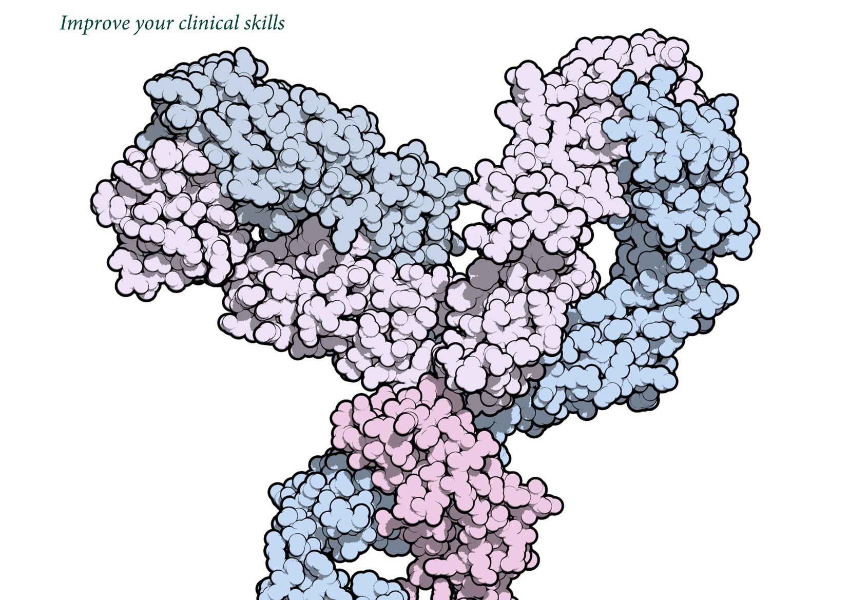
Thank You
Deepak Talwar
Director & Chair, Metro Centre for Respiratory Diseases
INDIA

